Slide 1
Advent Waiting for the coming of Jesus

Slide 2
Week 2 Adam Eve Noah
Come Lord Jesus (x3) come and be born in our hearts.

Slide 3
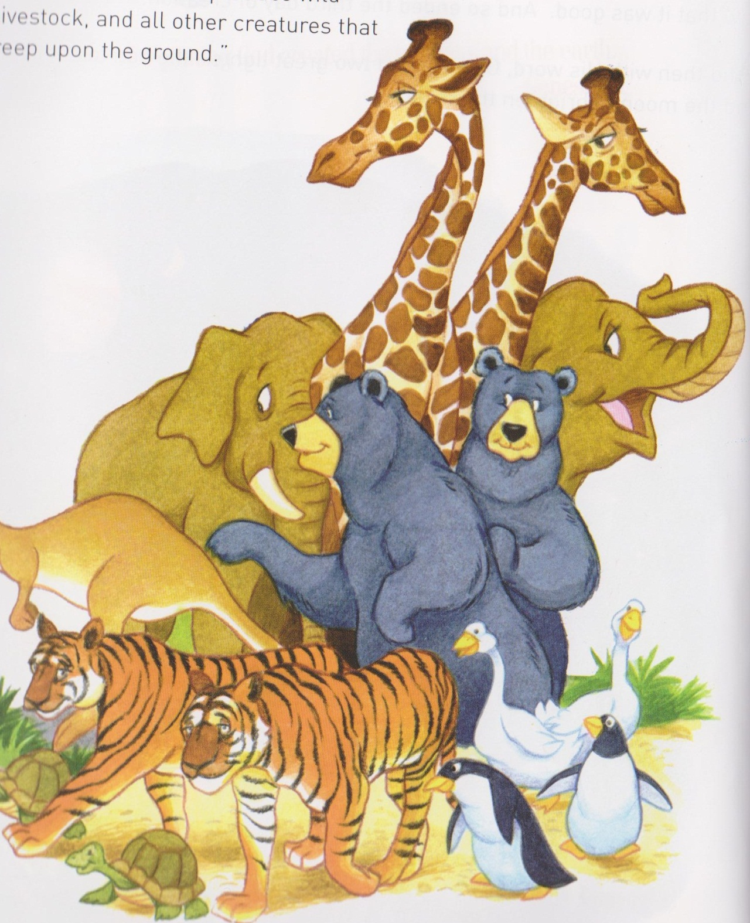
Adam and Eve

Slide 4
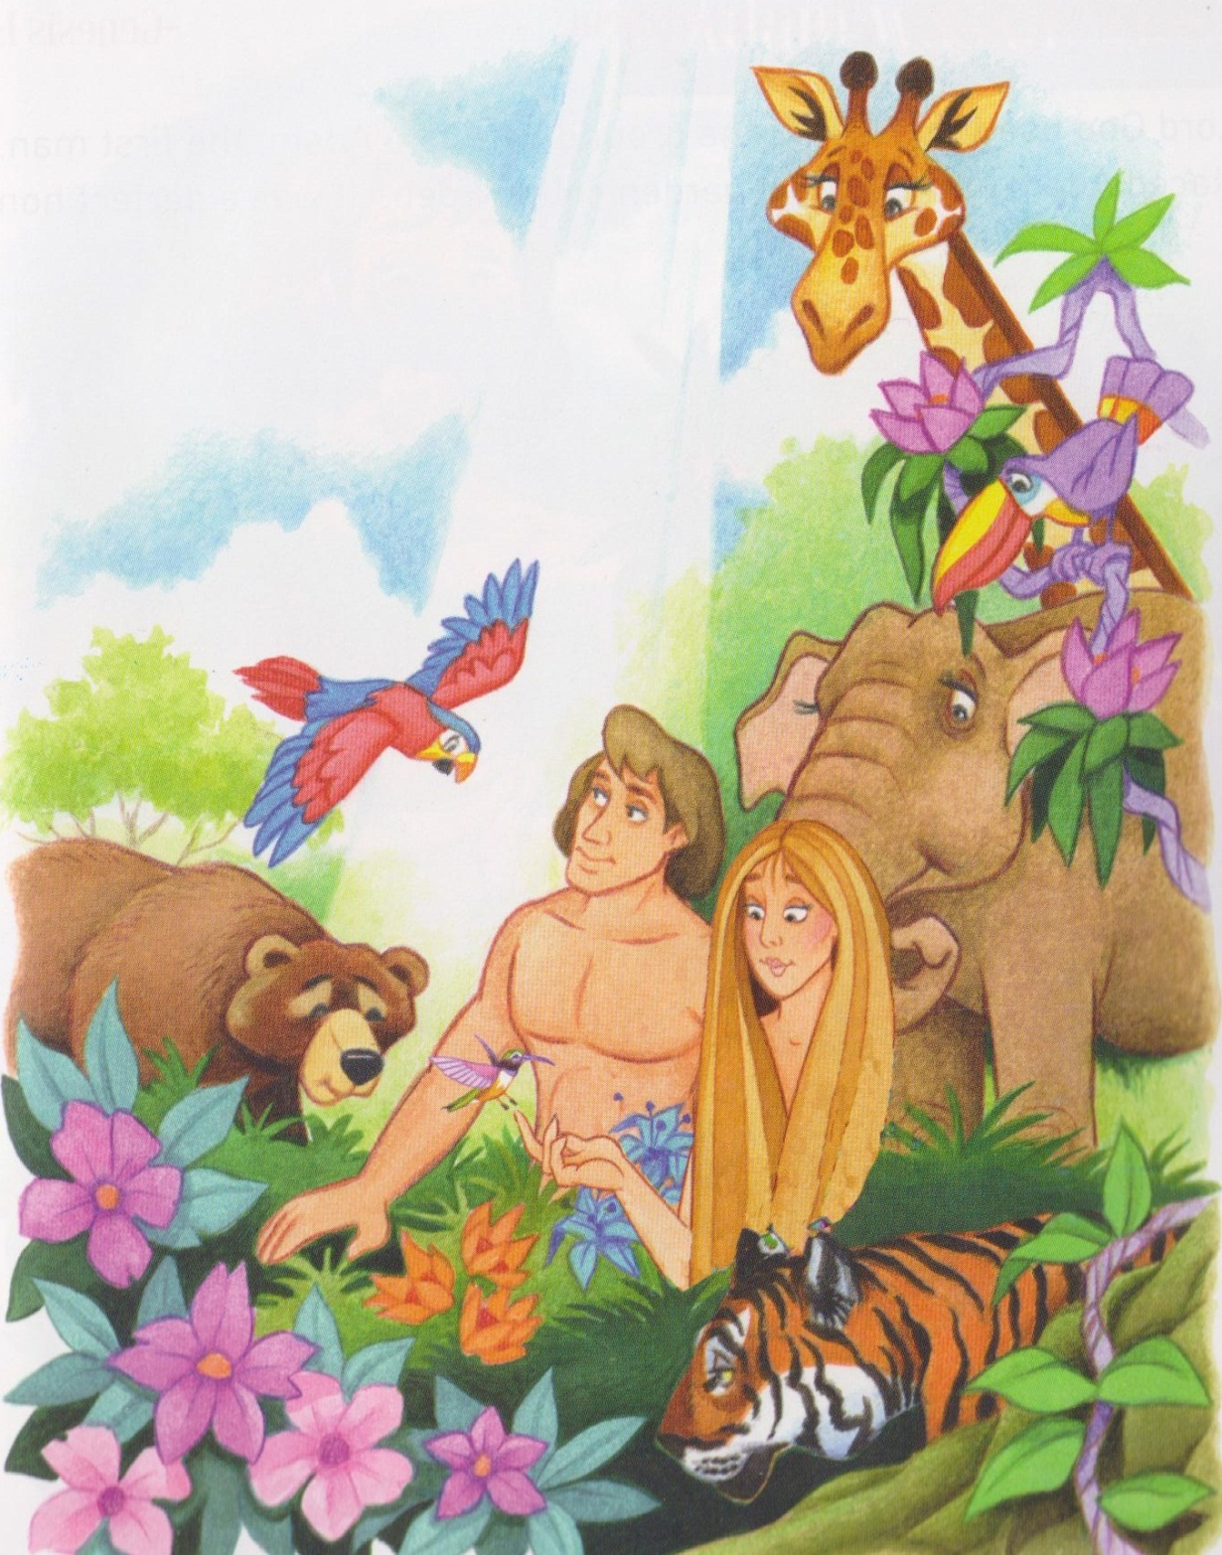

Slide 5
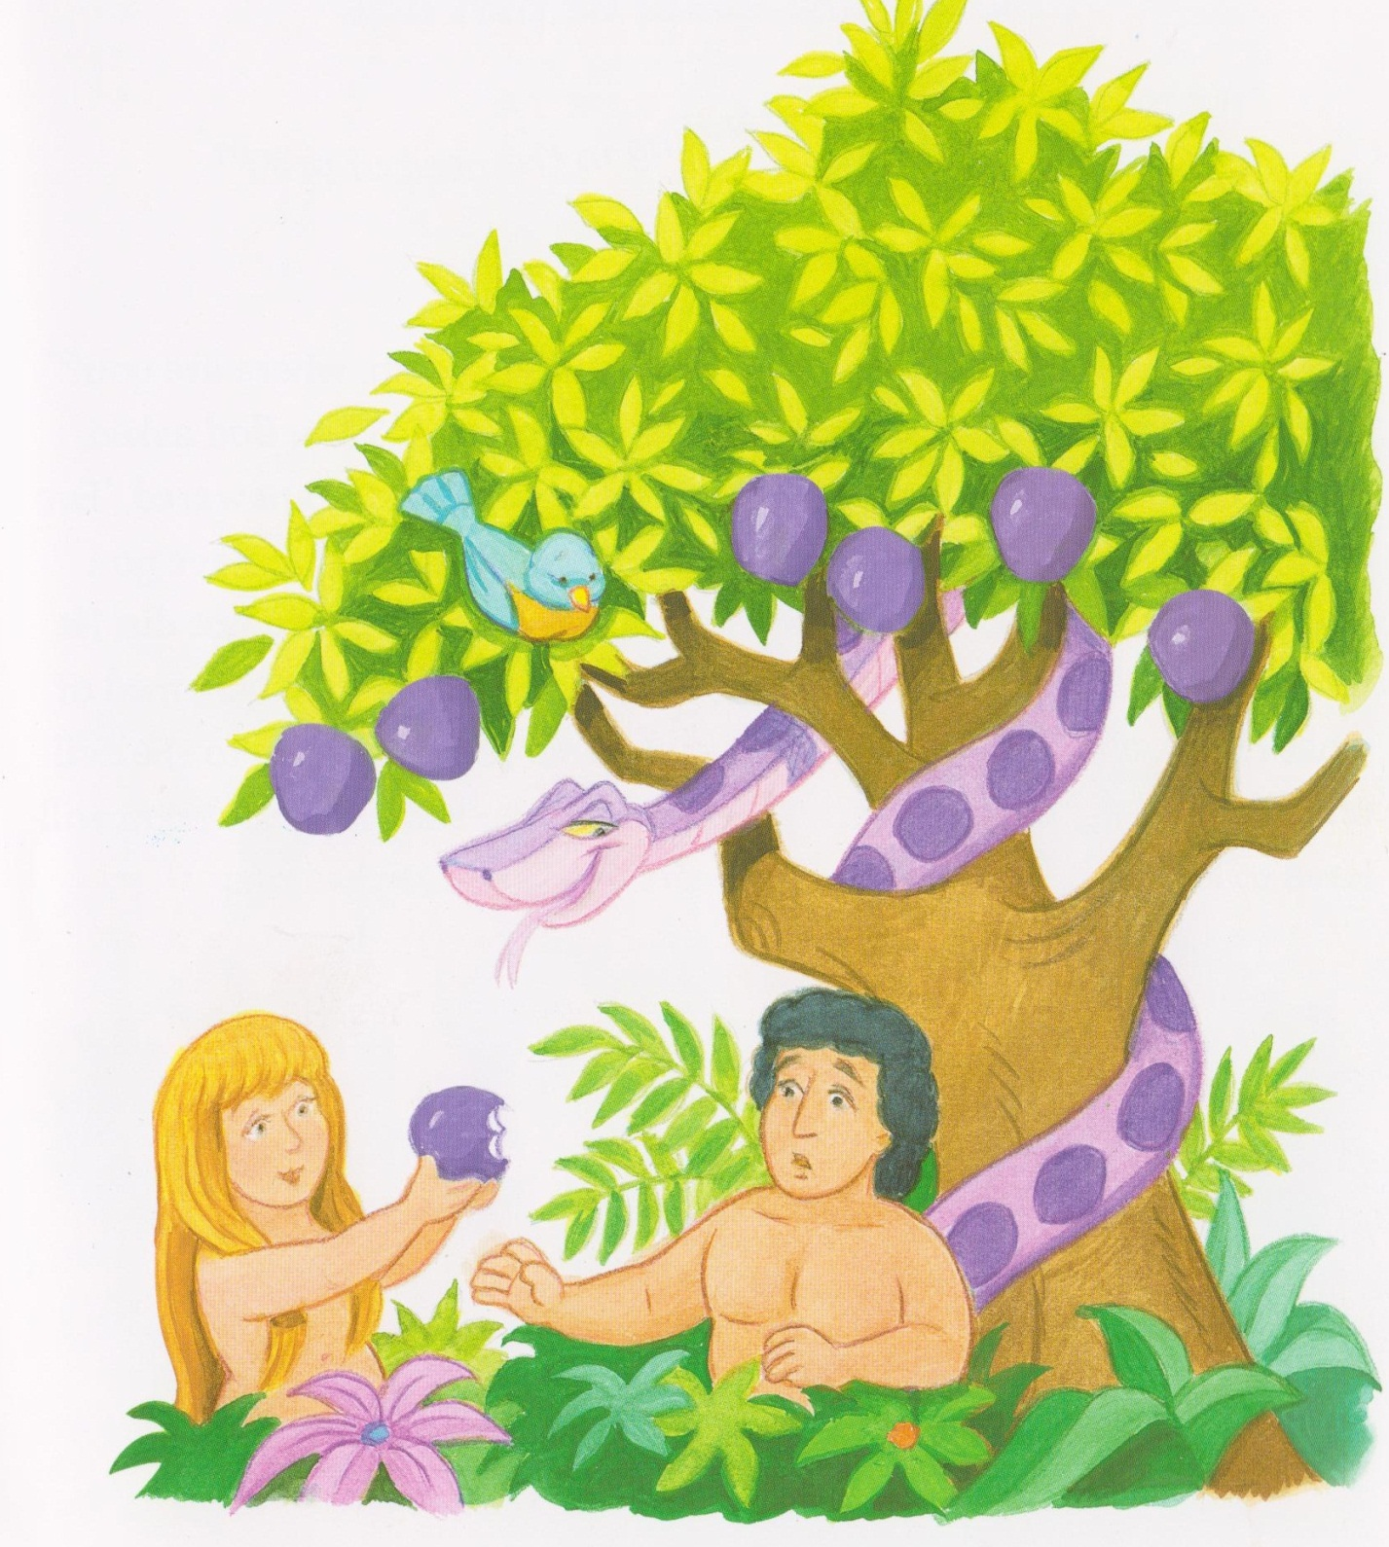
Adam and Eve symbol placed on tree.

Slide 6
God made me (2)
In my Bible book it says that God made me.
God loves me (x2)
In my Bible book is says that God loves me.
God helps me (x2)
In my Bible book is says that God helps me.
God made me (2)
In my Bible book it says that God made me.

Slide 7
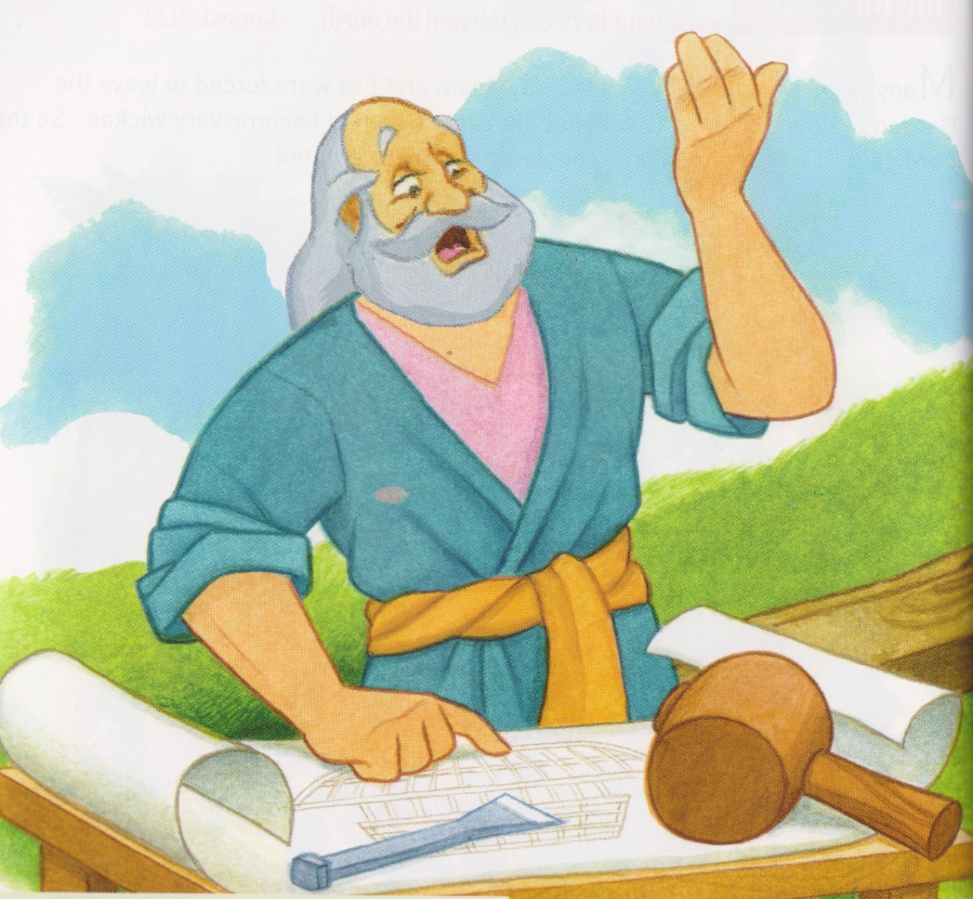
Noah

Slide 8
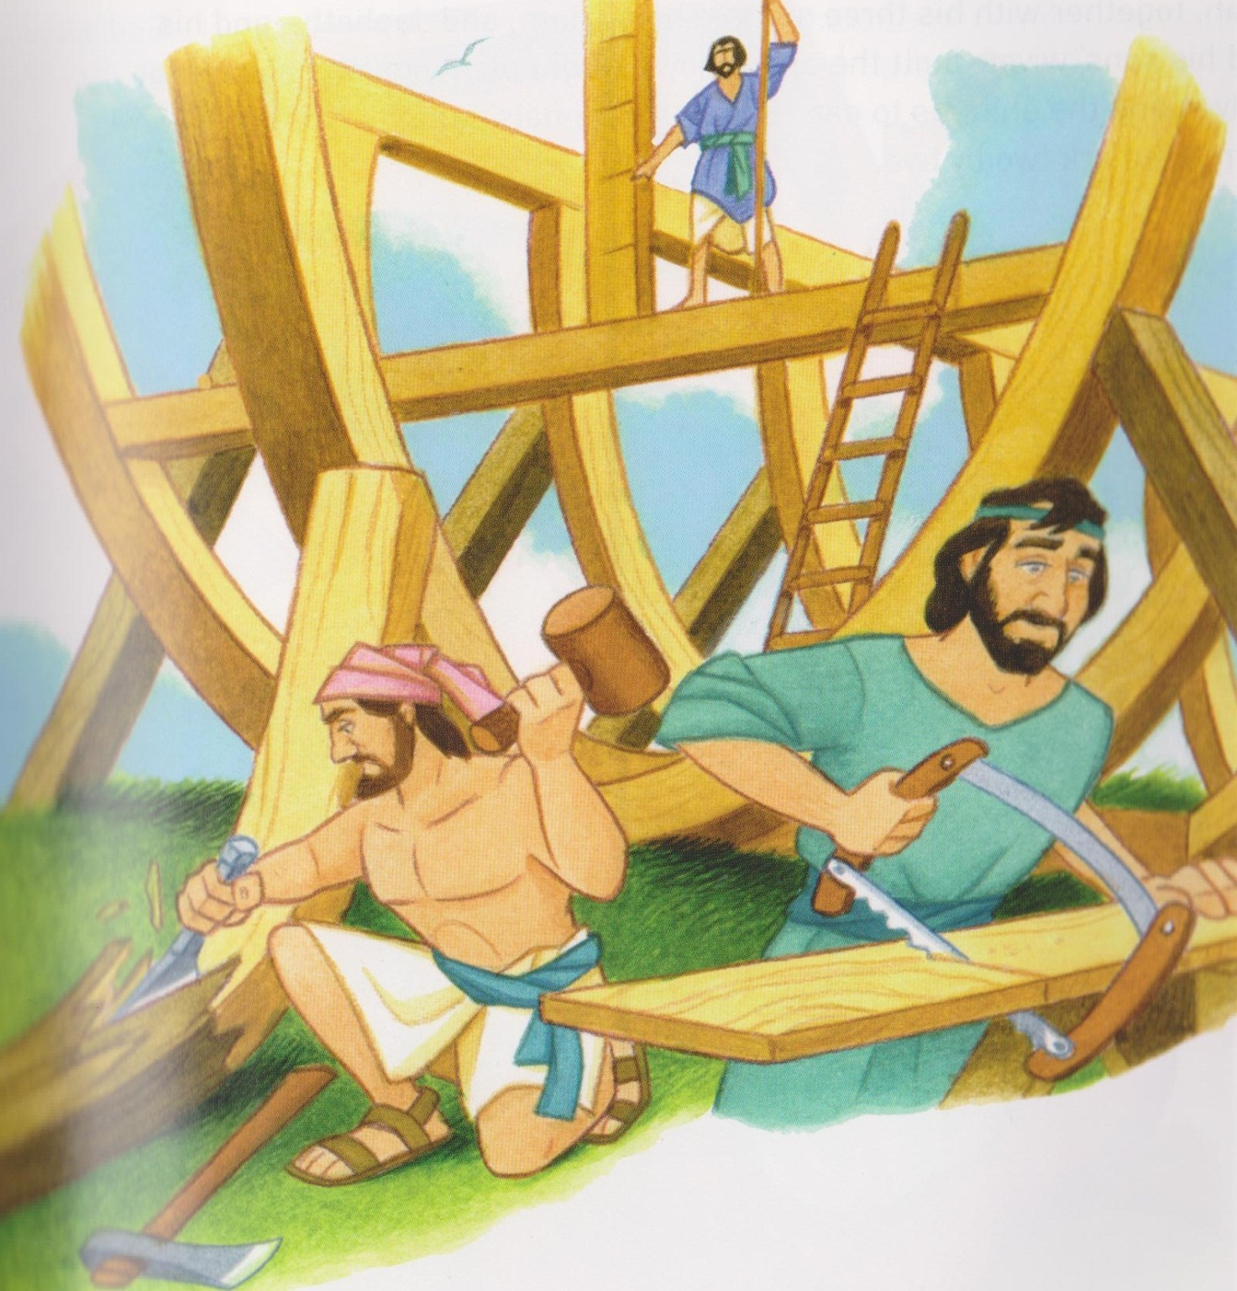

Slide 9
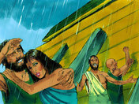

Slide 12
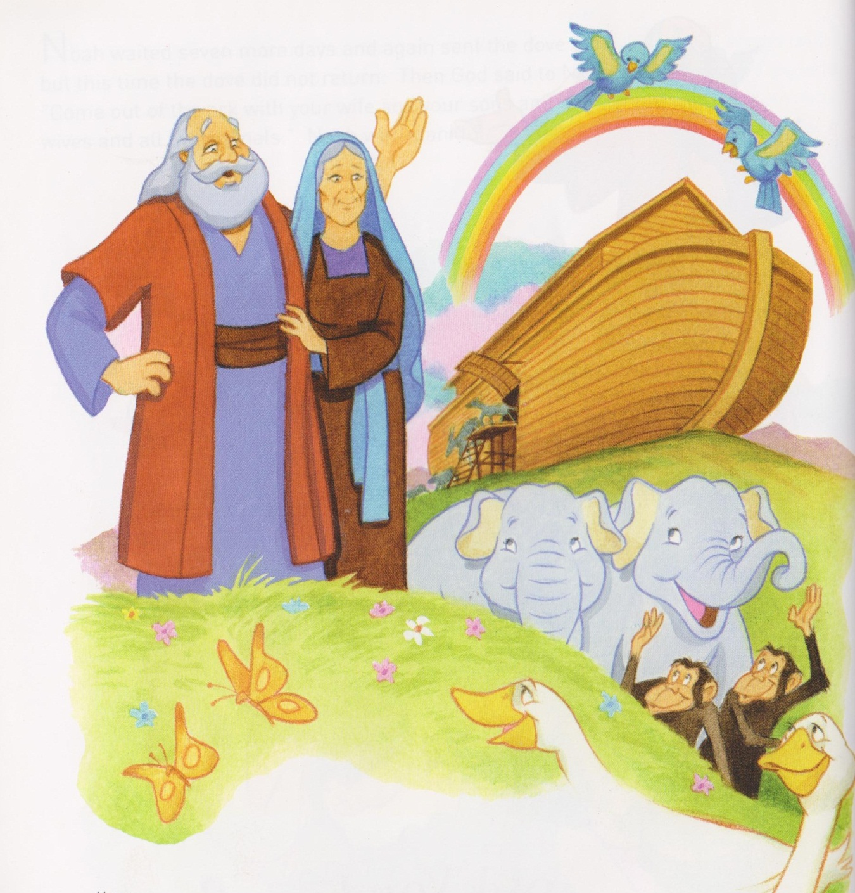
Noah symbol placed on tree.

Slide 13
It’s raining it’s pouring the old man is snoring,
The Lord said to Noah,
“There’s going to be a floody, floody (x2)
Get the children out of the muddy muddy,
children of the Lord.
Noah he built it, he built it an arky, arky, (x2)
Called his children into the arky arky,
children of the Lord.

Slide 14
It rained and poured for 40 long days, days(x2)
Till he had them the hazy cazy Children of the Lord.
So rise and shine and give God the glory, glory (x2)
Rise and shine and give God the glory, glory, children of the Lord.
Children of the Lord.
It’s raining it’s pouring.

Slide 15
Mamakankarra thank you for the world. Lord hear us.
Mamakankarra Help us to look after our world. Lord hear us
Mamakankarra help us to be good always. Lord hear us.
Mamakankarra help us to care for all creation. Lord hear us.
Mamakankarra help us not to give in and make bad choices. Lord hear us.

