Slide 1
Advent Waiting for the coming of Jesus

Slide 2
Week 3 Abraham Sarah Isaac
Come Lord Jesus (x3)
Come and be born in our hearts.

Slide 3
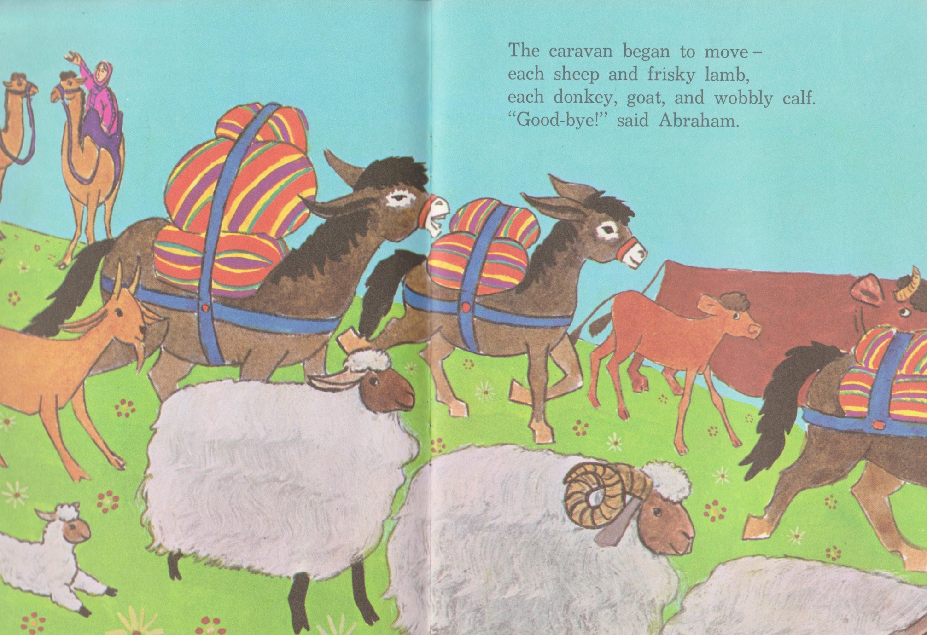
Abraham, Sarah and Isaac

Slide 4
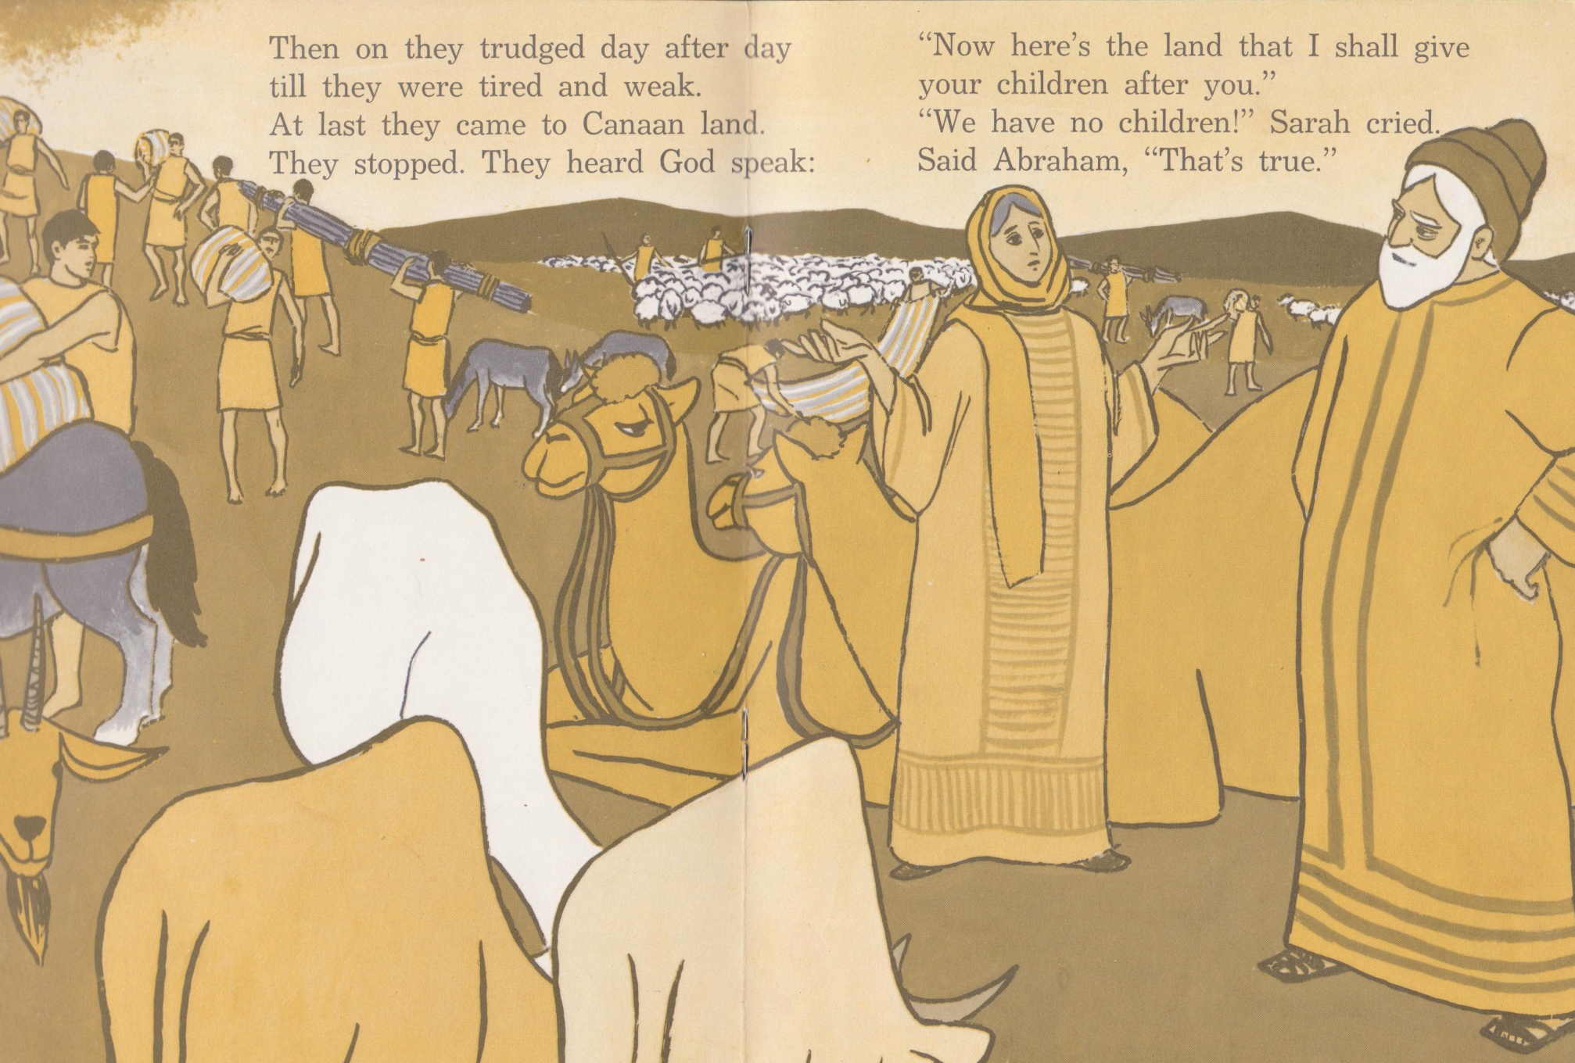

Slide 5
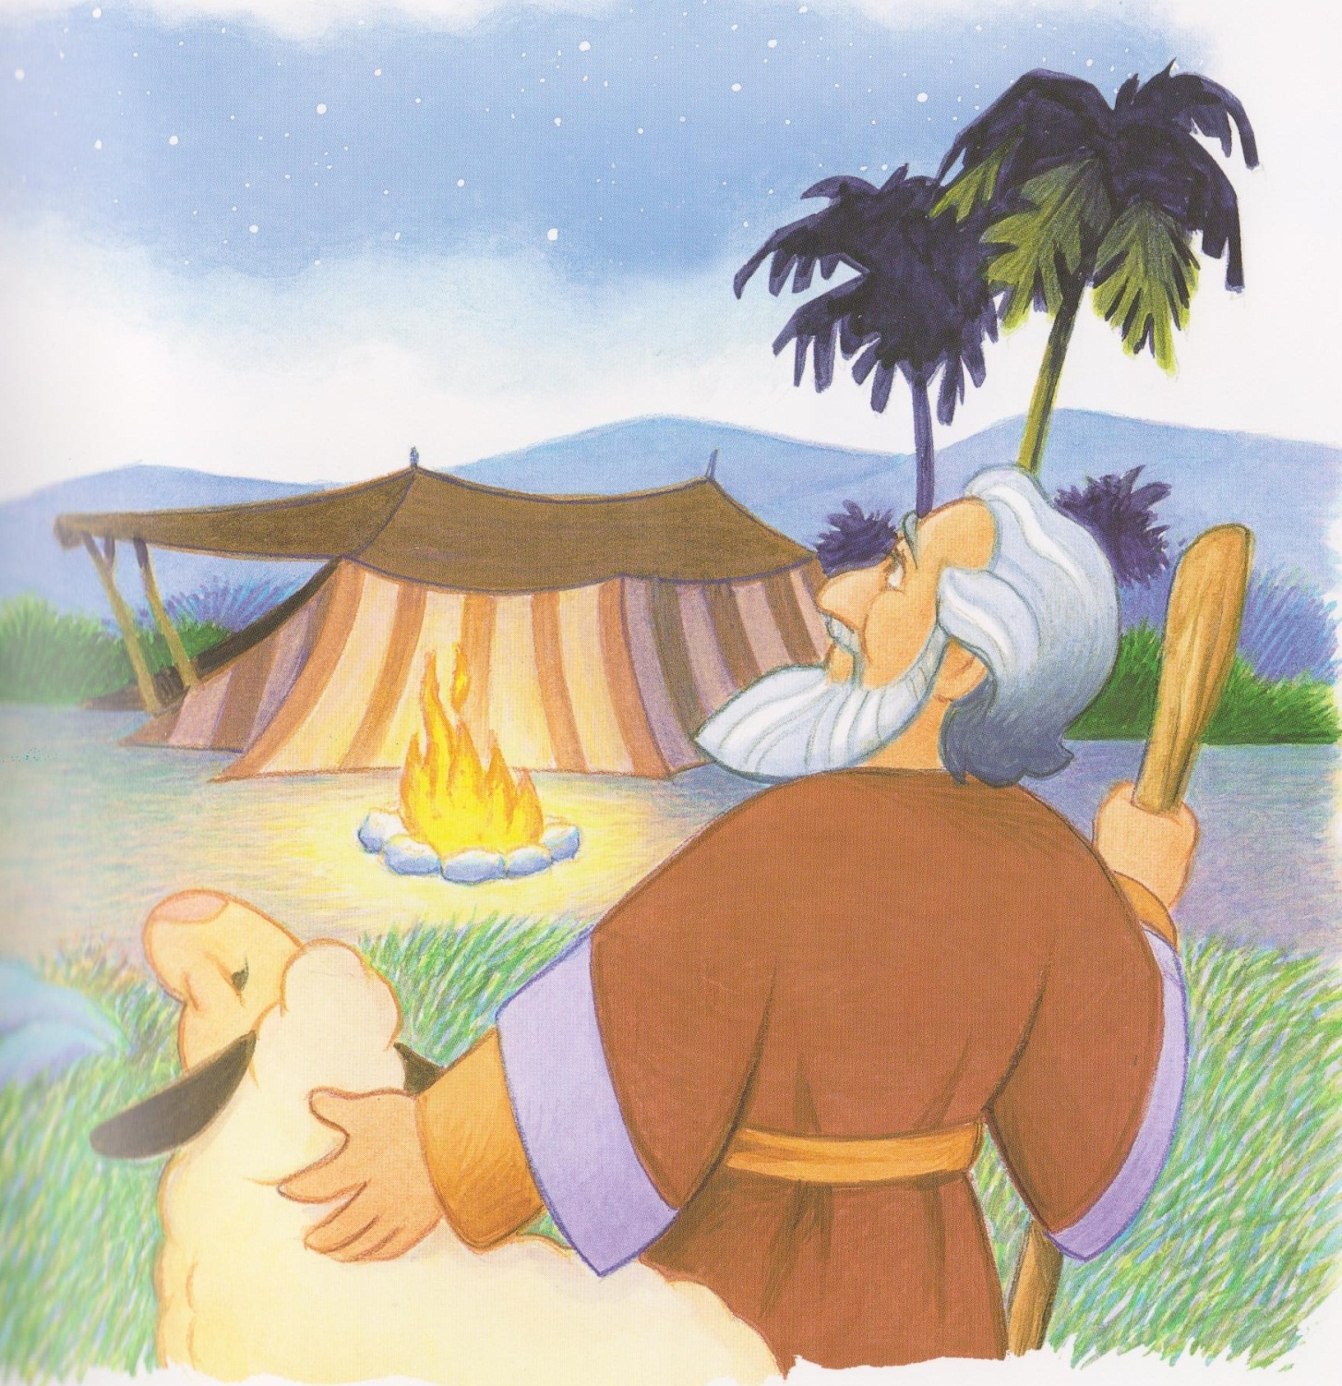

Slide 6
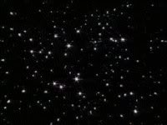

Slide 7
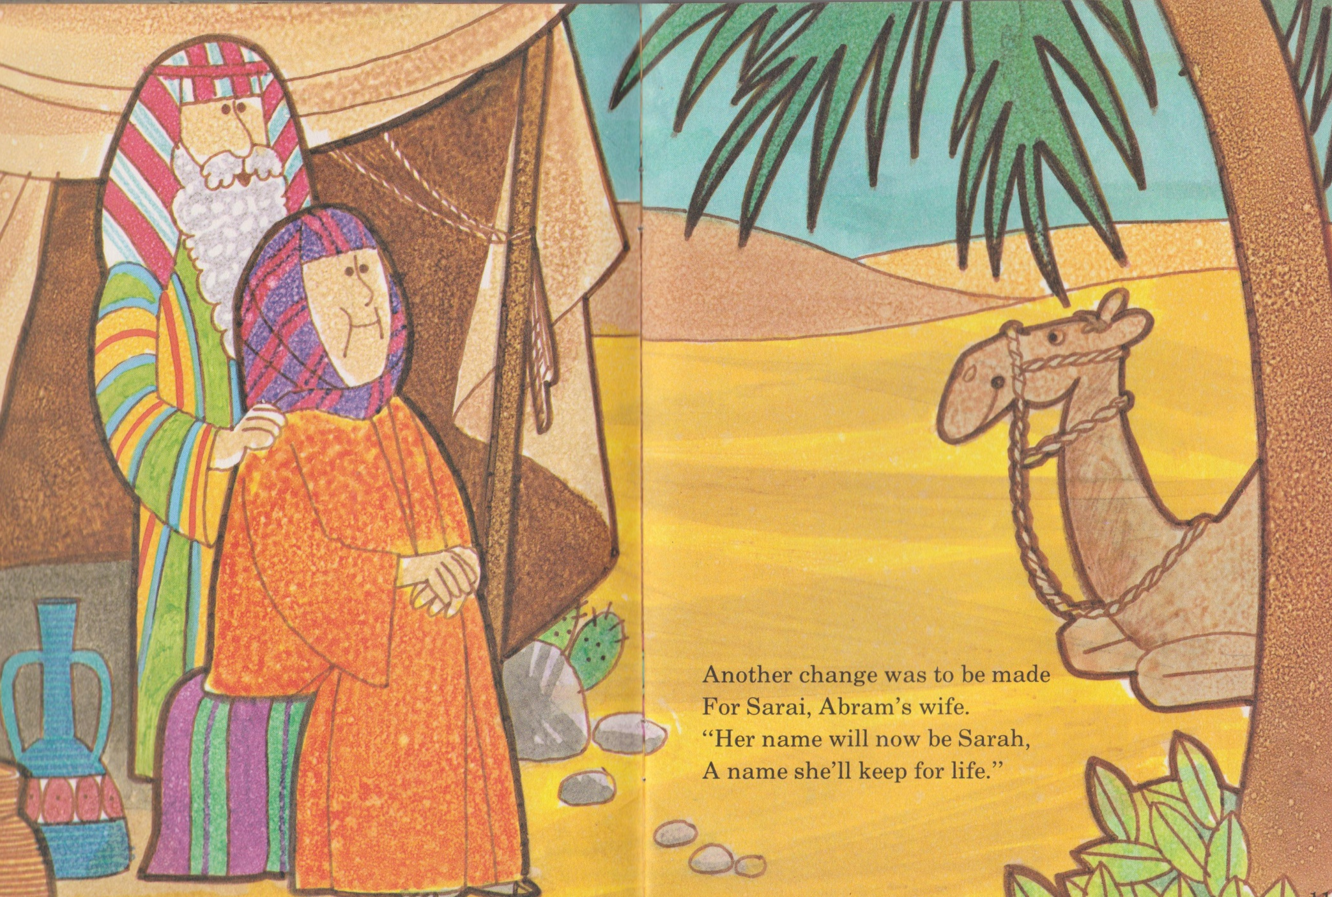

Slide 9
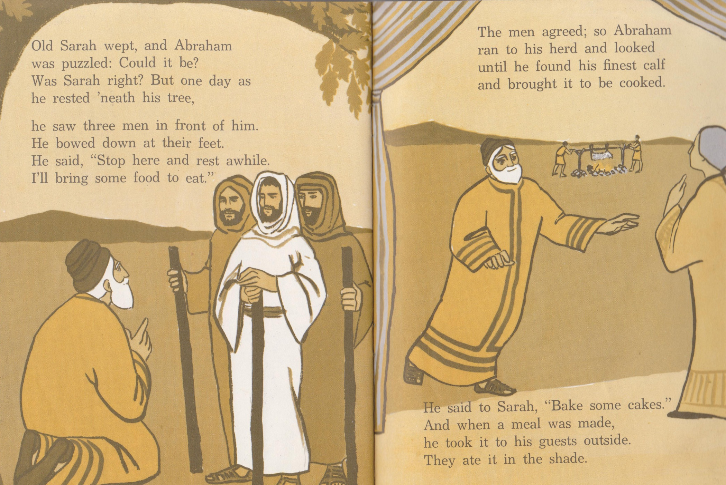

Slide 10
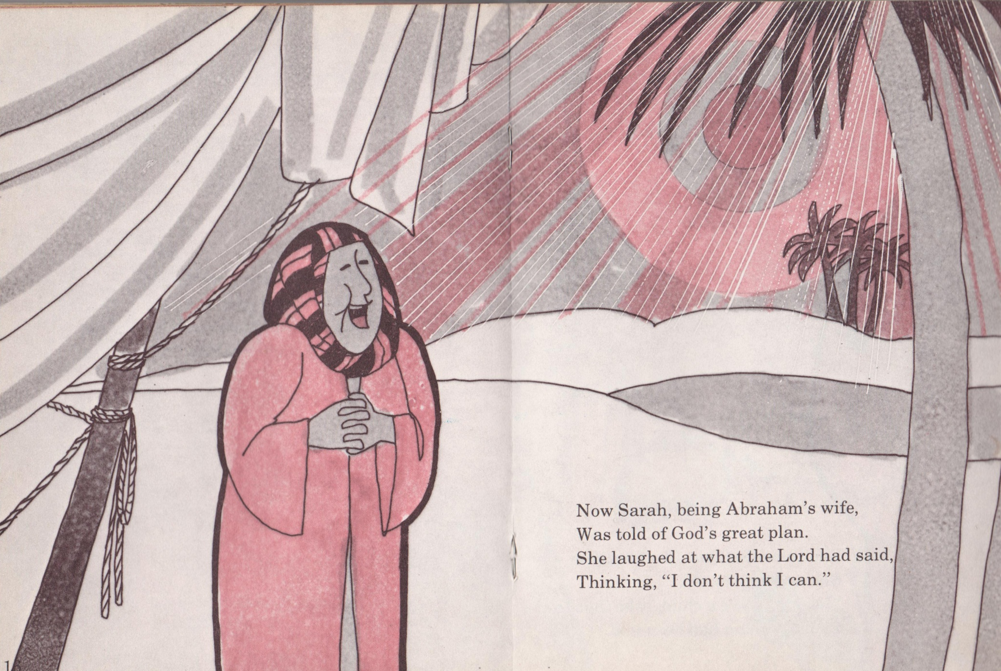

Slide 11
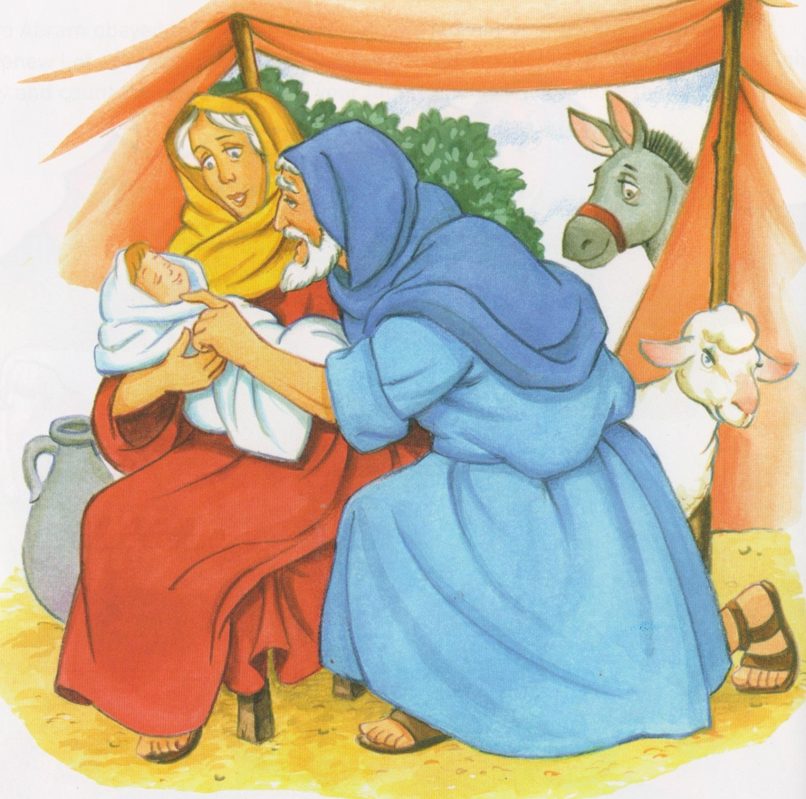

Slide 12
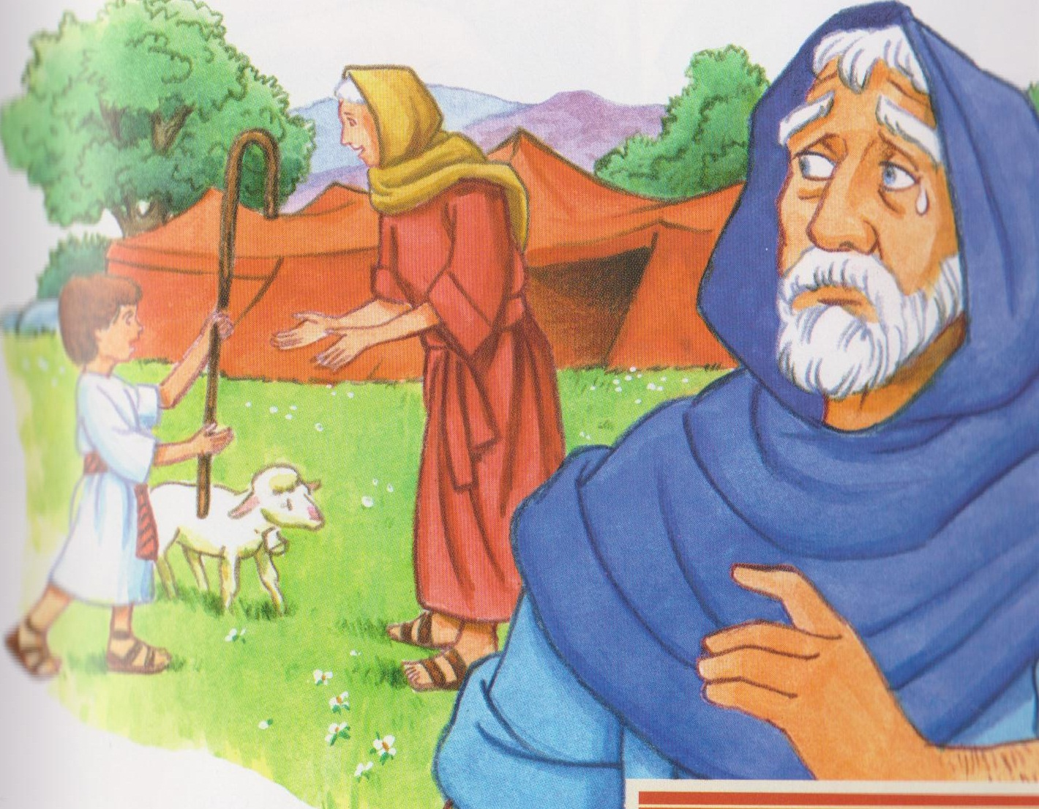

Slide 13
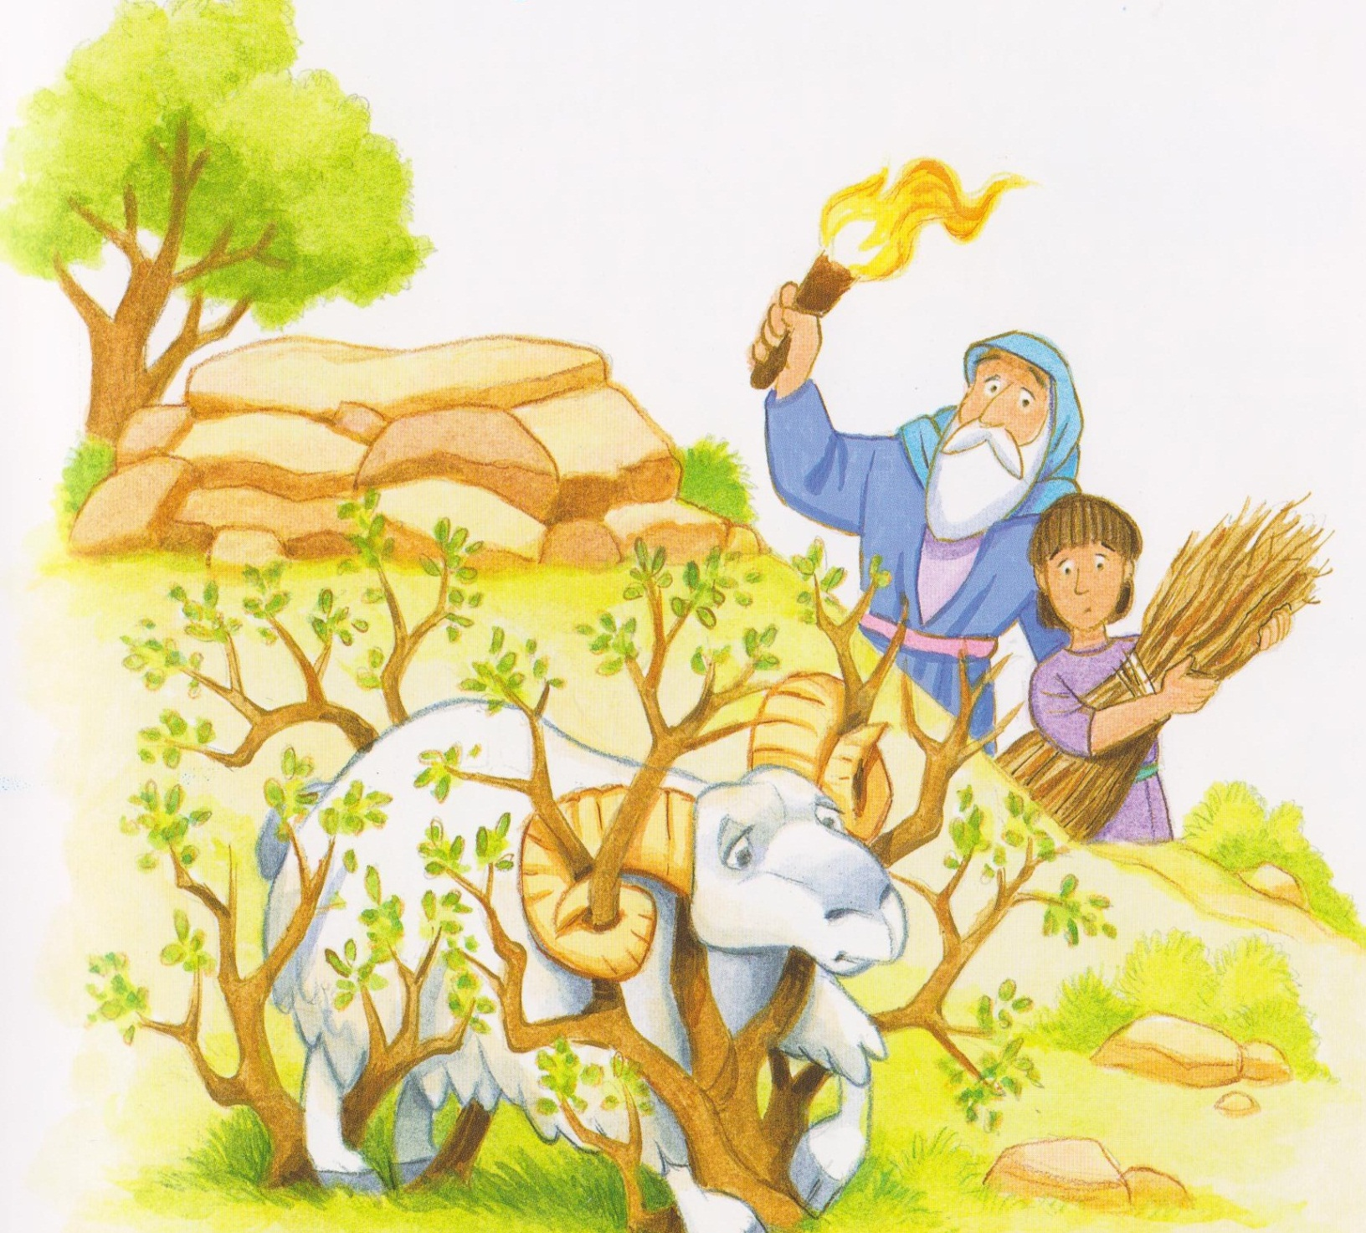

Slide 14
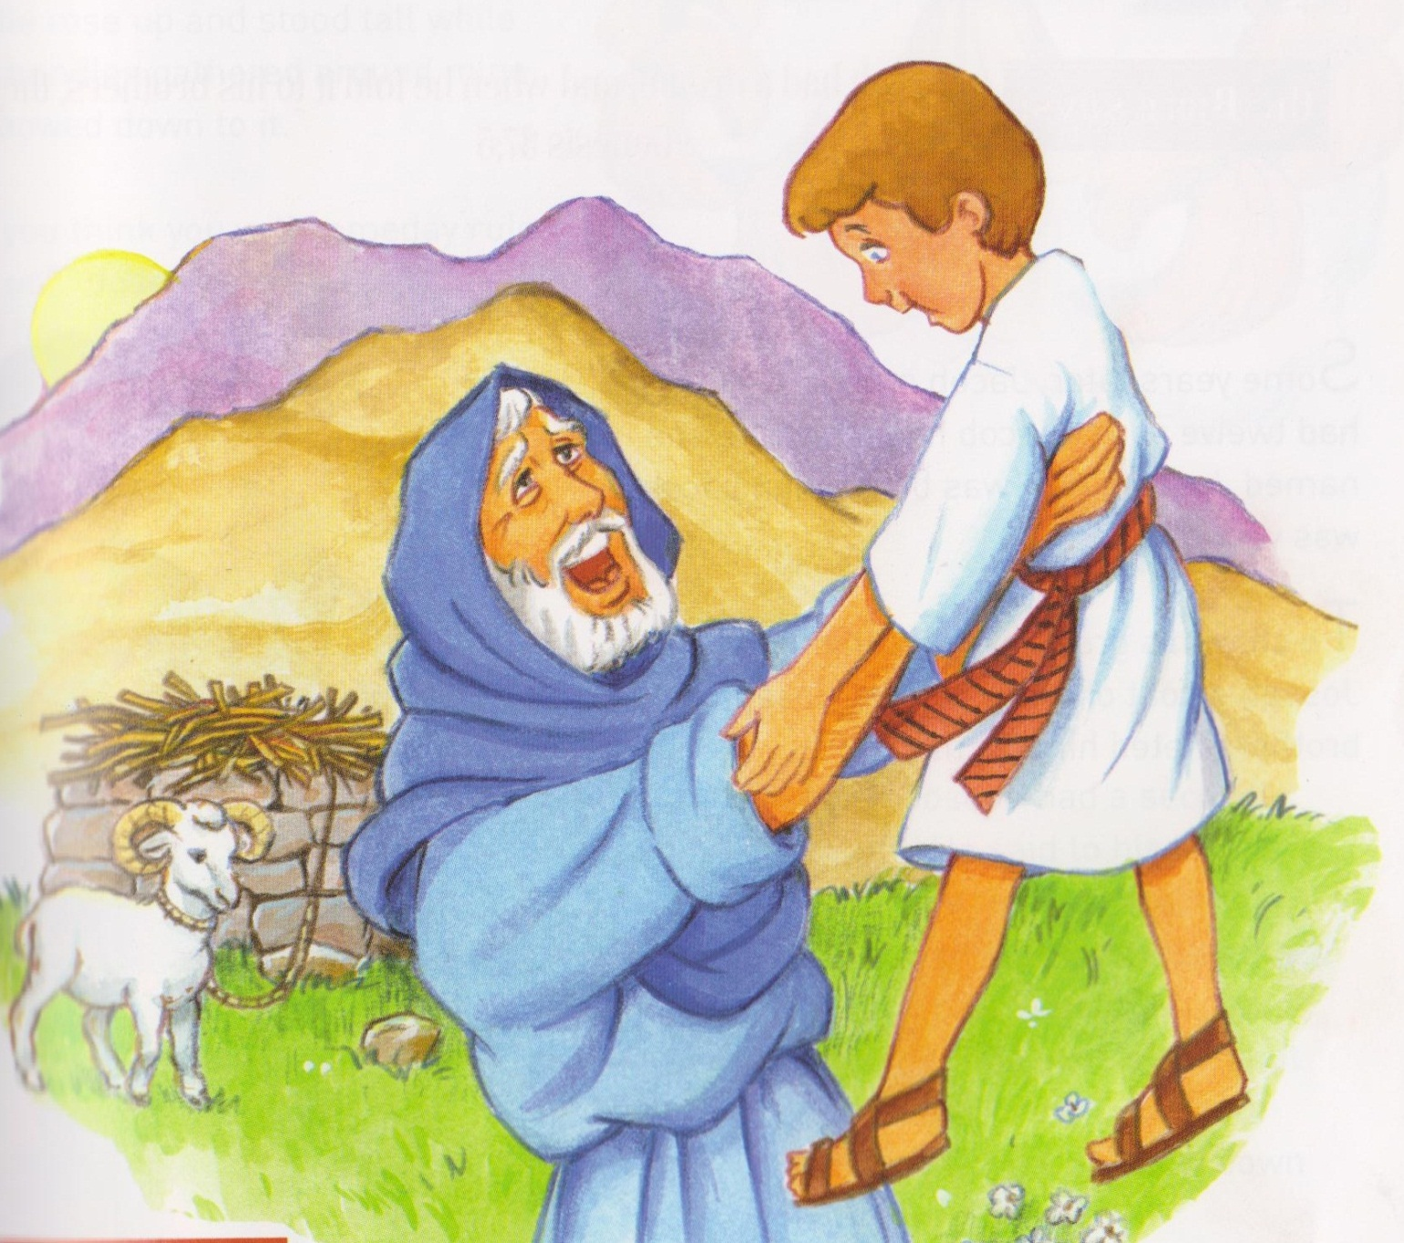
Abraham and Sarah and Isaac symbols placed on tree.

Slide 15
Rock my soul
Rock a my soul in the bosom of Abraham (x3)
Oh rock a my soul.
Too high can’t get over it, (x3)
Gotta go through the door.

Slide 16
Rock a my soul in the bosom of Abraham (x3)
Oh rock a my soul.
Too wide can’t get round it, (x3)
Gotta go through the door.
Too deep can’t get under it, (x3)
Gotta go through the door.
Rock a my soul in the bosom of Abraham (x3)
Oh rock a my soul.

Slide 17
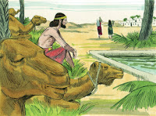
Issac

Slide 18
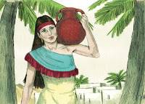

Slide 19
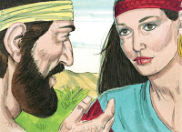

Slide 20
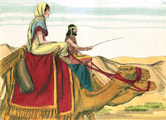

Slide 21
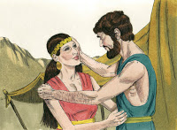

Slide 22
Father Abraham had many children,
Many children had Father Abraham.
I am one of them and so are you,
So let’s all praise the Lord……right hand
Left hand, right foot, left foot.

Slide 23
Mamakankarra help us to be your children. Lord hear us.
Mamakankarra help us to remember to go to church on Saturdays. Lord hear us.
Mamakankarra help us to act like you want us to act. Lord hear us.
Mamakankarra help us to forgive others. Lord hear us.
Mamakankarra help us to look after our brothers and sisters. Lord hear us.

