Slide 1
Advent Waiting for the coming of Jesus

Slide 2
Week 4 Joseph Moses Joshua
Come Lord Jesus (x3)
Come and be born in our hearts.

Slide 3
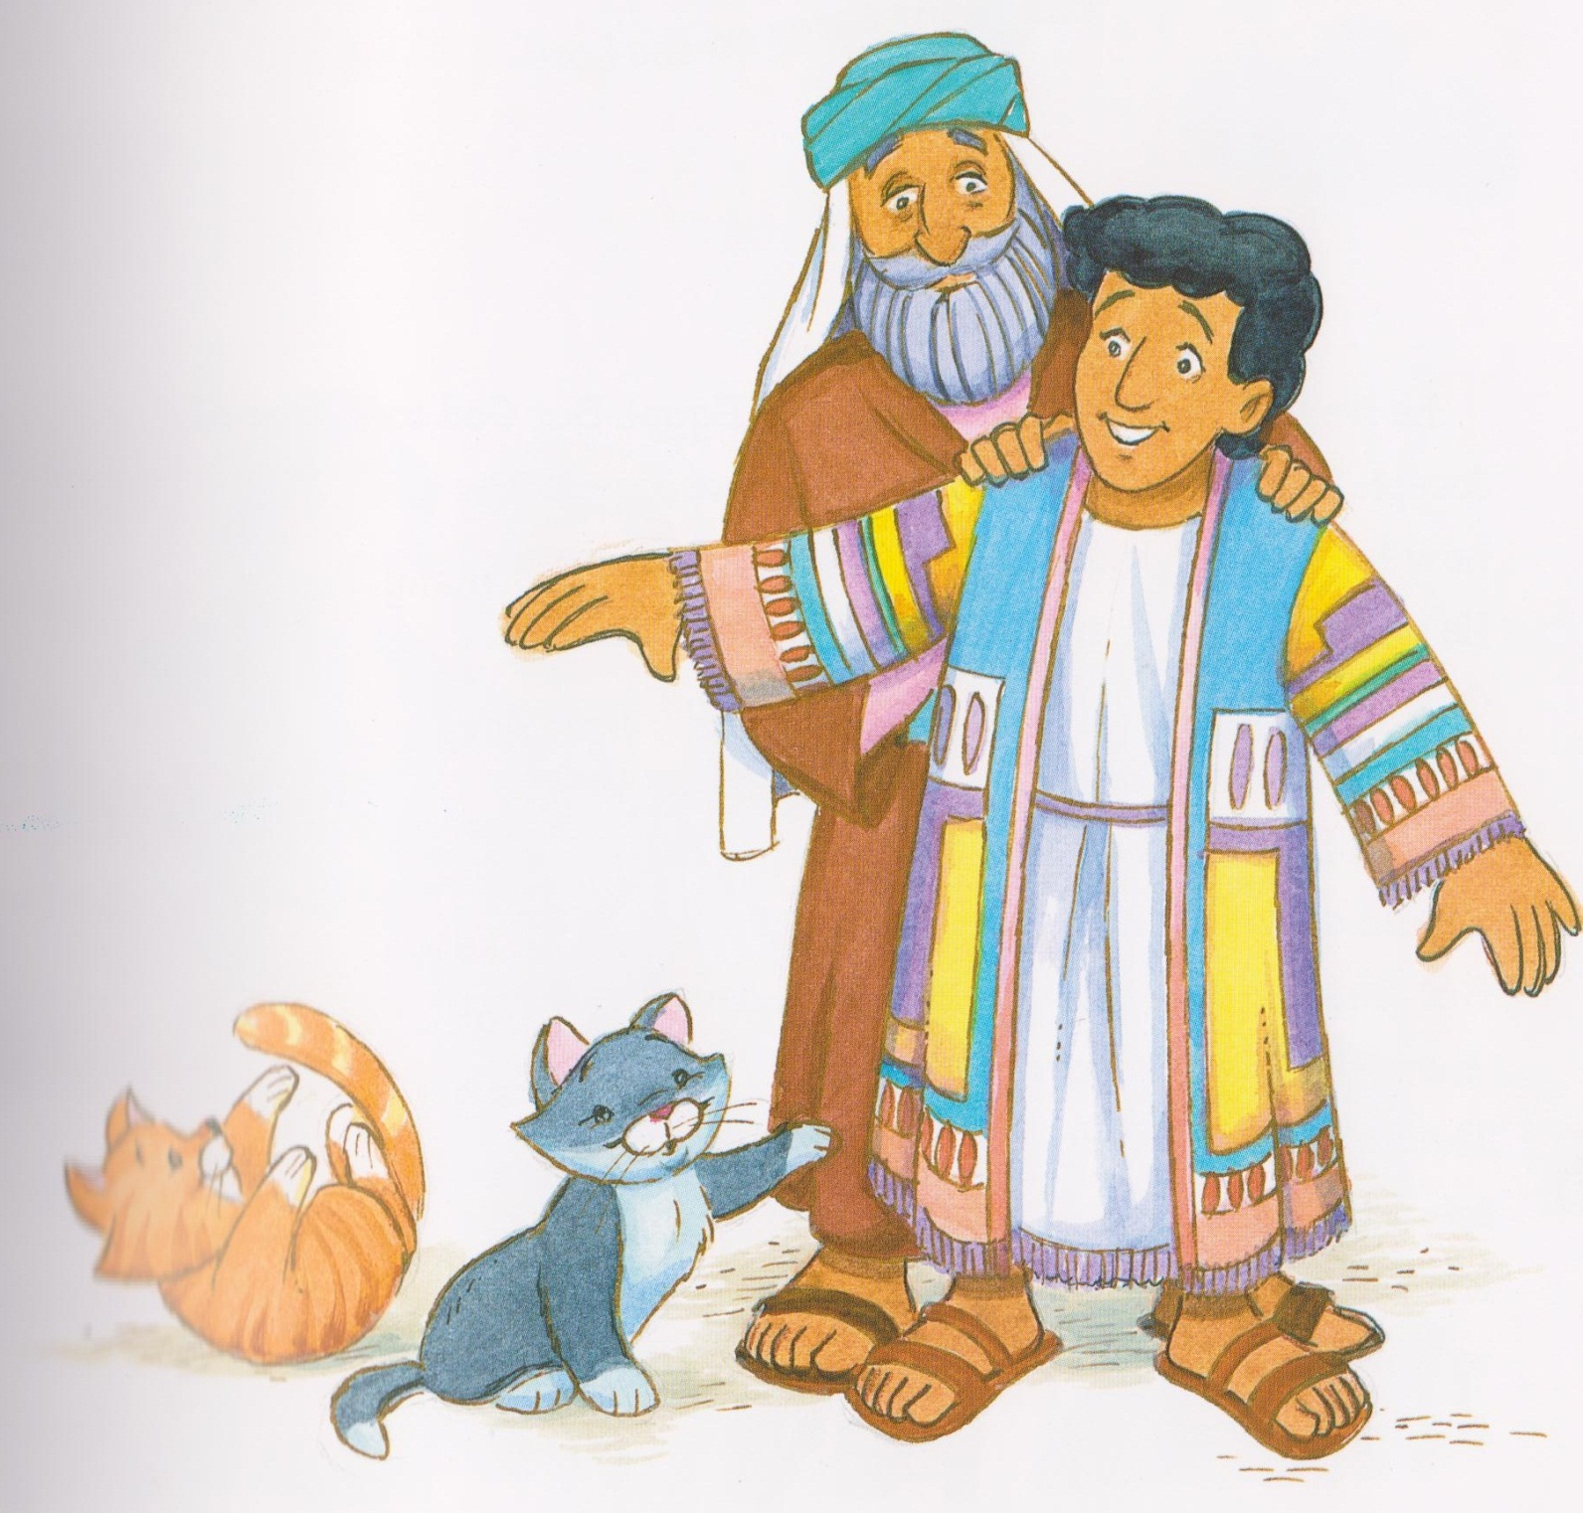

Slide 4
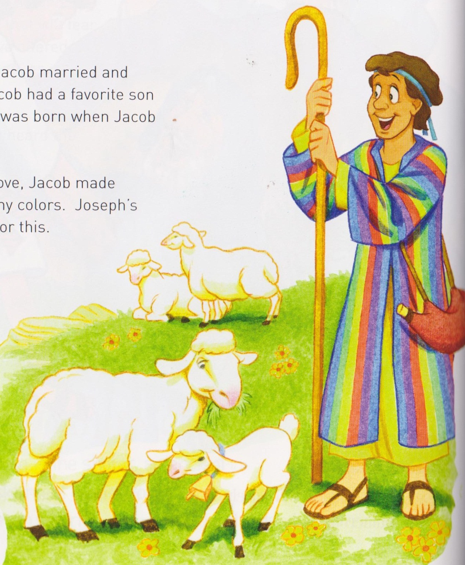

Slide 5
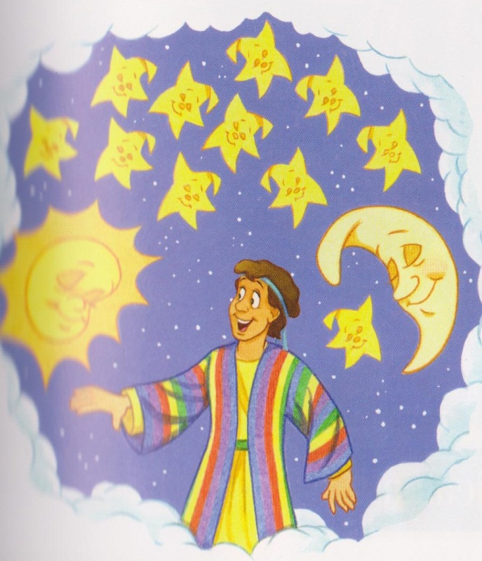

Slide 6
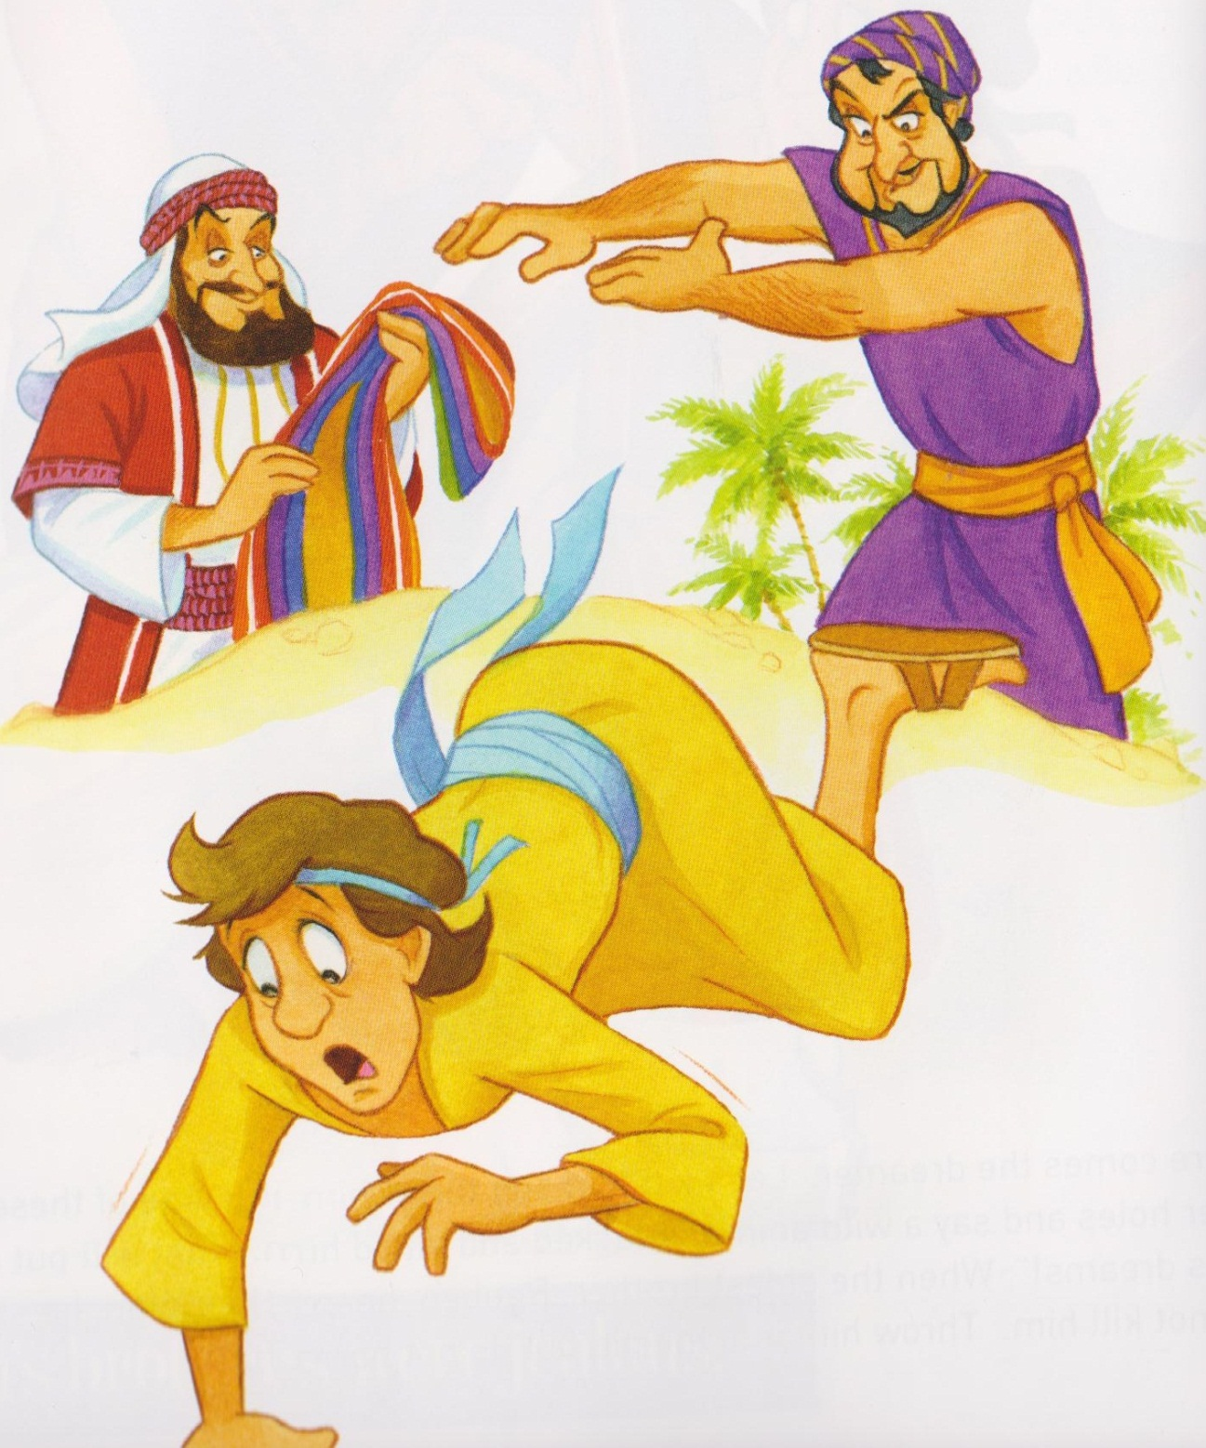

Slide 7
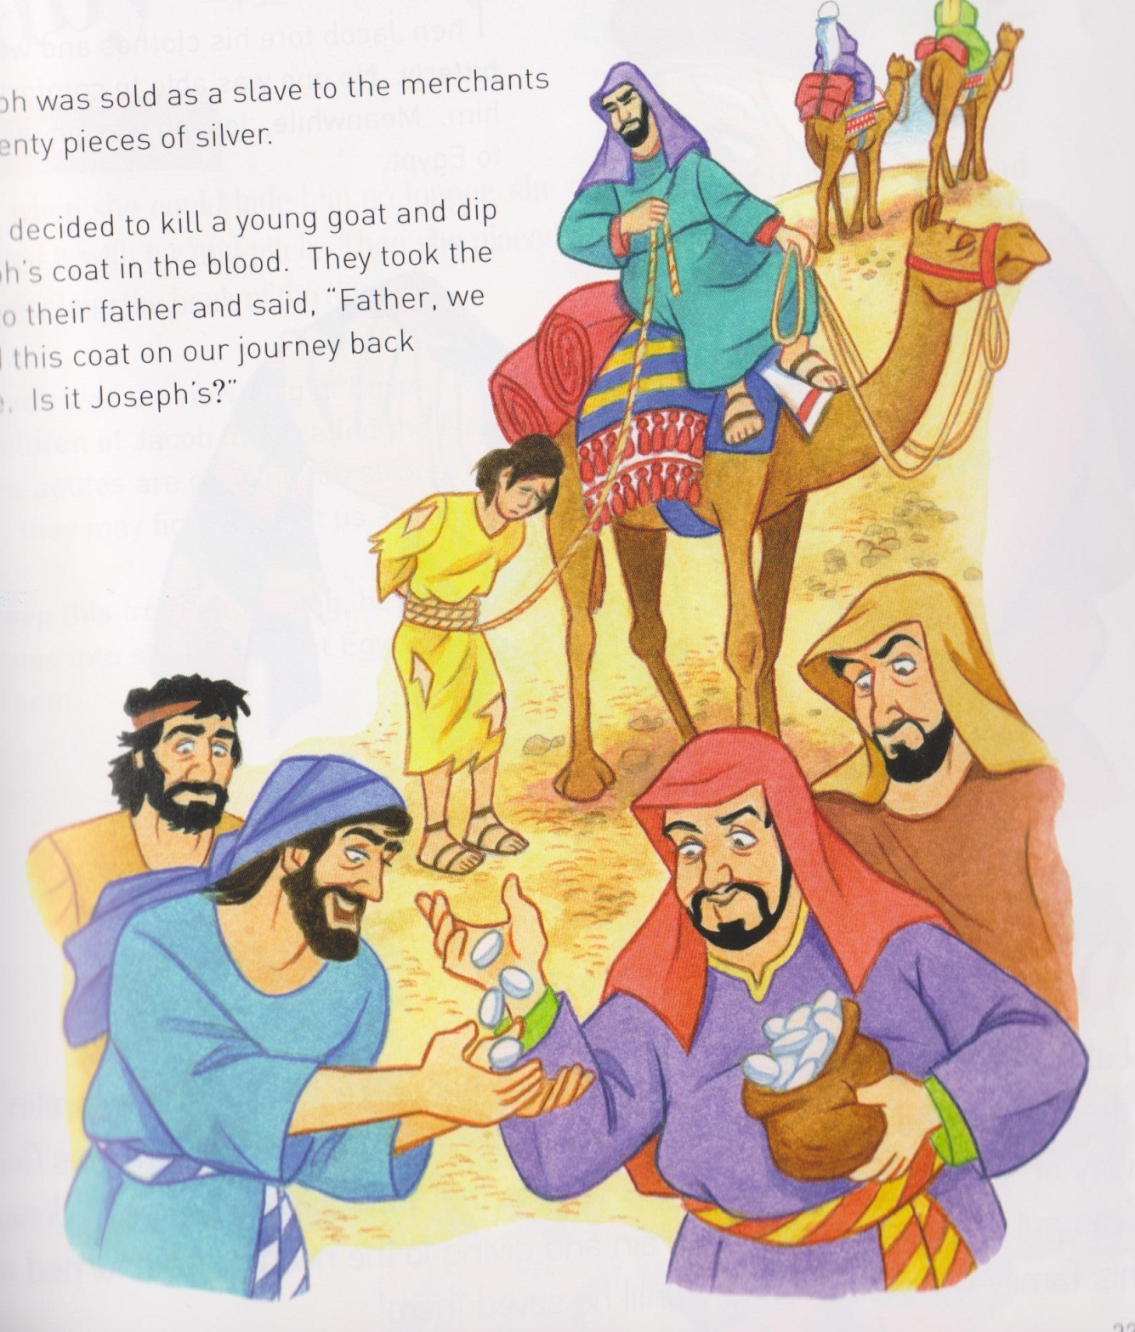

Slide 8
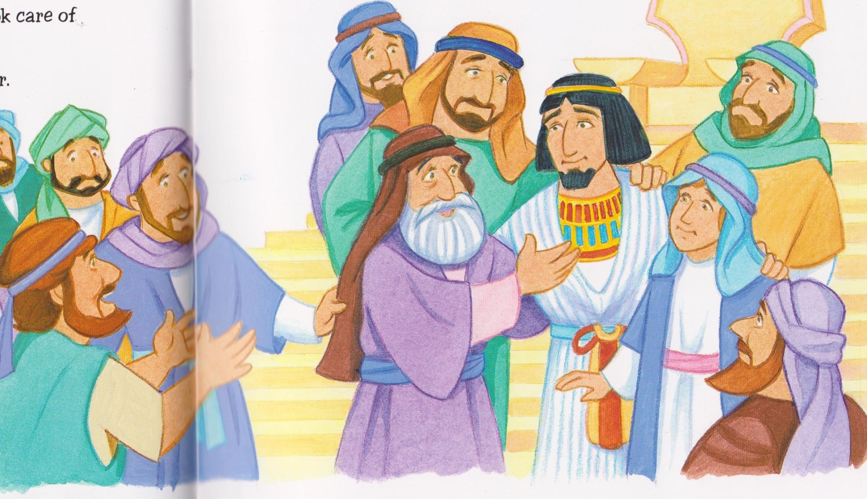
Joseph symbol placed on tree.

Slide 9
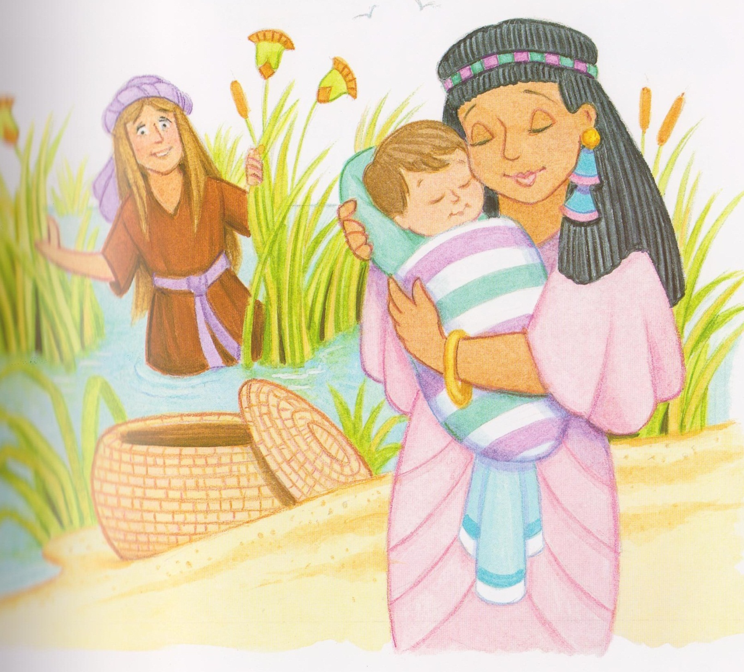
Moses

Slide 10
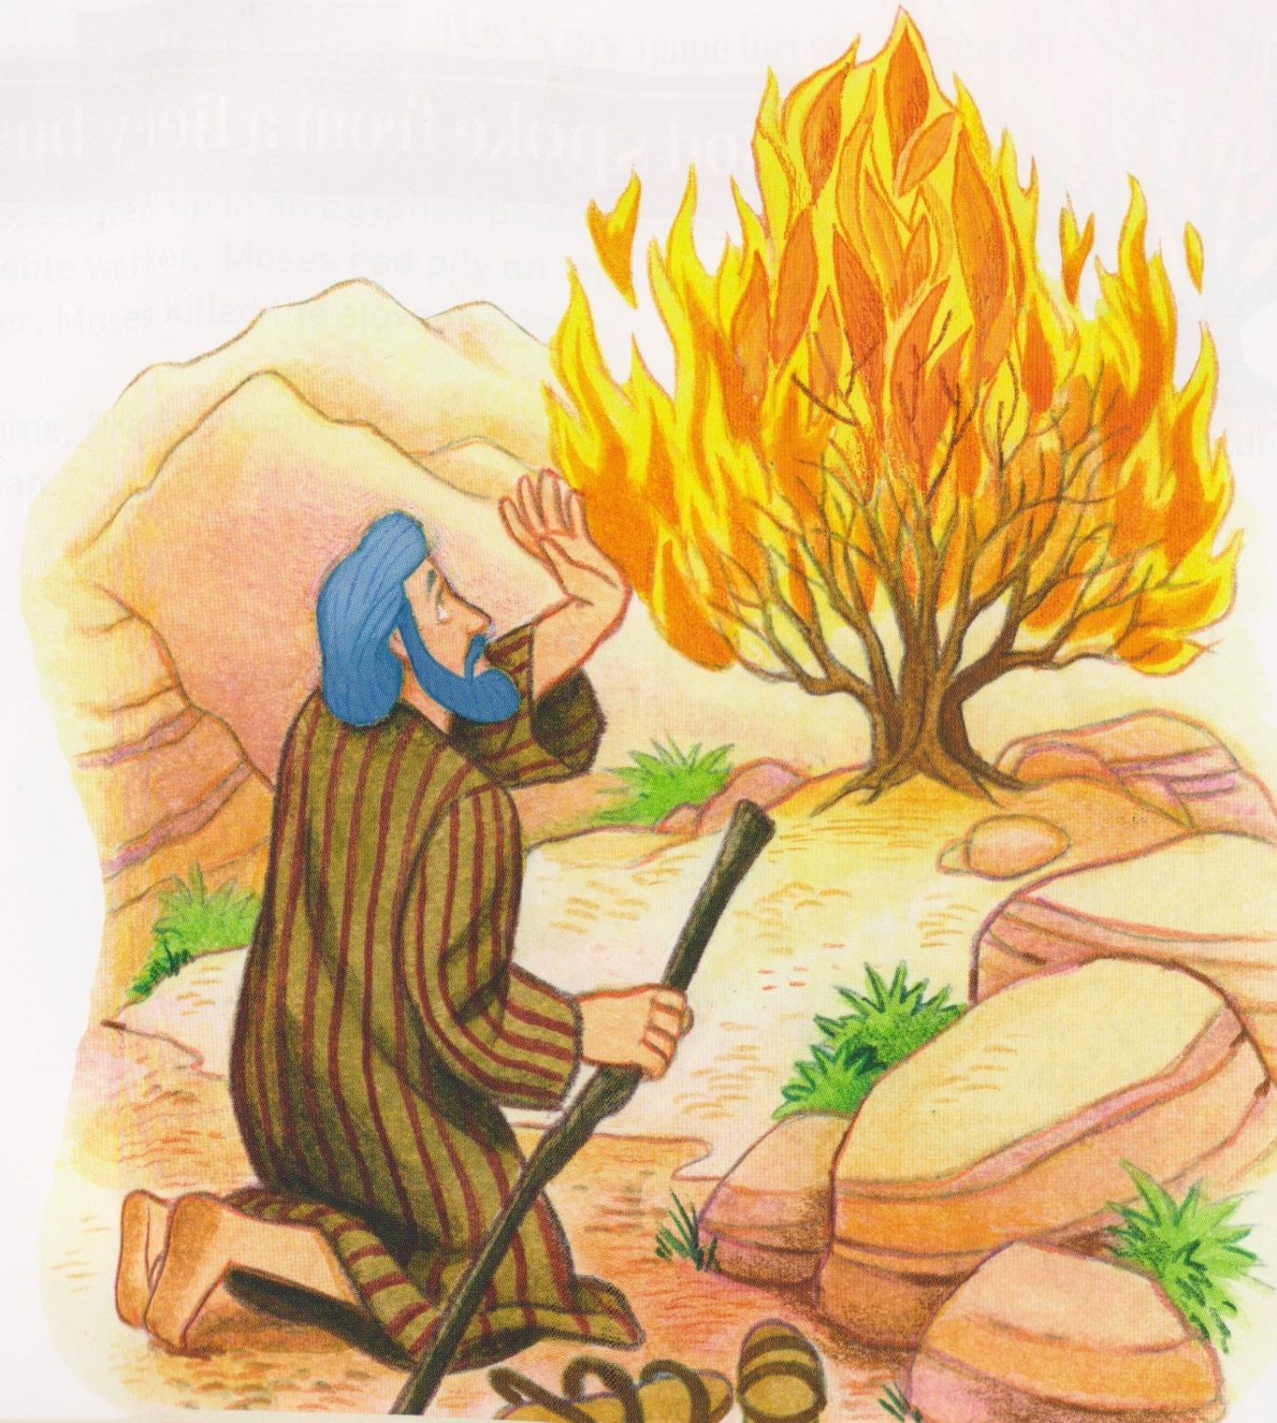

Slide 11
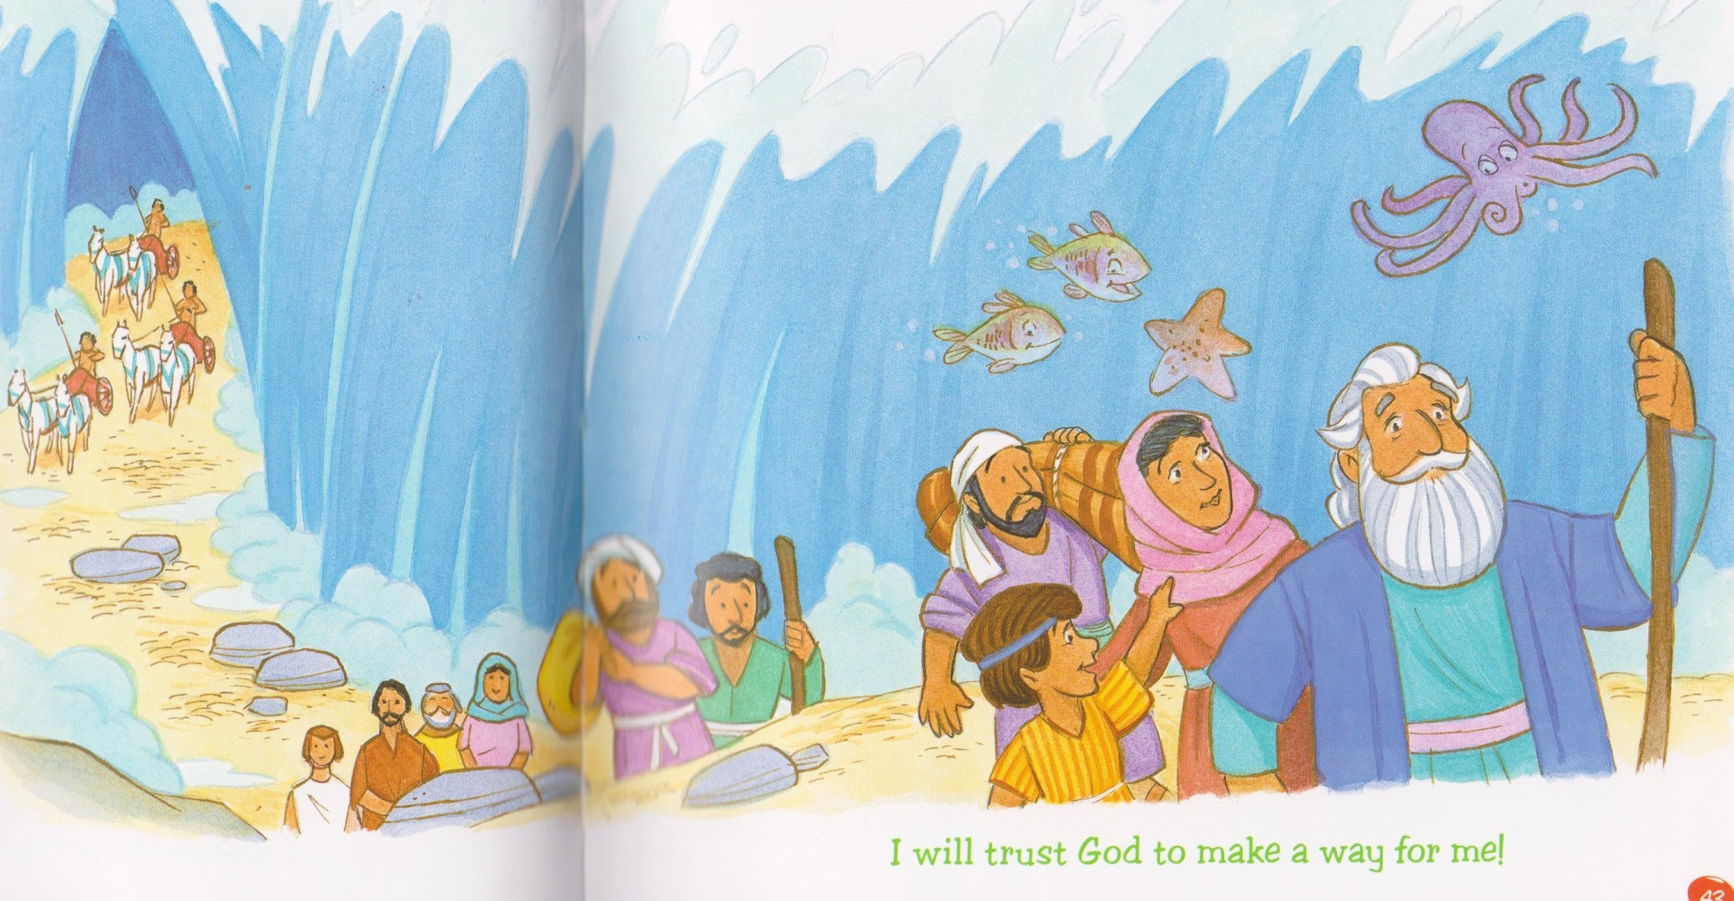

Slide 12
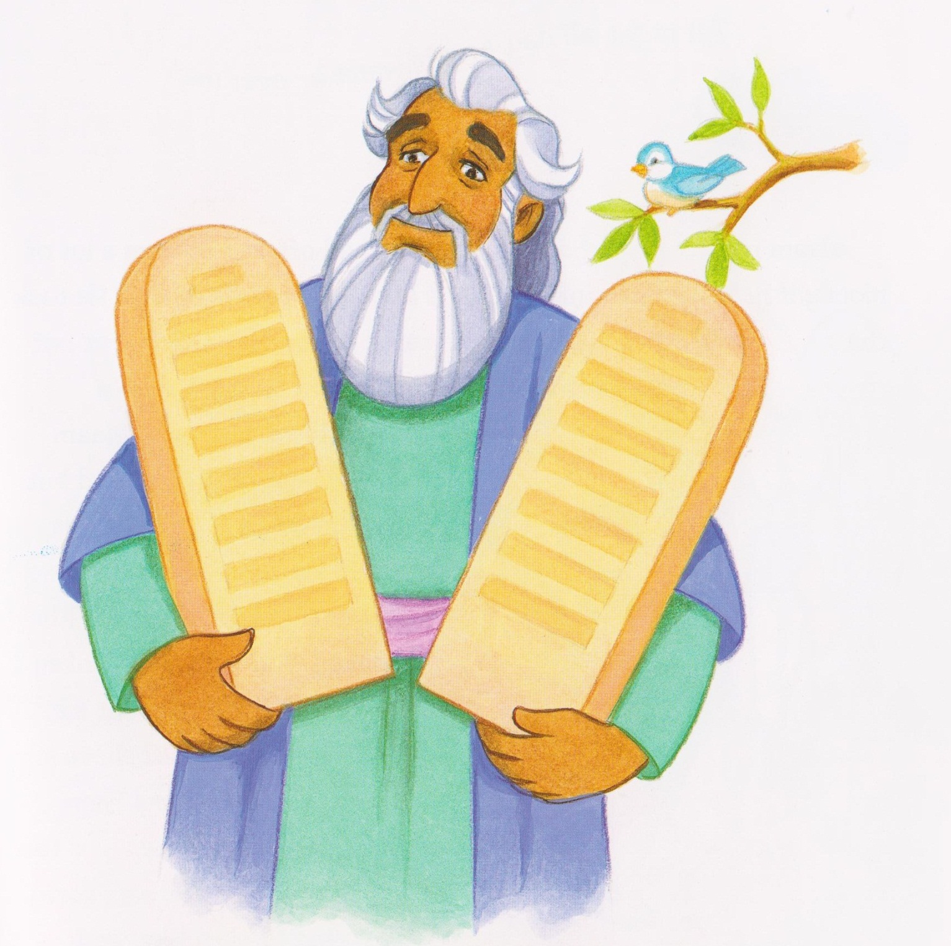
Moses symbol placed on tree.

Slide 13
Keep my commandments and you will live (x2)
If you keep my commandments you will live (x2)
You will live.
God’s word is like a flare in the darkest night Showing us the way.
God’s word is like a flare shining for this light Helping us to see where we can be.
Keep my commandments and you will live (x2)
If you keep my commandments you will live (x2)
You will live.

Slide 14
God’s word is wonderful keeping us from harm. Showing us the way
God’s word is wonderful it sounds a big alarm,
When then I can see there is only me
Keep my commandments and you will live (x2)
If you keep my commandments you will live (x2) You will live.
Keep my commandments and you will live (x2)
If you keep my commandments you will live (x2) You will live.

Slide 15
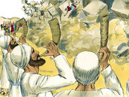
Joshua symbol placed on tree.

Slide 16
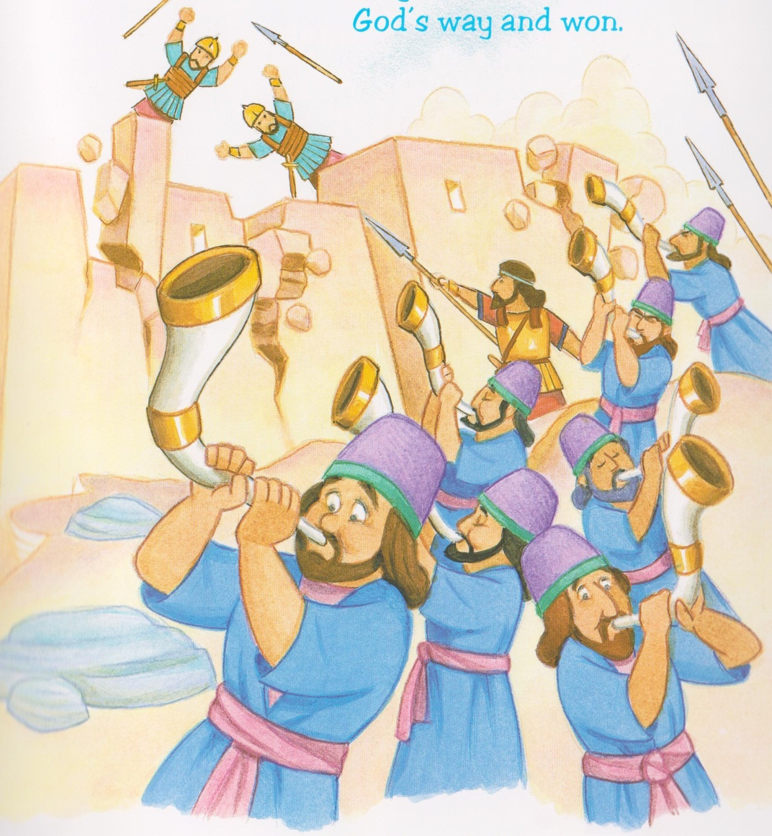
We are travelling in the footsteps of those who’ve gone before
And we’ll want to be reunited on the new and distant shore.
Oh when the Saints go marching in, oh when the Saint’s go marching in.
Oh how I want to be in their number when the saints go marching in.

Slide 17
Oh when the trumpet sounds its call, oh when the trumpet sounds its call
Oh how I want to be in their number when the trumpet sounds its call.
Oh when the Saints go marching in, oh when the Saint’s go marching in.
Oh how I want to be in their number when the saints go marching in.

Slide 18
Mamakankarra help us to pray to you. Lord hear us.
Mamakankarra help us keep your laws. Lord hear us.
Mamakankarra help us to always love you and one another. Lord hear us.
Mamakankarra help us listen to you in our prayers. Lord hear us.
Mamakankarra help us to listen to you in the bible. Lord hear us.

