Slide 1
Advent Waiting for the coming of Jesus

Slide 2
Week 5 Ruth Samson Samuel
Come Lord Jesus (x3)
Come and be born in our hearts.

Slide 3
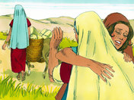

Slide 6
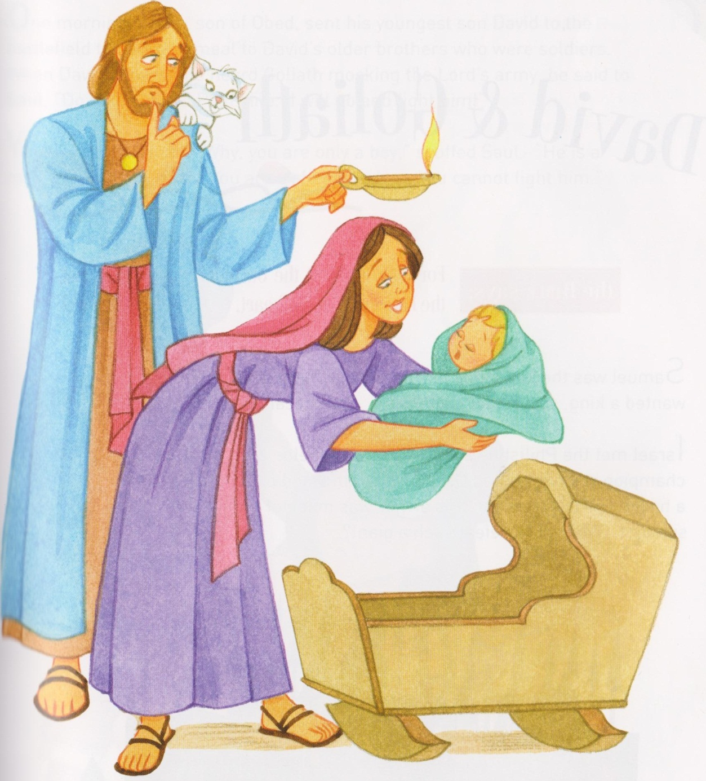
Ruth symbol placed on tree.

Slide 7
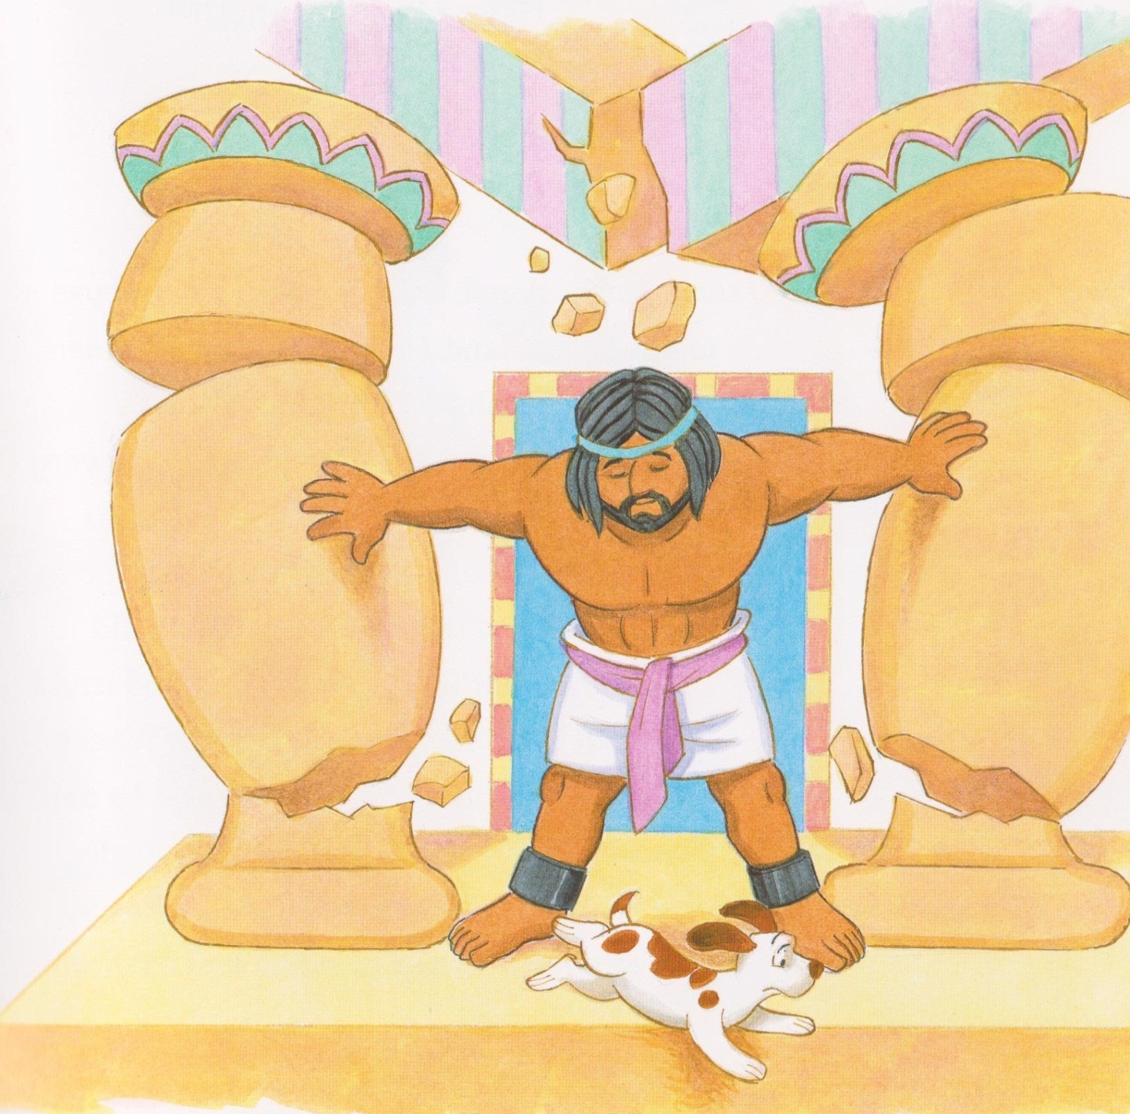
Samson
Samson symbol placed on tree.

Slide 8
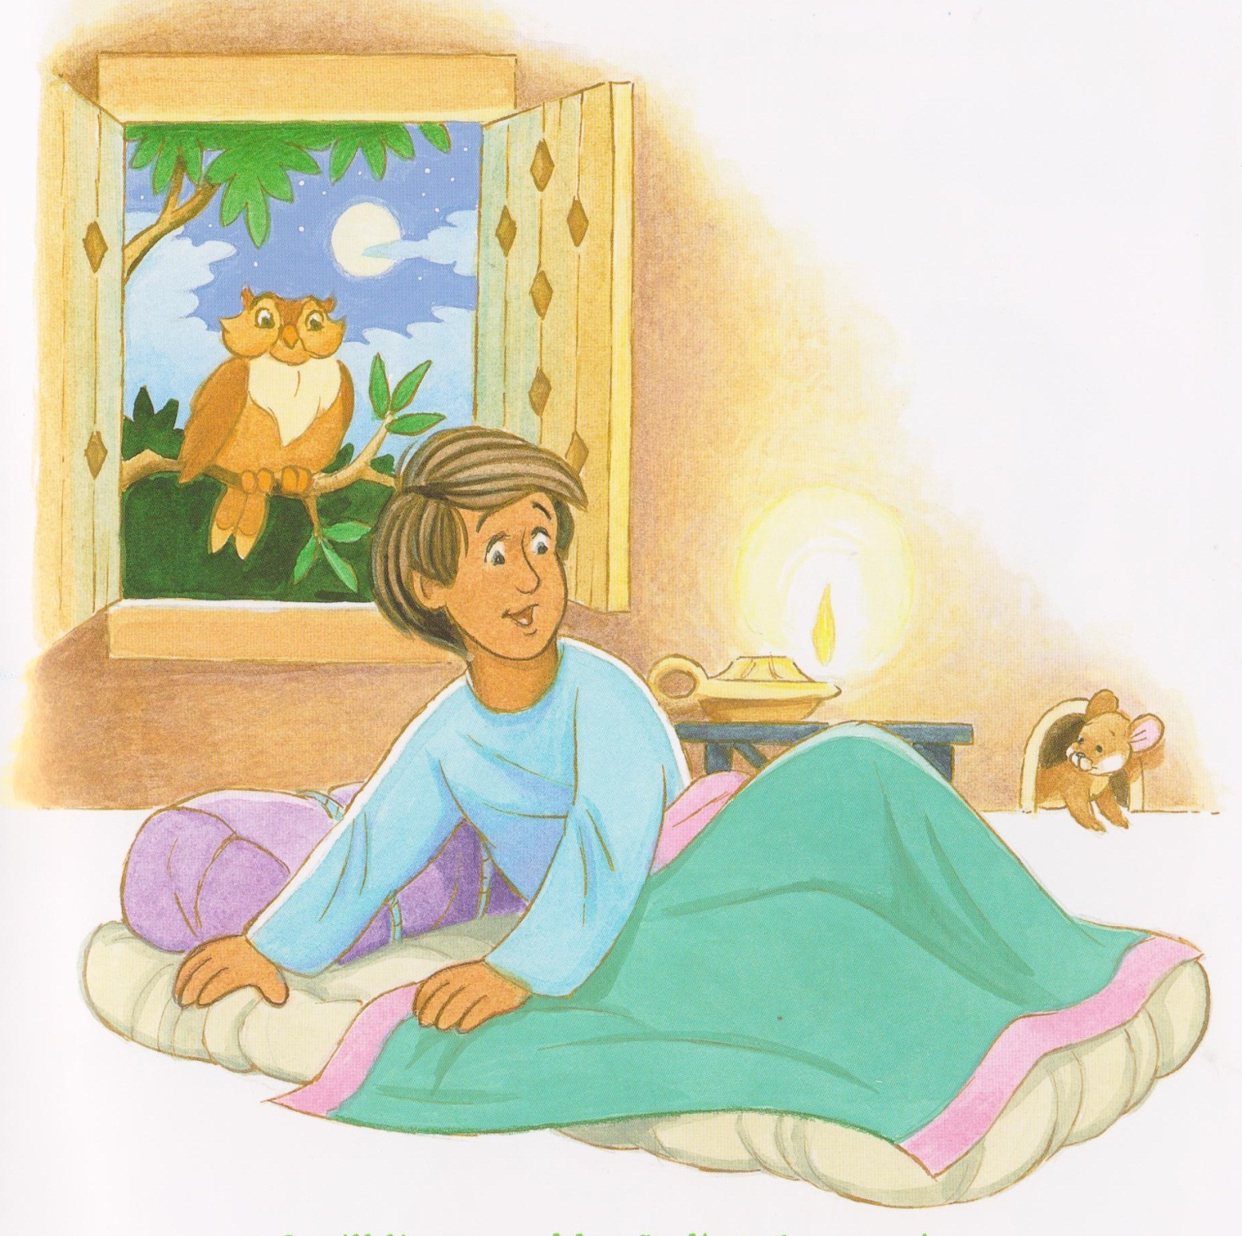
Samuel symbol placed on tree.

Slide 9
God is our refuge and strength an ever present help in trouble. (x2)
Call upon the name of the Lord, He will hear you, he will hear you.
Call upon the name of the Lord, He will hear you, if you pull through.
God is our refuge and strength an ever present help in trouble. (x4)
God is our refuge and strength an ever present help in trouble. (x2)
An ever present help in trouble (x3)

Slide 10
Mamakankarra help us to be strong. Lord hear us.
Mamakankarra help us to be wise and help others. Lord hear us.
Mamakankarra help us to look after everyone in our community. Lord hear us.
Mamakankarra help us so we will make good choices. Lord hear us.
Mamakankarra help us to be faithful like Ruth, wise like Samuel and strong like Samson. Lord hear us.

