Slide 1
Advent Waiting for the coming of Jesus

Slide 2
Week 6 David Solomon Elijah
Come Lord Jesus (x3)
Come and be born in our hearts.

Slide 3
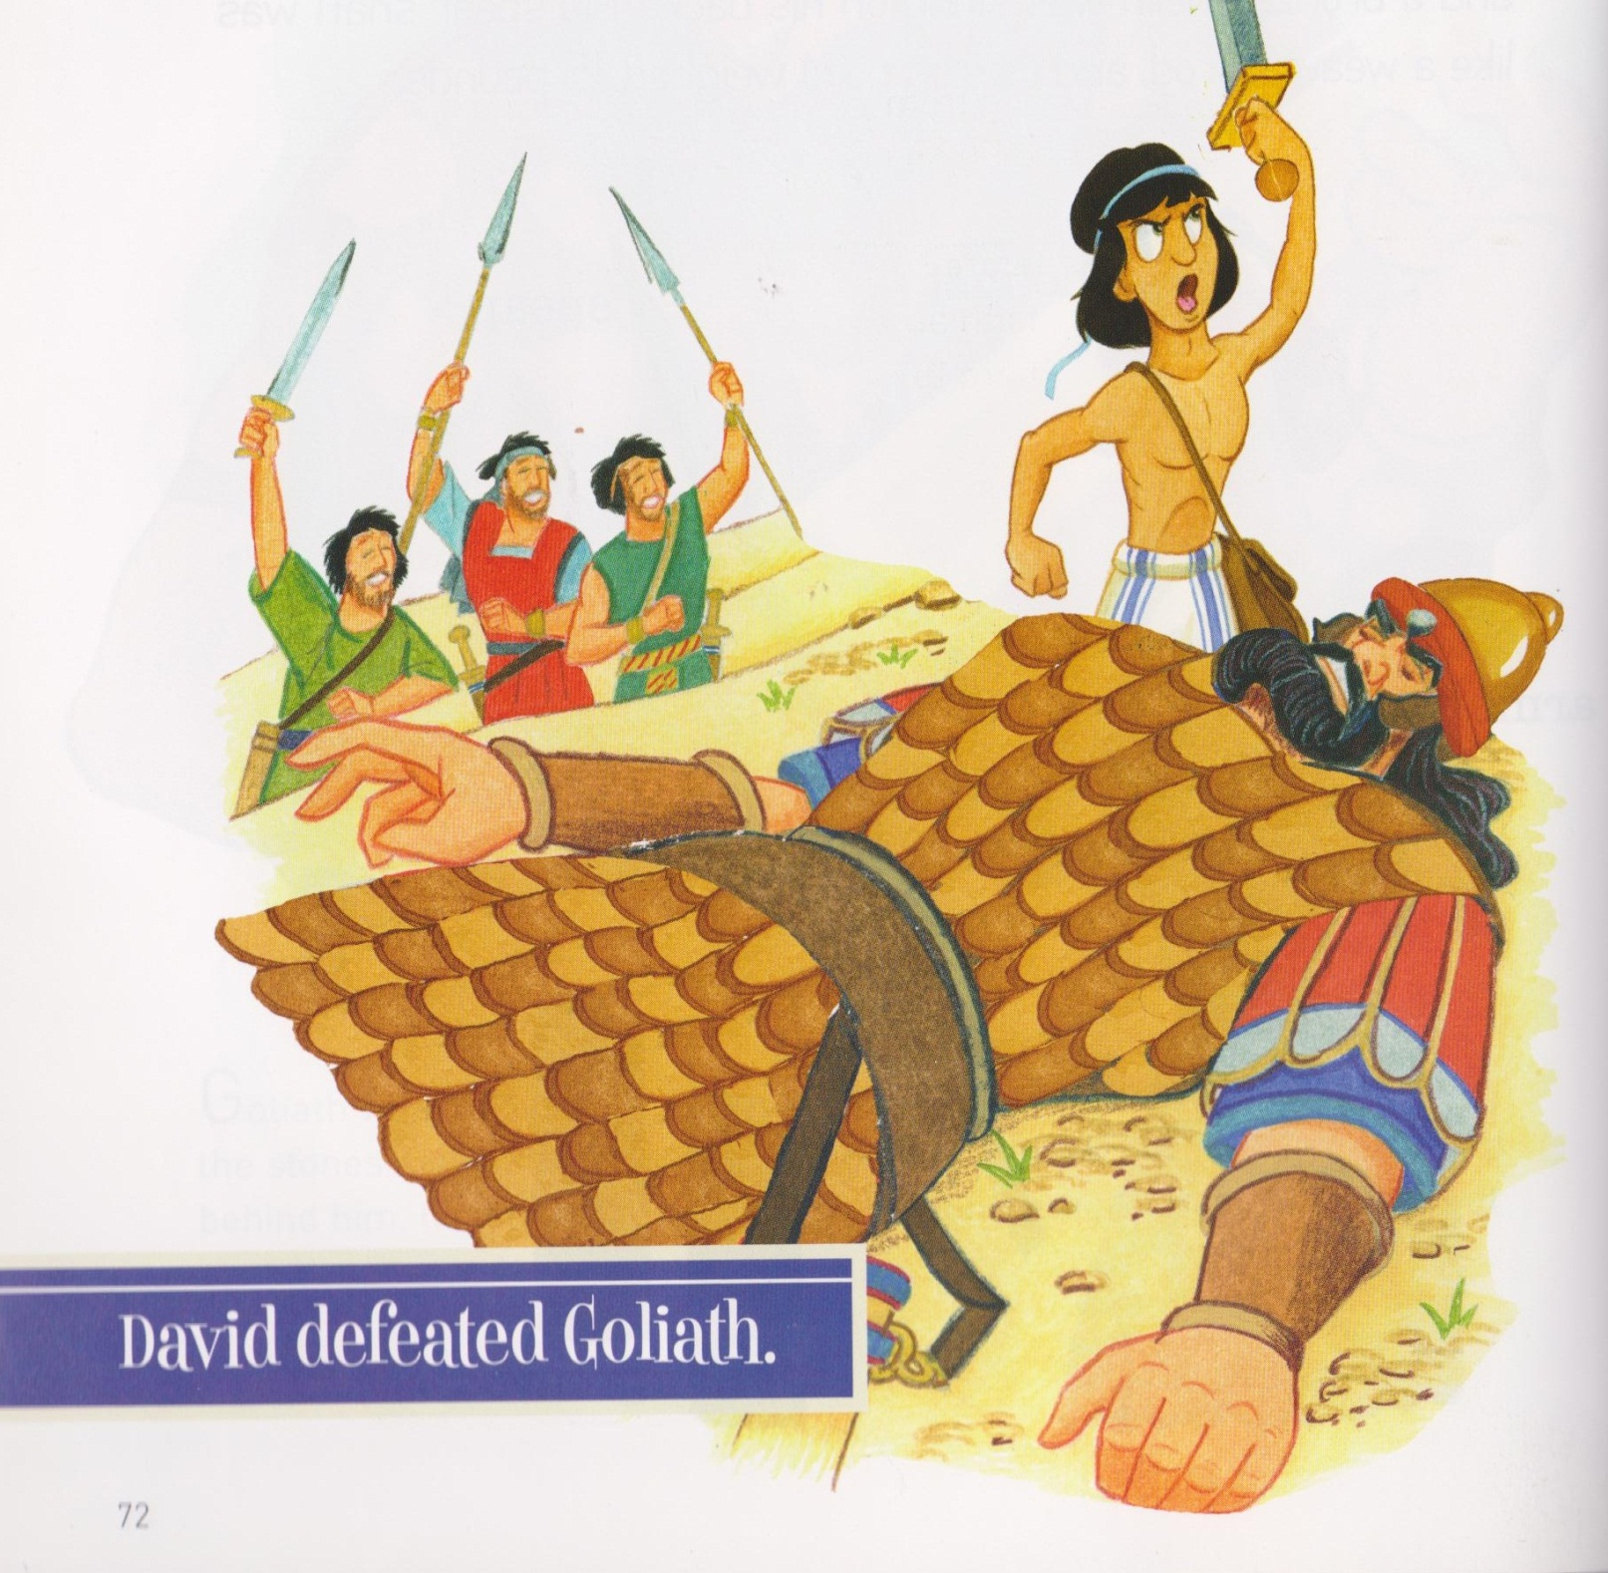

Slide 4
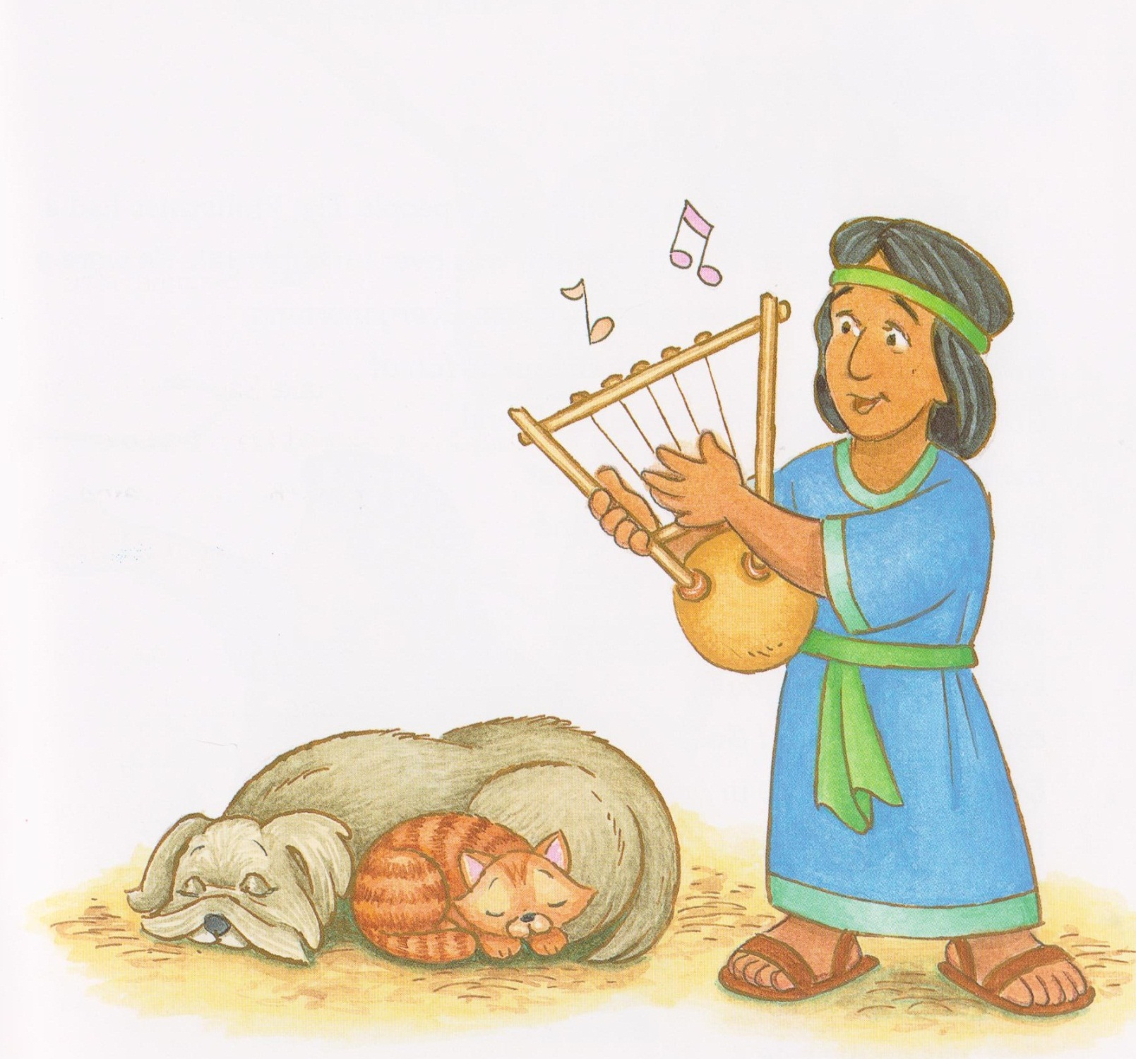
David symbol placed on tree.

Slide 5
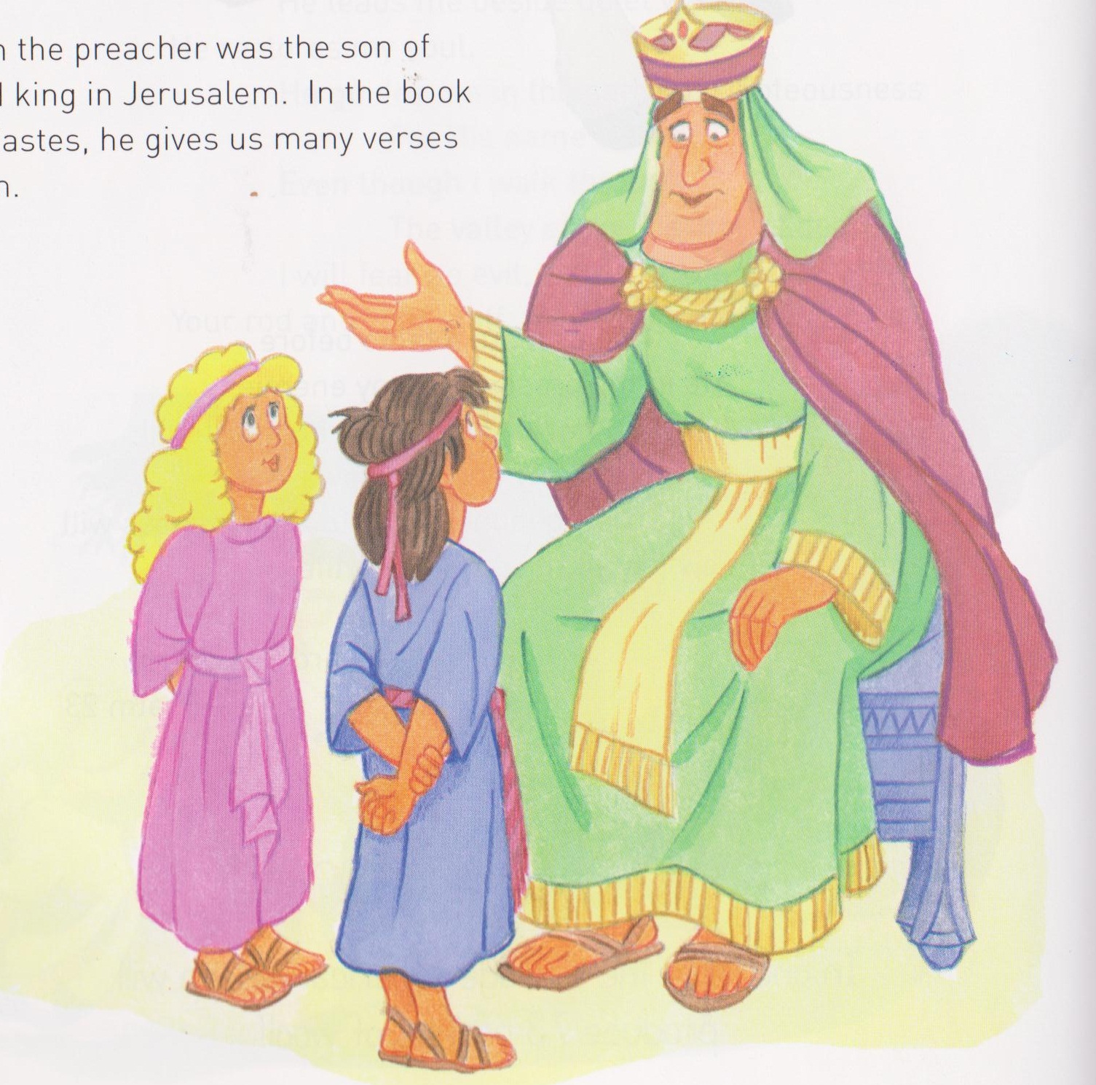
King Solomon
King Solomon symbol placed on tree.

Slide 6
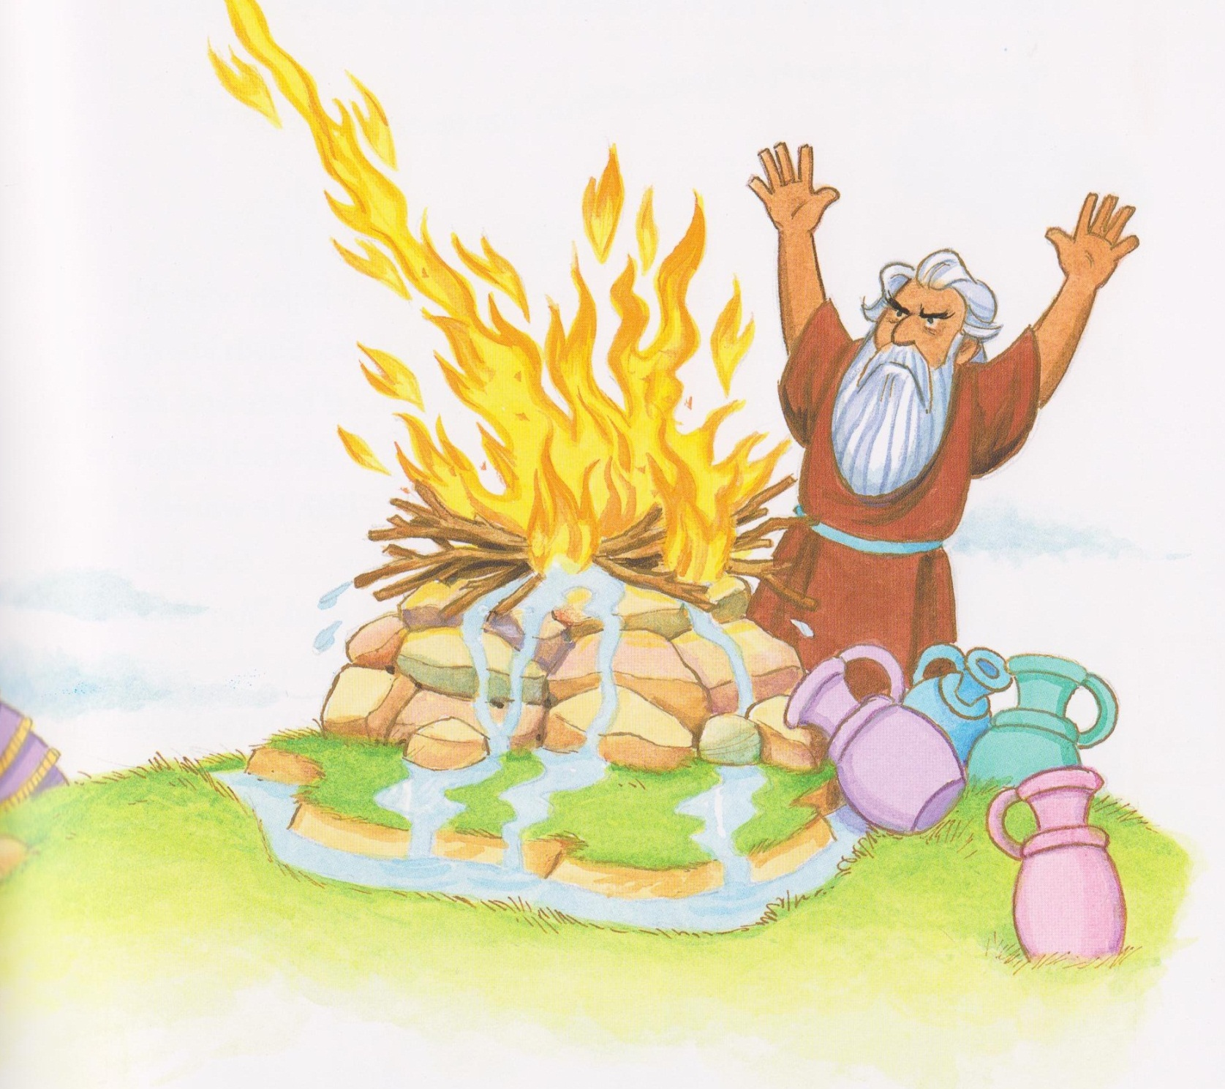
Elijah

Slide 7
Elijah symbol placed on tree.

Slide 8
Little David play on your harp. Allelu allelu
Little David play on your harp. Allelu
Little David play on your harp. Allelu allelu
Little David play on your harp. Allelu
Little David was a shepherd boy
He kept all life and sang for joy
Little David play on your harp. Allelu allelu
Little David play on your harp. Allelu (x2)

Slide 9
Little David was a shepherd boy
He kept all life and sang for joy
Little David play on your harp. Allelu allelu
Little David play on your harp. Allelu (x2)

Slide 10
Mamakankarra help us to stand up and be good. Lord hear us.
Mamakankarra help our leaders to make good choices. Lord hear us.
Mamakankarra help our Prime Minister to look after all people. Lord hear us.
Mamakankarra give the world peace. Lord hear us.
Mamakankarra help our leaders to be strong and wise. Lord hear us.

