Slide 1
Advent Waiting for the coming of Jesus

Slide 2
Week 7 Jonah Ezeckiel Annunciation
Come Lord Jesus (x3)
Come and be born in our hearts.

Slide 3
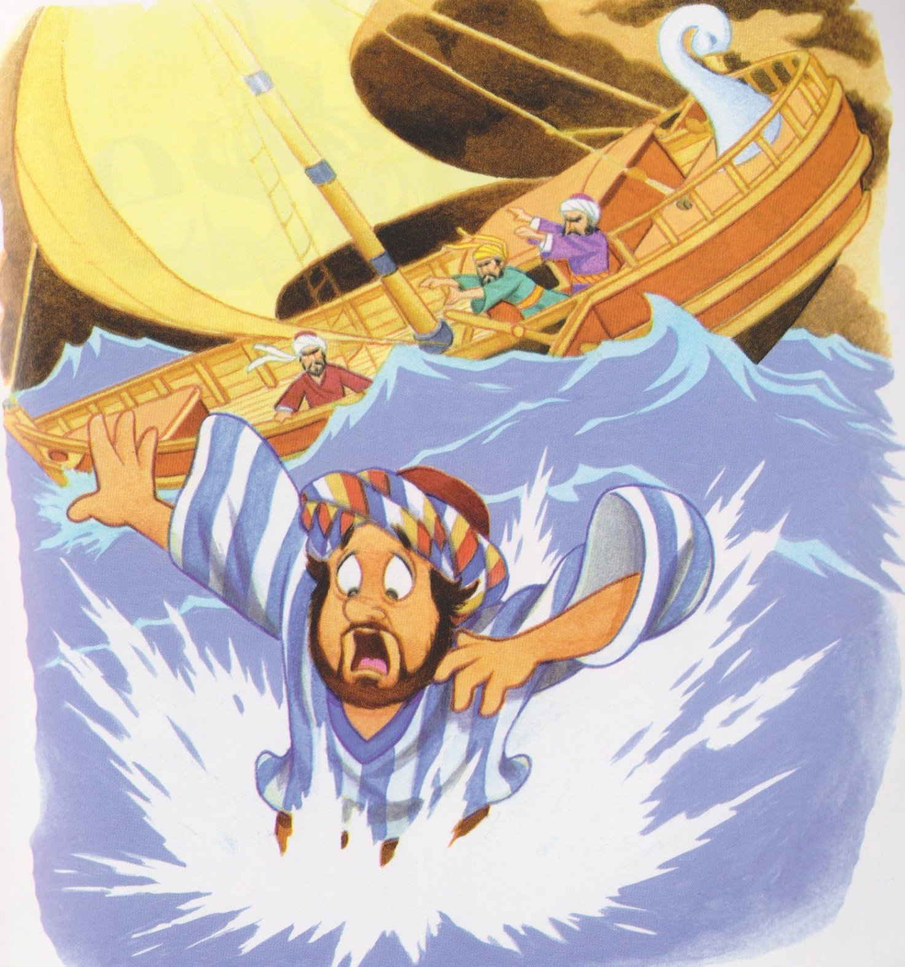

Slide 4
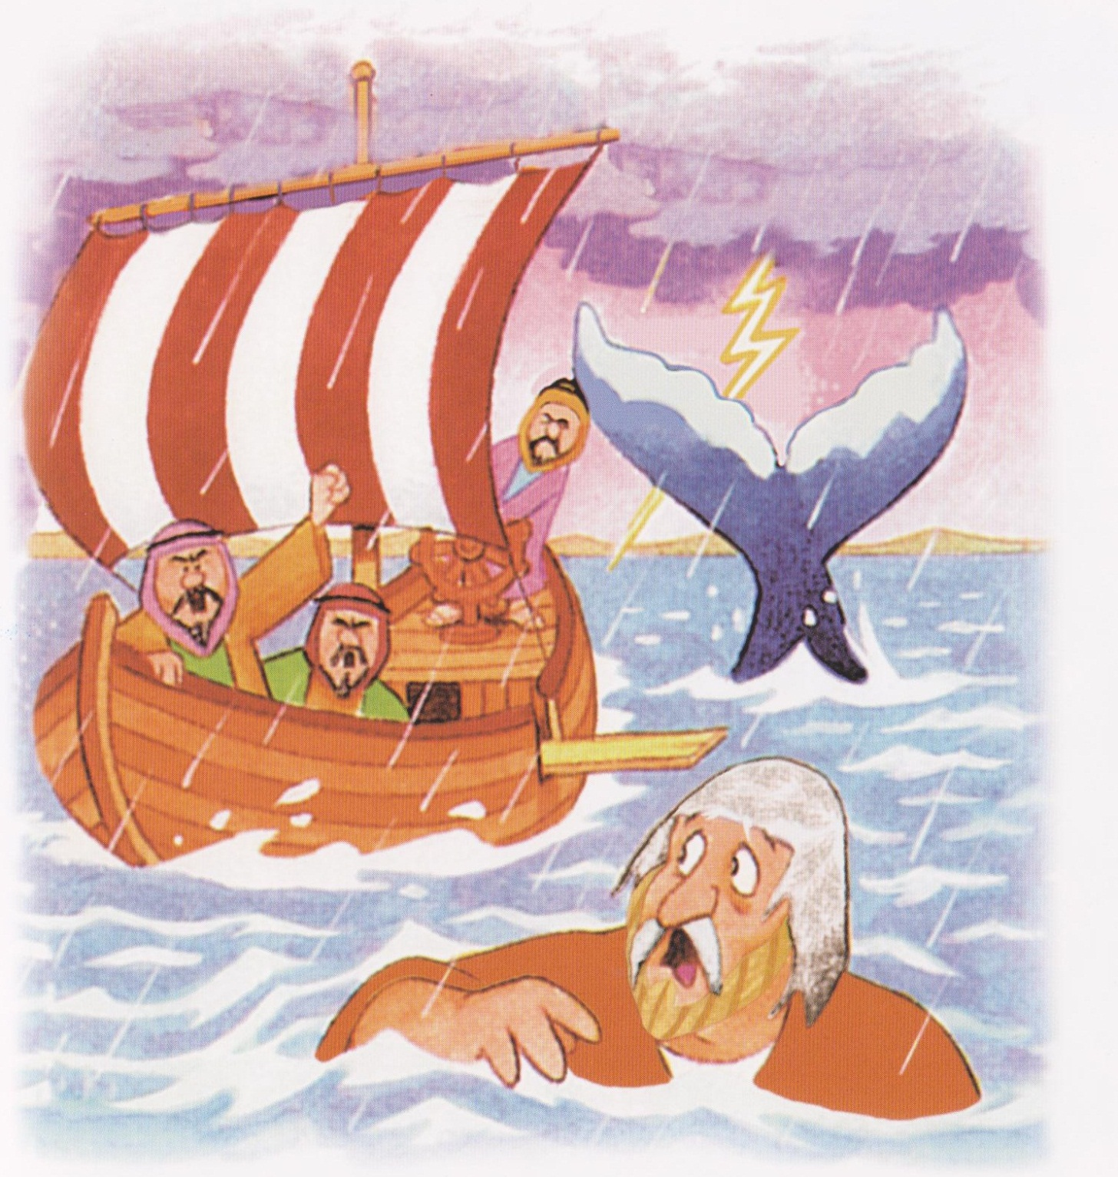

Slide 5
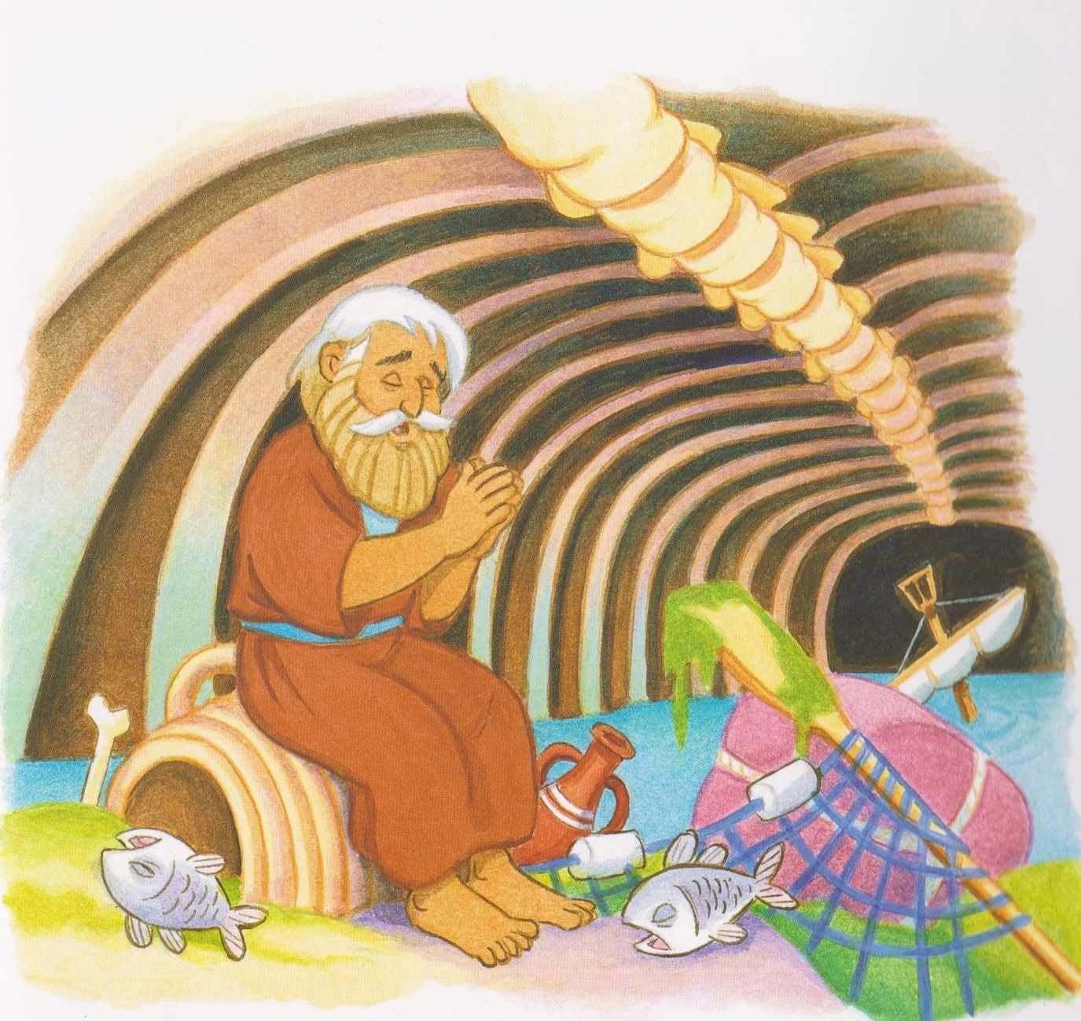

Slide 6
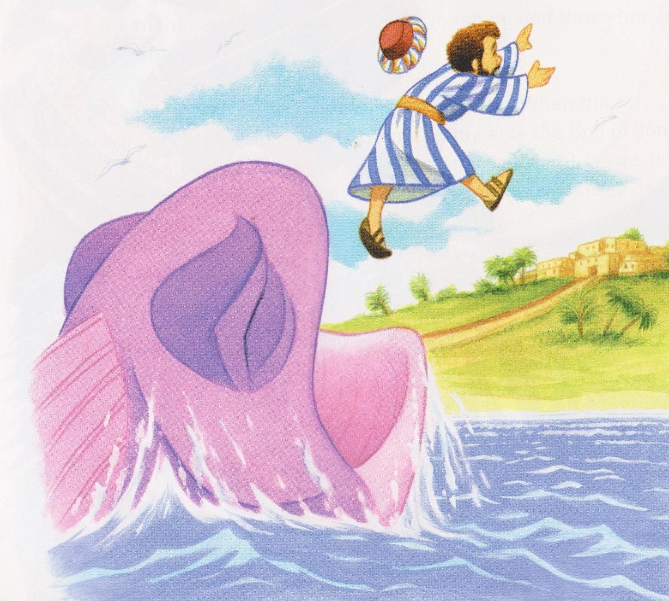
Jonah symbol placed on tree.

Slide 7
Sailor, sailor, sailor afraid, (x2)
Call upon the Lord in your trouble (x2)
And you will be saved.
Call upon the Lord in your trouble (x2)
And you will be saved. Today
Saviour, saviour, saviour alive (x2)

Slide 8
I call upon your name in my troubles (x2)
I call upon your name in my troubles now.
I call upon your name in my troubles (x2)
I call upon your name in my troubles now.
Safer, safer, saviour alive
Saver, saver, saver are saved
Saviour Saviour saviour ALIVE.

Slide 9
Ezeckiel
Ezeckiel symbol placed on tree.

Slide 10
Dem bones, dem bones, dem dry bones,(x3)
Now hear the word of the Lord.
Oh Ezekiel connected dem dry bones (x3)
Now hear the word of the Lord.
The tail bone connected to the flipbone,
The flipbone connected to the heelbone
The heel bone connected to the ankle bone
Now hear the word of the Lord.

Slide 11
The ankle bone connected to the legbone
The legbone connected to the knee bone
The kneebone connected to the thighbone
Now hear the word of the Lord.
The thigh bone connected to the hip bone
The hipbone connected to the backbone
The backbone connected to the shoulderbone
Now hear the word of the Lord.

Slide 12
The handbone connected to the wristbone
The wristbone connected to the armbone
The armbone connected to the elbone
Now hear the word of the Lord
The elbow connected to the shoulderbone
The shoulderbone connected to the neckbone
The neckbone connected to the headbone
Now hear the word of the Lord

Slide 13
Dem bones, dem bones, gonna walk around (x3)
Now hear the word of the Lord
Dem bones, dem bones, dem dry bones,(x3)
Now hear the word of the Lord.

Slide 14
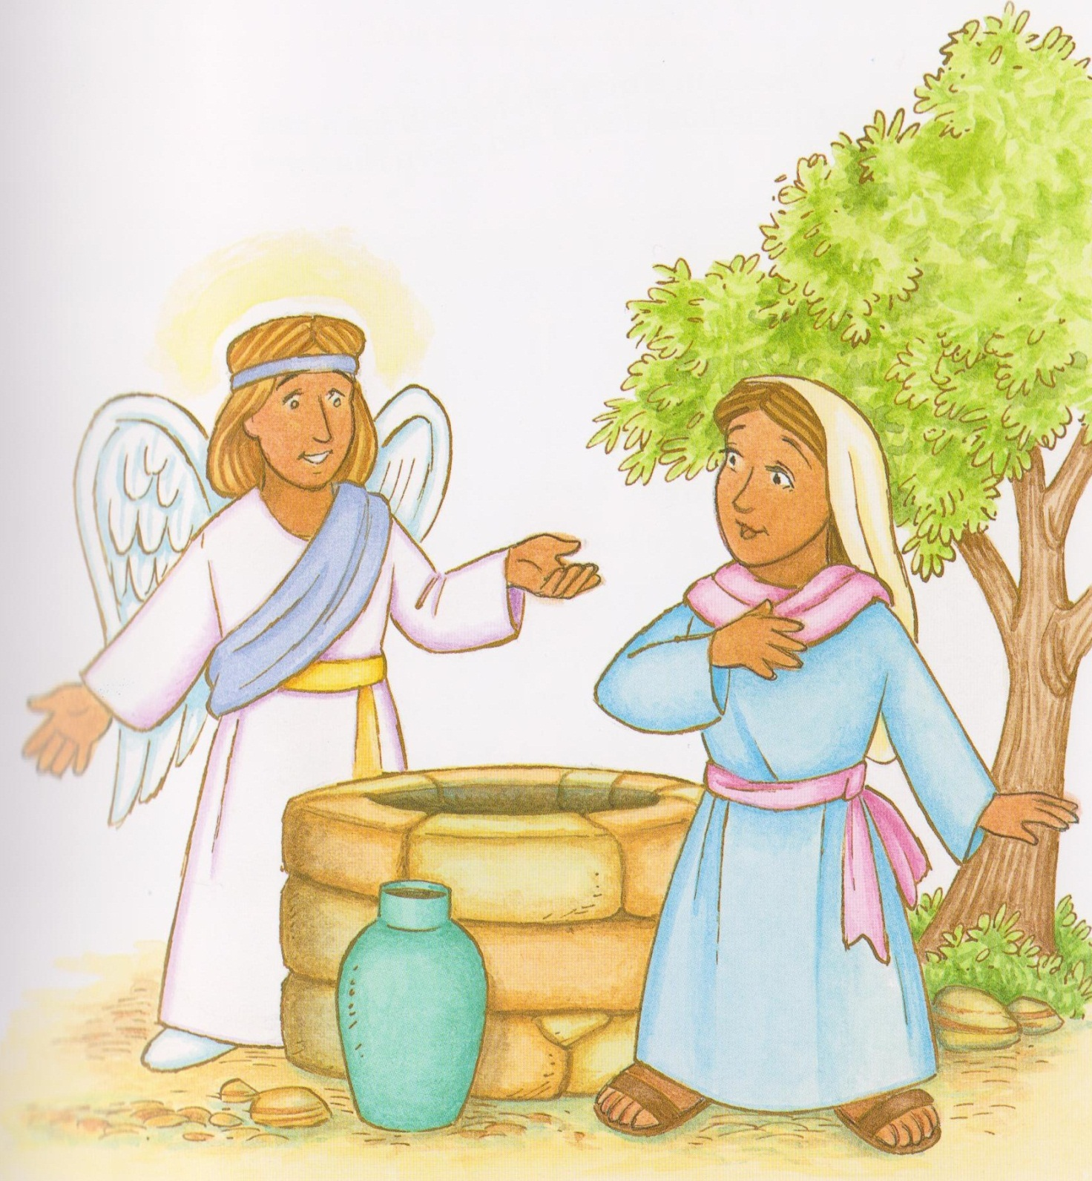

Slide 15
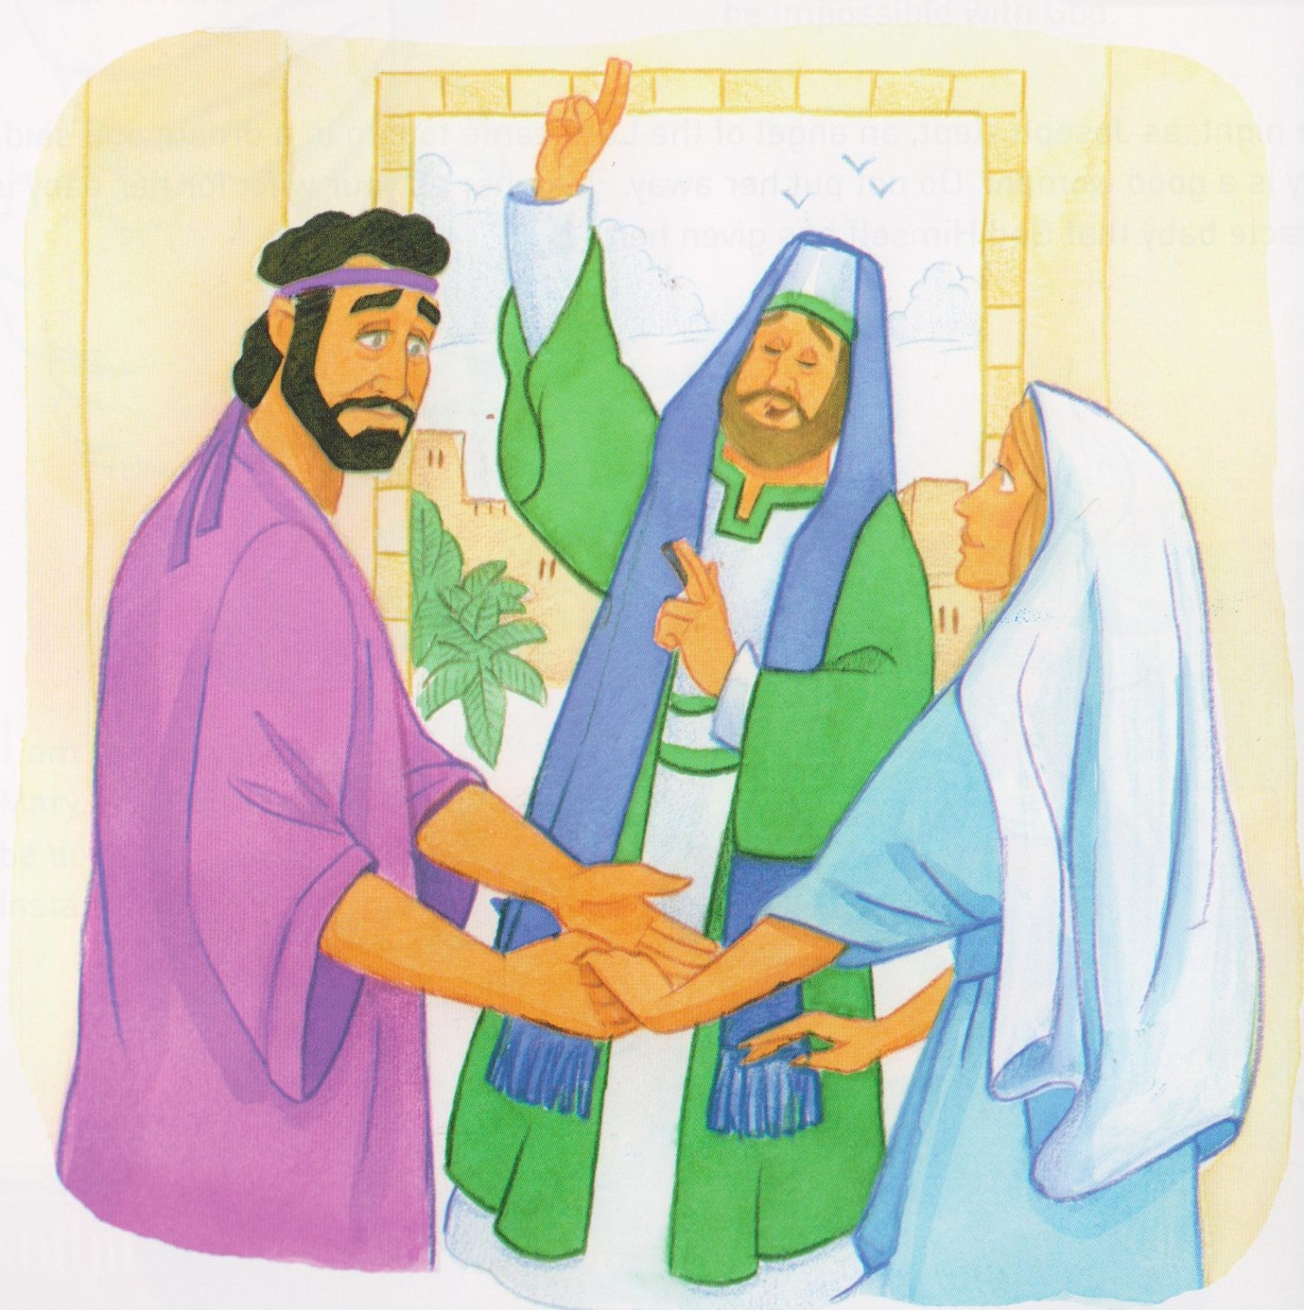
Symbol for the annunciation placed on tree.

Slide 16
Mamakankarra help us to listen to our teachers. Lord hear us.
Mamakankarra help us to listen to manangku at mass. Lord hear us.
Mamakankarra help us to prayer often so we will know what you want us to do. Lord hear us.
Mamakankarra help us to think before we act. Lord hear us.
Mamakankarra help us to get ready for the coming of Jesus by praying. Lord hear us.

