Slide 1
Advent Waiting for the coming of Jesus

Slide 2
Week 8 Mary and Joseph Baby Jesus is born Wise men follow the star
Come Lord Jesus (x3)
Come and be born in our hearts

Slide 3
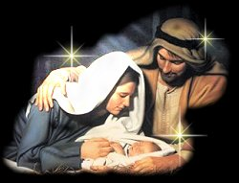

Slide 4
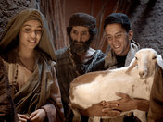

Slide 5
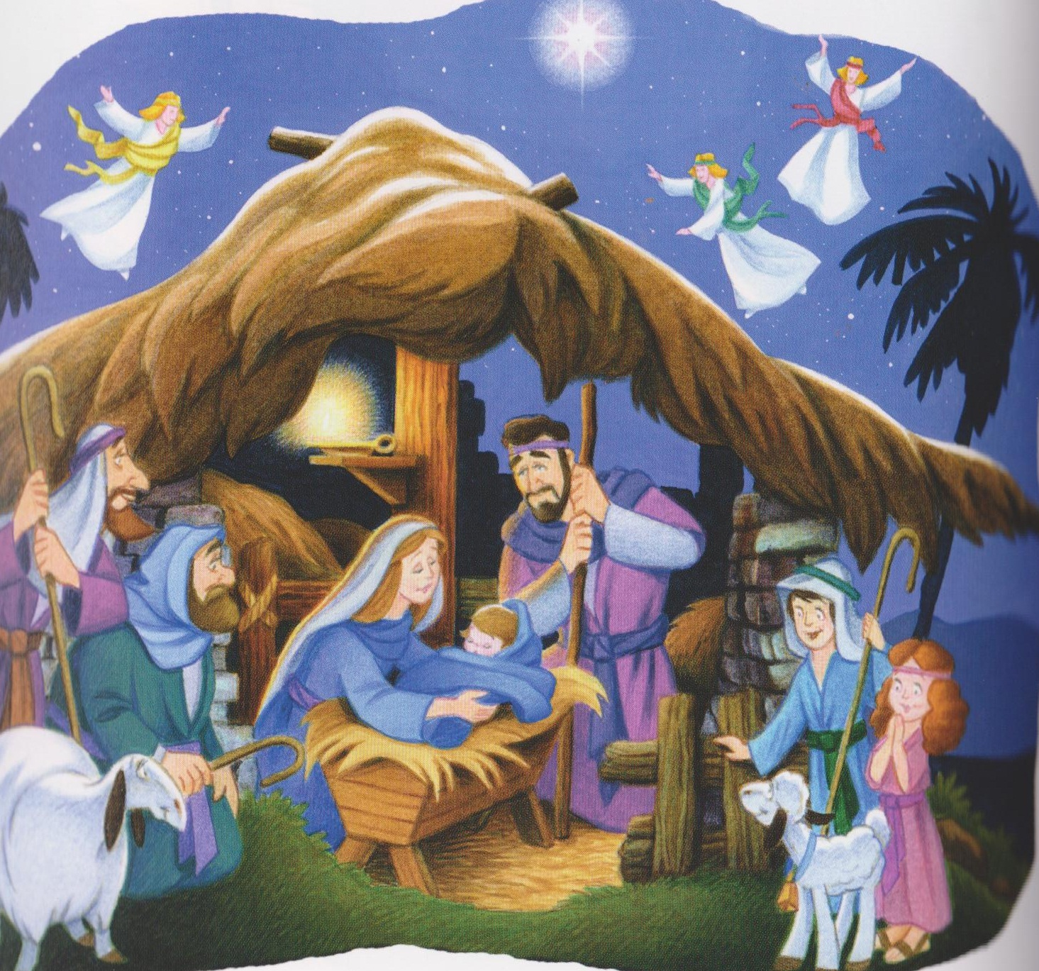
Mary, Joseph and the baby Jesus symbols placed on tree.

Slide 6
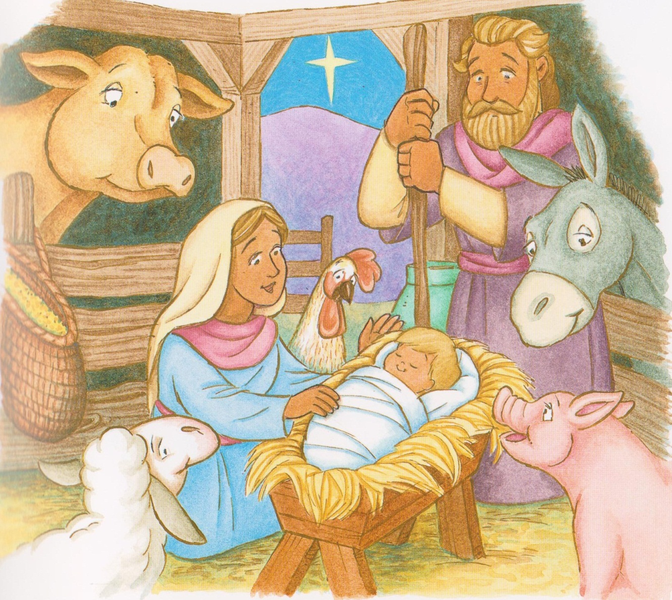
Away in the Manger no crib for a bed
The little lord Jesus lay down his sweet head
The stars in the sky looked down where he lay
The little lord Jesus asleep on the hay

Slide 7
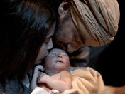
The cattle are lowing the baby awake
The little lord Jesus no crying he makes
I love you lord Jesus look down from the sky
And stay by my cradle till morning is nigh.

Slide 8
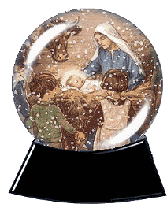
Be near me lord Jesus I ask you to stay
Close by me forever and love me I pray
Bless all the dear children in they tender care
And fit us for heaven to live with you there.

Slide 9
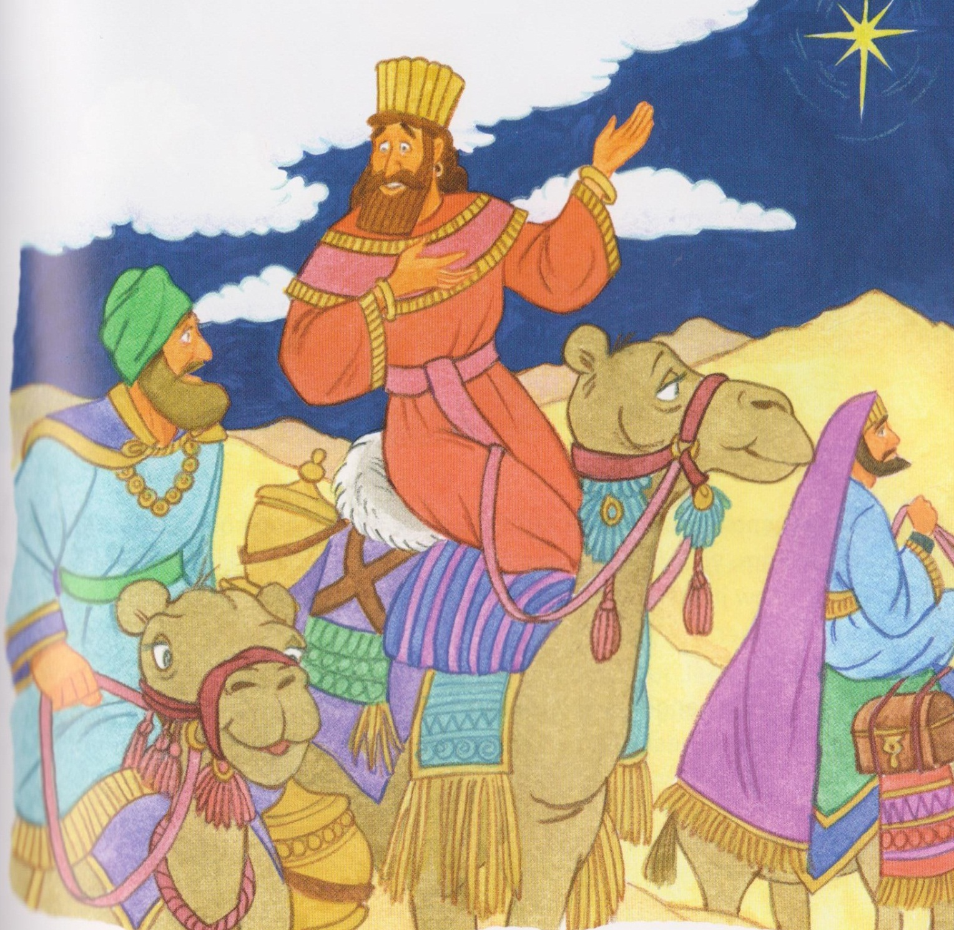
Wise men symbolsplaced on tree.

Slide 10
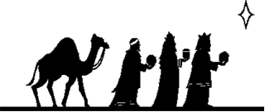

Slide 11
Behold that star, behold that star up yonder
Behold that star, it is the star of Bethlehem.
Behold that star, behold that star up yonder
Behold that star, it is the star of Bethlehem.
There was a room found in the inn
It is the star of Bethlehem
For him who was born free from sin
It is the star of Bethlehem.

Slide 12
Oh Behold that star, behold that star up yonder
Behold that star, it is the star of Bethlehem.
The wisemen came down from the east
It is the star of Bethlehem.
To worship him the prince of peace.
It is the star of Bethlehem.
Oh Behold that star, behold that star up yonder
Behold that star, it is the star of Bethlehem.

Slide 13
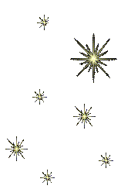
A star shone forth upon the night
It is the star of Bethlehem.
Now angel hosts are welcome wide
It is the star of Bethlehem
Oh Behold that star, behold that star up yonder
Behold that star, it is the star of Bethlehem.

Slide 14
Mamakankarra help us get ready for Jesus’ coming. Lord hear us.
Mamakankarra help us to do good things so we will be ready for Christmas. Lord hear us.
Mamakankarra help us be good to the poor people just as people were kind to you. Lord hear us.
Mamakankarra help us love our mothers and father, and all our family. Lord hear us.
Mamakankarra help us to care about all people just like you did. Lord hear us.

