Slide 1
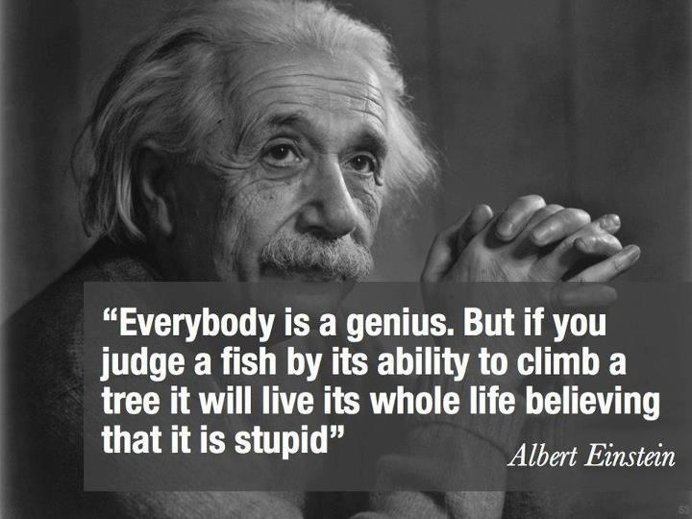
ASSESSMENT IN RE

Slide 2
RE ASSESSMENT: CHALLENGES
Not recognising that there is a valid
teaching and learning required in RE
Not focusing on specific knowledge and understanding – i.e. focus is on the affective, subjective and/or invalid content
Mimic/recall details –Lower order thinking
A limited range of assessment types and/or purposes
Assessment?! Anonymous self assessment?!
Lack of rigour in the marking process
Sufficient points of discrimination?

Slide 3
EFFECTIVE ASSESSMENT PRACTICE IN RELIGIOUS EDUCATION ~ TASK
Unit of Work: focus or content of learning – specific Catholic content
Teaching: the process for facilitating learning
Task: how we capture the learning

Slide 4
KEY ELEMENTS FOR ASSESSMENT
Syllabus
Teaching
Task
Marking key
Marking
Feedback

Slide 5
STUDENT TASK: YEAR ONE
Students understand that by listening to stories people can learn about Jesus and how to live like God.

Slide 6
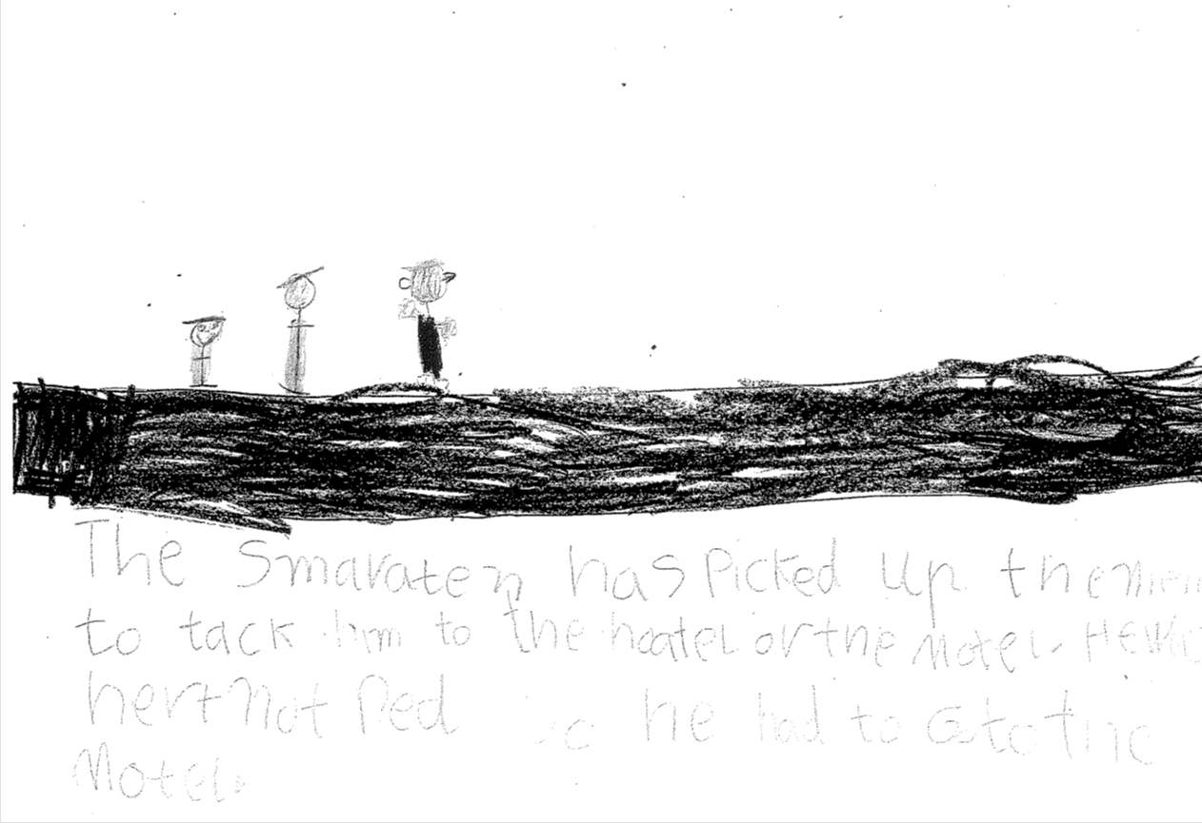

Slide 7
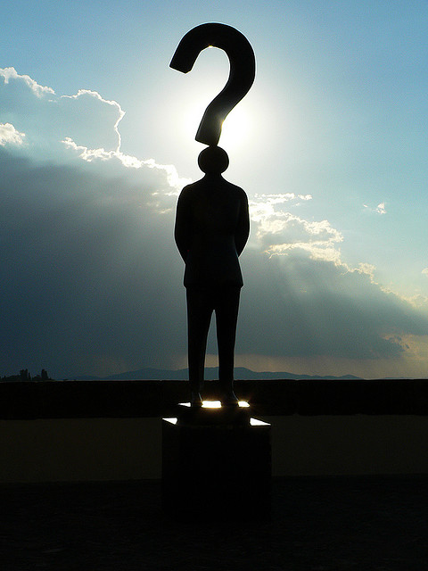
STUDENT TASK: CRITERIA
What criteria should be used to inform the “marker” of this assessment?

Slide 8
STUDENT TASK: CRITERIA
Control of process: writing, drawing – integral to the task
Recall of story – rubric asks for a key idea
Matching the story, picture and words

Slide 9
STUDENT TASK: CRITERIA
Students understands that by listening to stories people can learn about Jesus and how to live like God
Listening to stories
How to live like God
Students illustrate one of the key ideas in the story of ‘the Good Samaritan’

Slide 10
STUDENT TASK: REFINEMENT
There is recall – of the story
Is this enough – recall – higher order?
And there is recall of the message
Care for people
Some people don’t want to care for others
In Jesus' time the Samaritans were a group people didn’t want to care for

Slide 11
STUDENT TASK: CRITERIA
The student articulates (orally) what they have drawn – there may be more behind what they have drawn/written
What is Jesus trying to tell people – oral component – learn about Jesus and how to live like God

Slide 12
HOTS IN RE

Slide 13
CONSIDER…
What assessment task do you have in mind?
How will the teaching look and what will it aim to do?
What is the task?
What are the criteria you will use when marking
How will this be marked?
Review and align

Slide 14
NETWORKING AND SHARING

Slide 15
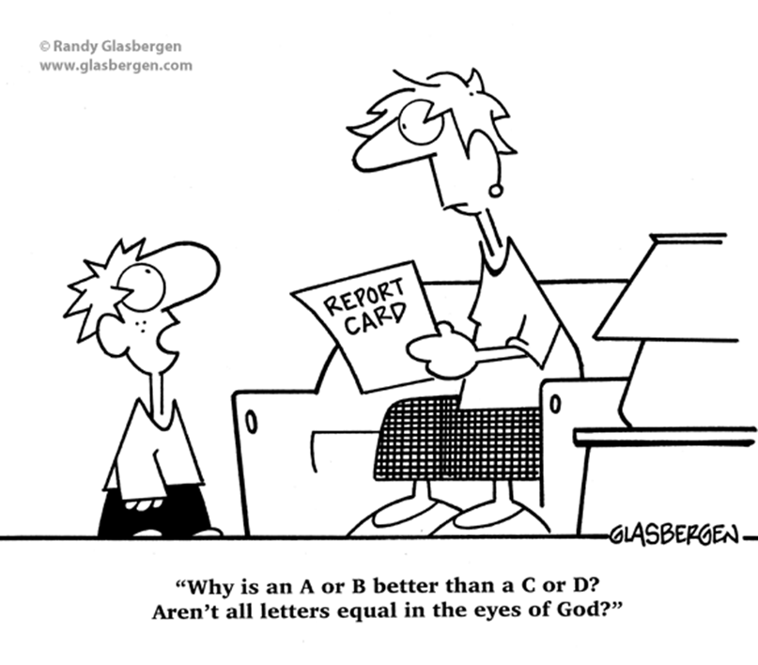
REPORTING IN RE

Slide 16
THE RELIGIOUS EDUCATION LEARNING AREA
The outcomes in the Religious Education learning area are interrelated and describe learning that occurs from Kindergarten to Year 12.
Learning and teaching programs should allow students to learn and achieve essential knowledge, understandings, values and skills in an integrated manner.

Slide 17
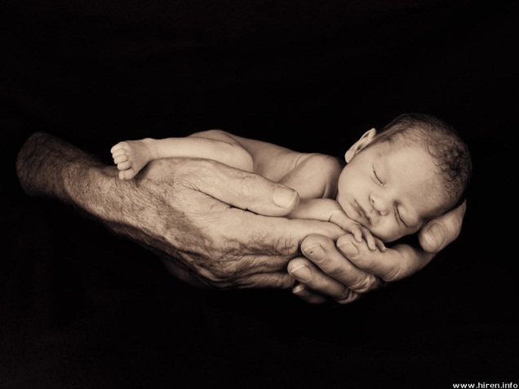
RELIGIOUS EDUCATION
OUTCOMES
DISCOVERING GOD
People come to discover God
through experiences in creation
Notes:
Look at p. 86 in RELAO book.

Slide 18
God’s act of self-revelation began with creation.
People are drawn to the Creator of the universe as they come to wonder about the beauty and power of creation.
People are created to relate with the Creator.
People explore their deeper questionings and yearnings.
Explore the common quest for meaning, truth, happiness and God at work in the lives of all people, including other religions.

Slide 19
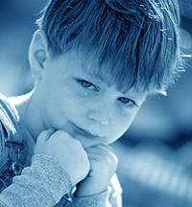
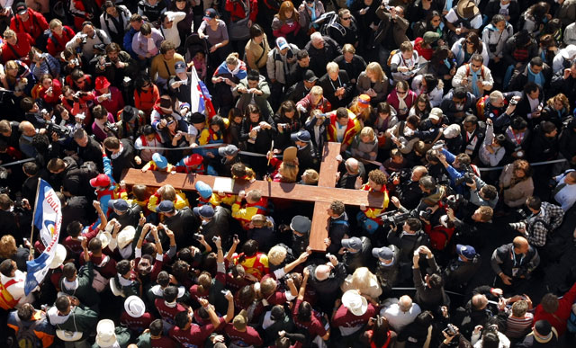
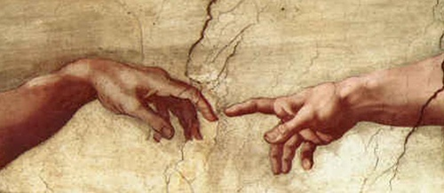
DRAWING ON HUMAN EXPERIENCE
The human experience of the Christian message and its significance
Notes:
Look at p. 88 in RELAO book.

Slide 20
Reflect on the experiences in theirs and others lives.
Relate Catholic beliefs and practices to real life situations and experiences.
Give Gospel meaning to the questions and experiences of life.

Slide 21
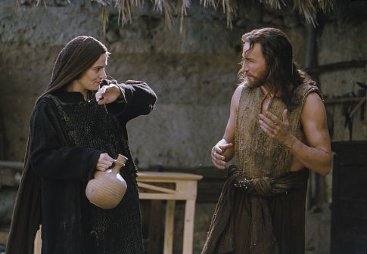
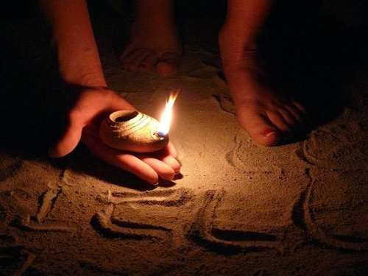
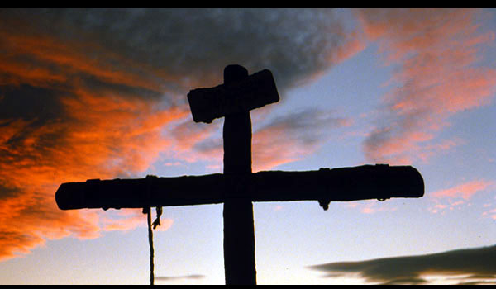
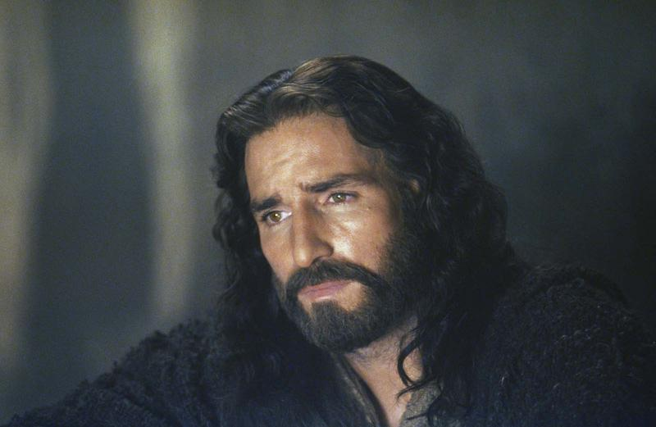
KNOWING JESUS
The person of Jesus is the model for living out the Christian mission in the world
Notes:
Look at p. 90 in RELAO book.
Know the life and ministry of Jesus.
Jesus taught and demonstrated the commandment to love.
This commandment is shown through the Christian values of justice, compassion, truthfulness and respect.
Understand what it means to develop a Gospel vision of society.
**Know the seven sacraments of the Church and understand how people can draw on the fruits and effects of sacraments throughout their lives.
**Sacrament of the Eucharist is at the centre of Christian life.

Slide 22
Know the life and ministry of Jesus.
Jesus taught and demonstrated the commandment to love. - shown through the Christian values of justice, compassion, truthfulness and respect.
Understand what it means to develop a Gospel vision of society.
Know the seven sacraments of the Church and understand how people can draw on the fruits and effects of sacraments throughout their lives.
Sacrament of the Eucharist is at the centre of Christian life.

Slide 23
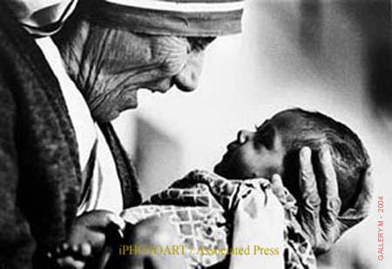
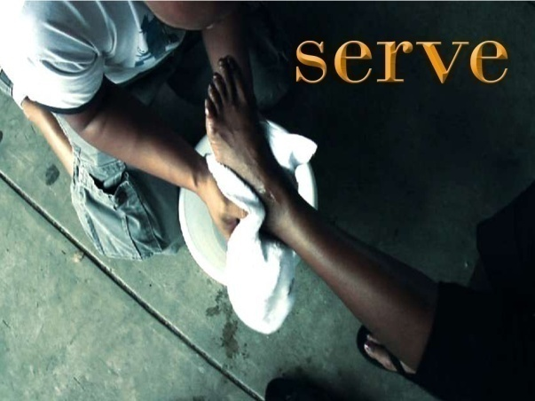
LIVING LIKE JESUS
Catholics are empowered to live like Jesus the Saviour as they draw on the power of God’s Spirit
Notes:
Look at p. 92 in RELAO book.

Slide 24
Jesus Christ is the fulfilment of God’s promise of a Saviour.
The Life, death and resurrection of Jesus is the message of Salvation.
Scripture and Tradition in the life of the Church today is reflected in the leadership and authority of the Church.
Meaning and significance of the commandments – love of God, neighbour and self.
Role of Mary and saints.
Understanding the meaning of Christian vocation.

Slide 25
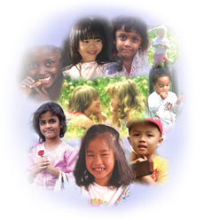
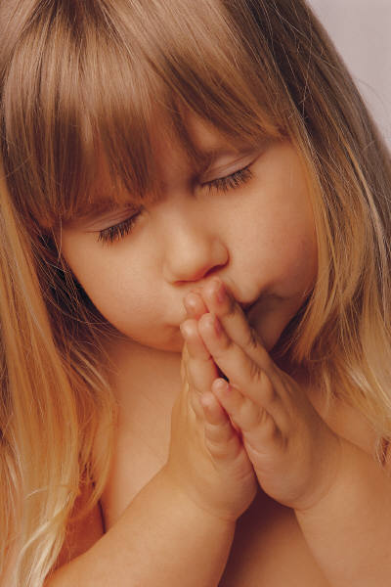
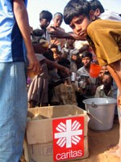
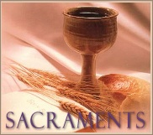
CATHOLIC PRACTICES
Read and apply Scripture to life and to participate in Catholic ritual and prayer.
Notes:
Look at p. 94 in RELAO book.
Bible and how it was written – literary forms and audience.
God inspired writers of the Bible.
Word of God – welcomed, believed, celebrated, lived and prayed by the Church
**Meaning and purpose of prayer, different forms of prayer tradition of the Catholic Church
**Essential elements of sacramental rites and how to participate in them.
**Symbols and gestures.
Scripture and Tradition (Creed, Sacraments, Life in Christ and Prayer)

Slide 26
Bible and how it was written – literary forms
and audience.
God inspired writers of the Bible.
Word of God – welcomed, believed, celebrated, lived and prayed by the Church
Meaning and purpose of prayer - different forms of prayer tradition of the Catholic Church
Essential elements of sacramental rites and how to participate in them.
Symbols and gestures.
Scripture and Tradition (Creed, Sacraments, Life in Christ and Prayer)

Slide 27
UNDERSTANDING THE
RE UNITS
A Begins with the students personal experience of God through creation
B Moves to Jesus as our model and guide and through his offer of salvation we can be empowered to live like him
C Ends with the Christian response through the Sacraments, prayer, scripture and worship
Discovering God
Drawing on Human Experience
Knowing Jesus
Living like Jesus
Catholic Practices

Slide 28
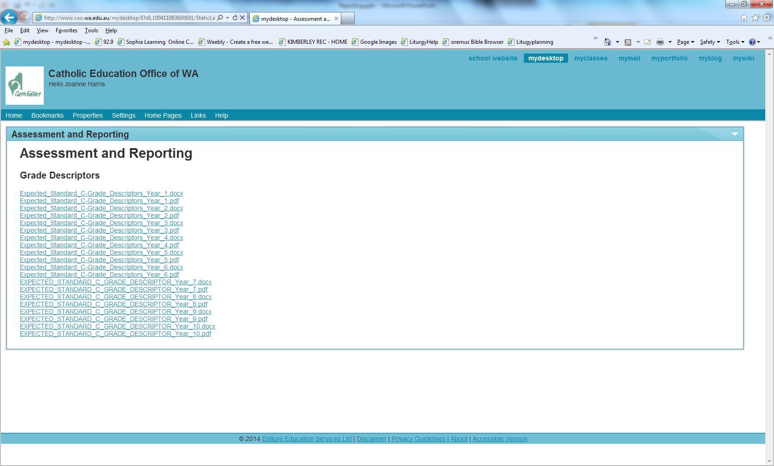
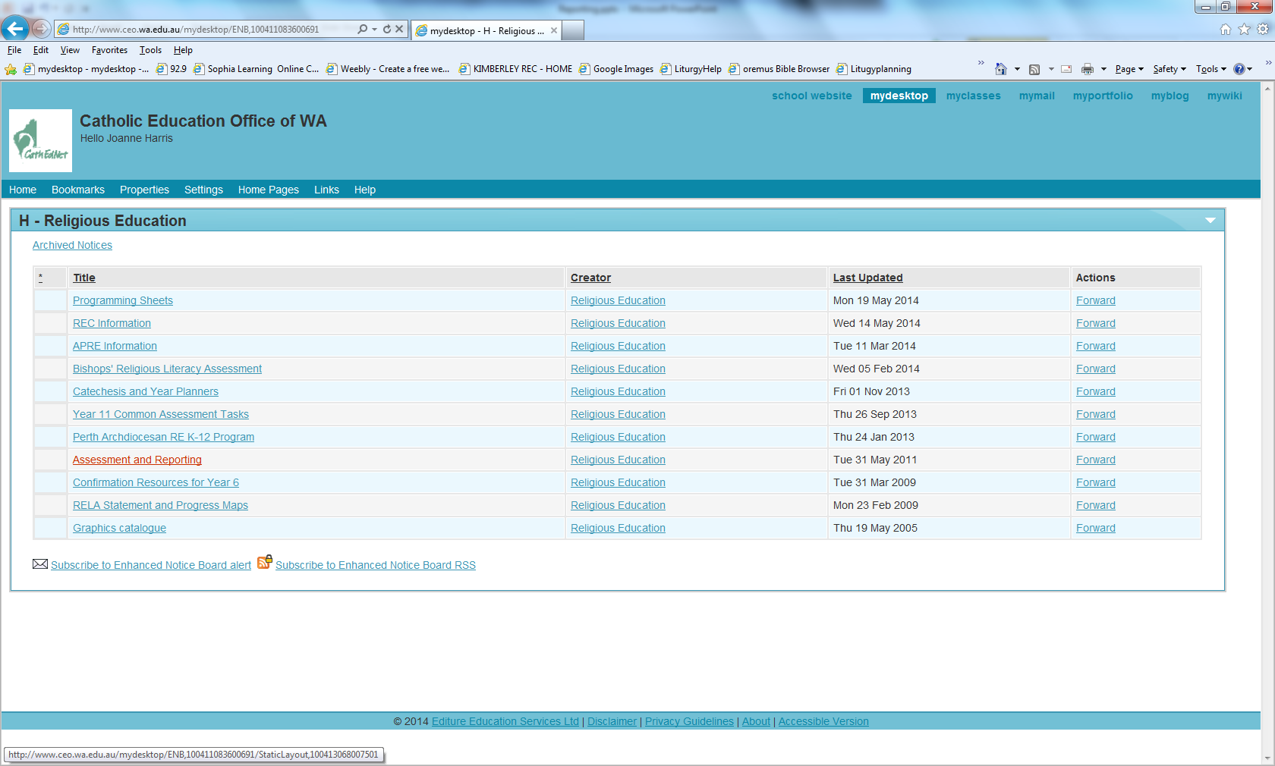
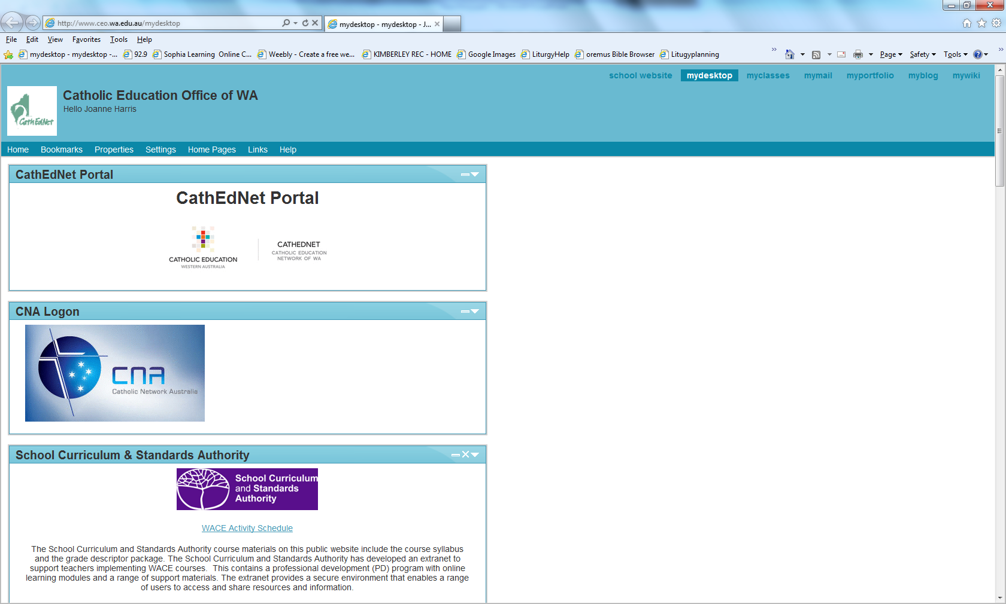
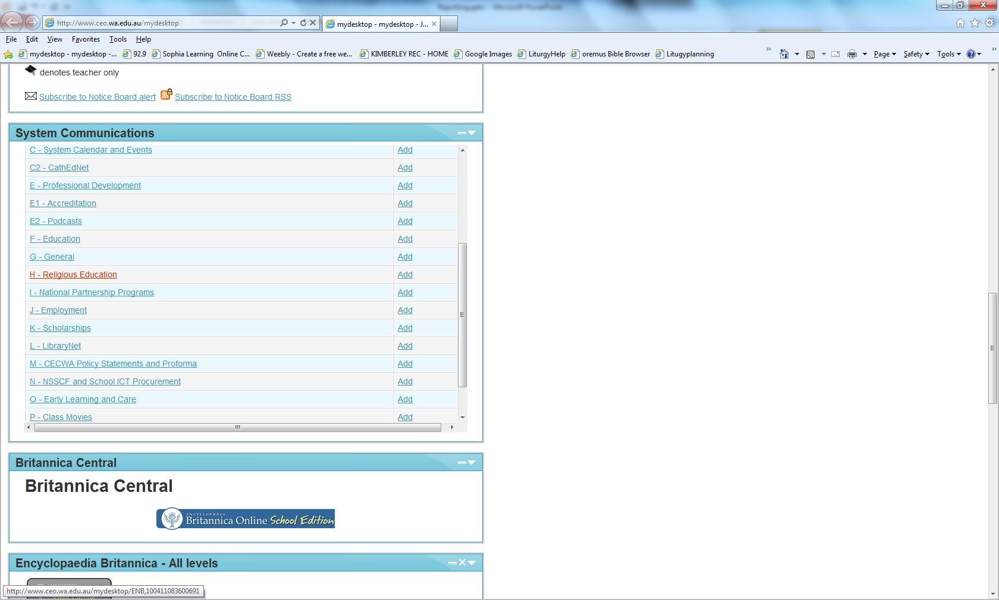
C-GRADE DESCRIPTORS

Slide 29
Grade | Brief description | Abbreviated description | Elaborated description (DoE)
A | Well above Standard | WAS | The student demonstrates achievement that has greatly exceeded the expected standard.
B | Above standard | AS | The student demonstrates achievement that exceeds the expected standard.
C | At standard | S | The student demonstrates achievement at the expected standard.
D | Below standard | BS | The student demonstrates achievement below the expected standard.
E | Well below standard | WBS | The student demonstrates achievement below the minimum expected for this year level.

Slide 30
It is important to note that the SCSA reporting policy indicates that the allocation of a grade for an individual student should describe the level of achievement that is expected for their year level at that point in time. Students do not need to be working ‘above their year level’ to achieve an ‘A’ grade. Students who are able to demonstrate an ‘Excellent’ level of achievement having been taught the curriculum content of that year level should be allocated an ‘A’ grade. This information can be found in ‘Frequently Asked Questions’ on the SCSA Curriculum and Assessment Outline: http://k10outline.scsa.wa.edu.au/Resources/faqs

Slide 31
RE COMMENTS
While there may be a correlation between some students behaviours and achievement of outcomes,
behaviour and achievement should be reported separately and
comments should be in a language parents and students can understand …
comments should avoid …. a description of a student’s faith development.
(Reporting Guidelines for Catholic Primary Schools)

Slide 32
WHERE TO GET RE COMMENTS FROM

Slide 33
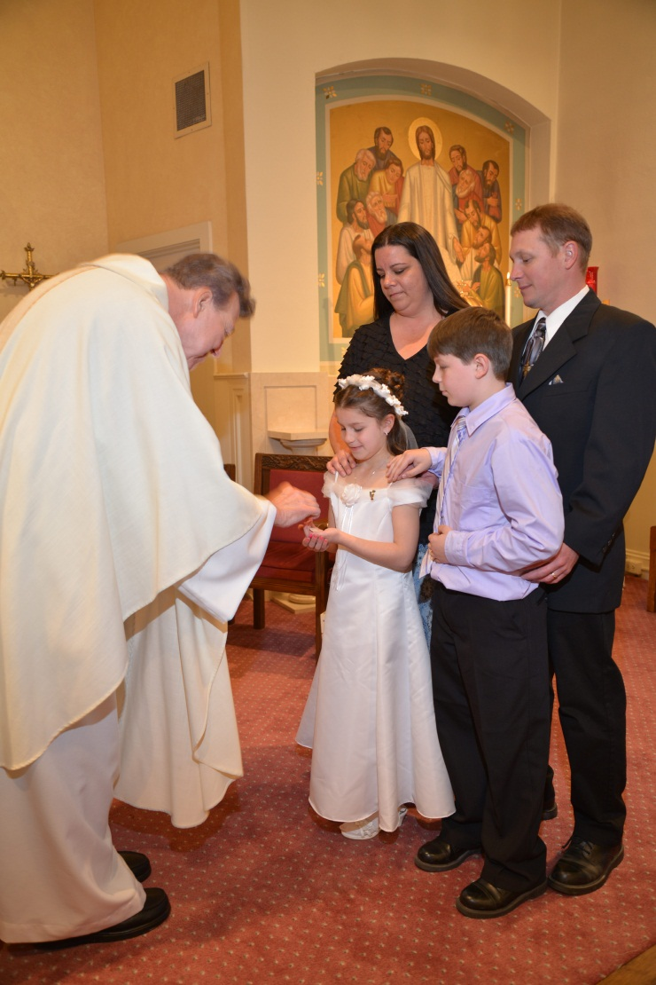
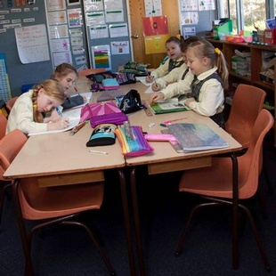
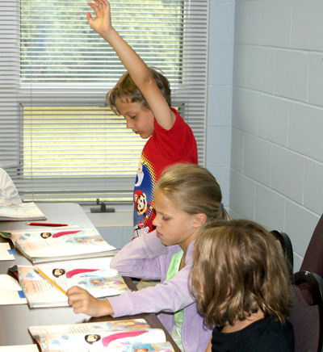
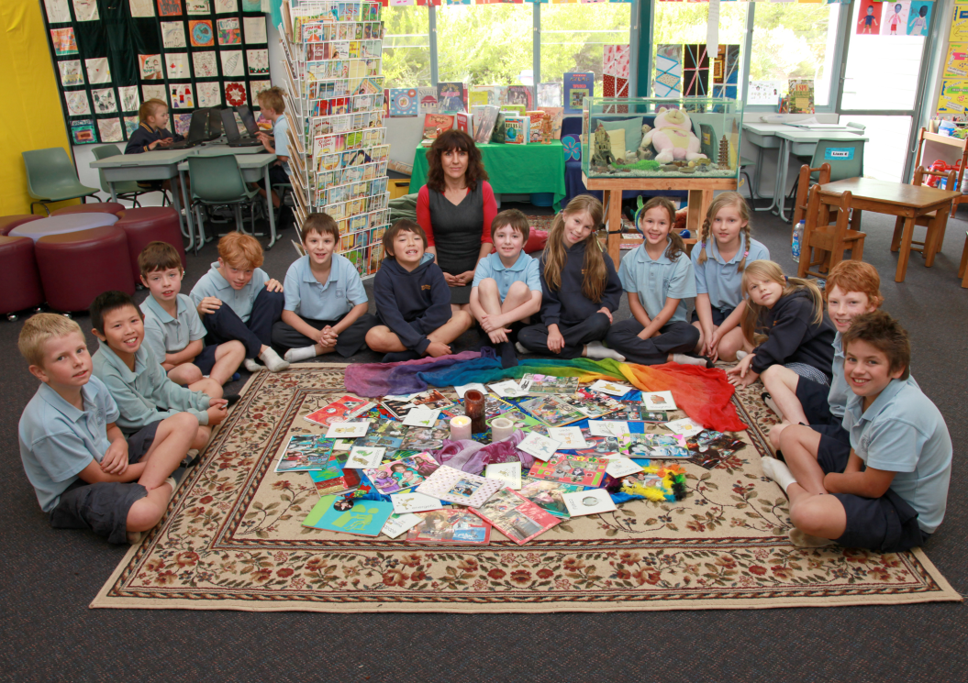
RE vs CATECHESIS
Notes:
In different small groups (chosen by coloured shapes on prayer booklet: 5 groups of 3), participants sort report comments into acceptable and unacceptable comments. Share with whole group.

