Slide 1
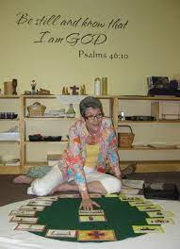
How to use this resource
This resource is to use when presenting the Eucharist to students in a visual Godly Play way.
Seat students around a white round tablecloth.
Place The Eucharist card at the top of the tablecloth, closest to you and explain that today we are going to look at the parts of the Eucharist/Mass.
Place the Last Supper card in the centre of the tablecloth and make the connection between the Last Supper and the Eucharist.
Then place The Liturgy of the Word and the Liturgy of the Eucharist cards down on the table cloth roughly where they will be in the ordering of the Eucharist (generally at 1 o’clock and 7 o’clock on the table cloth) and discuss the 2 parts of the Eucharist/Mass.
Then place the parts of each liturgy of the Mass down in order along the edge of the cloth and speak to each. Note, the numbering on the bottom right of the slides indicates the year level.
Note that the Eucharist is in a circle, because then we go out and live what we have heard and taken in and then come back for more sustenance.
Please note, it is much better to use photos from your own school Masses for the cards.

Slide 2

the eucharist

Slide 3
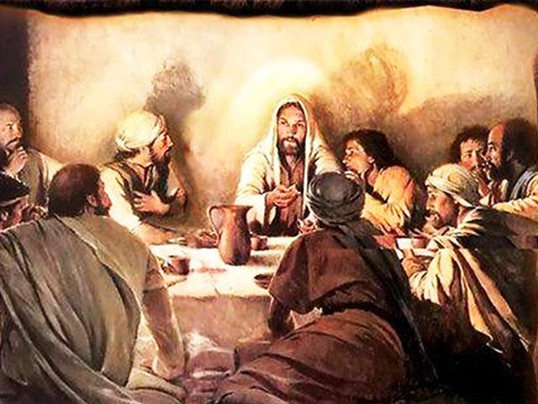

Slide 4
the liturgy of the word

Slide 5
the liturgy of the eucharist

Slide 6
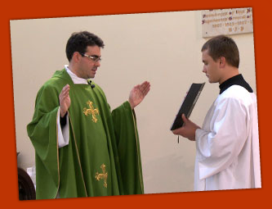
THE GATHERING RITE
Gathering hymn
Greeting
Sign of the Cross
Penitential Rite
4.4

Slide 7
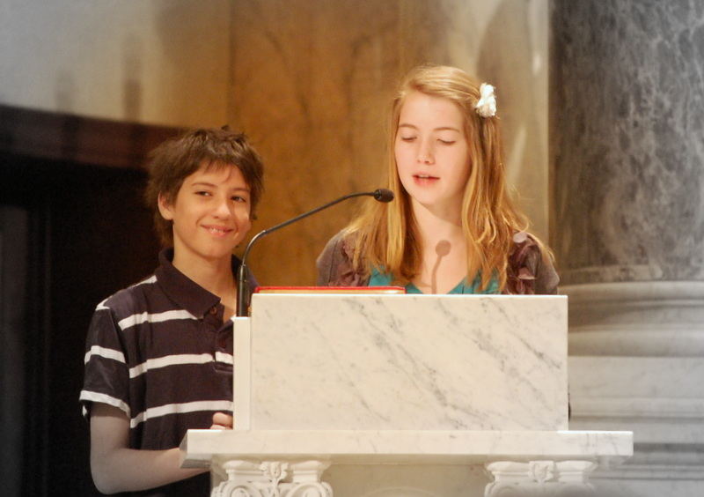
THE LITURGY OF THE WORD
First reading
Responsorial psalm
Gospel acclamation
Gospel
Homily
Prayer of the Faithful
4.4

Slide 8
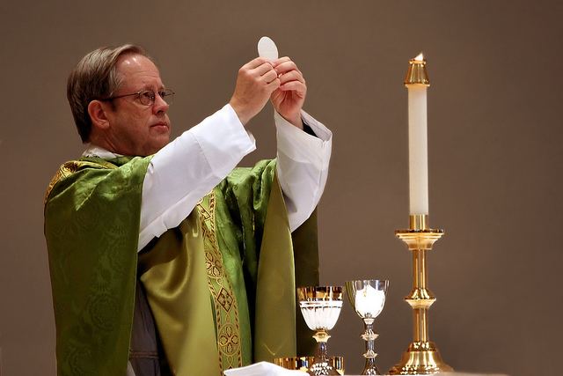
THE LITURGY OF THE EUCHARIST
Offertory
Eucharistic prayer
Our Father
Sign of peace
Communion
4.4

Slide 9
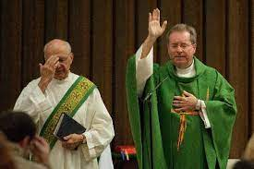
THE concluding rite
Final blessing
Dismissal
Final hymn
4.4

Slide 11
THE LITURGY OF THE WORD
First reading
Responsorial psalm
Second reading
Gospel acclamation
Gospel
Homily
Creed
Prayer of the Faithful
5.4

Slide 13
THE INTRODUCTORY RITE
Gathering hymn
Greeting
Sign of the Cross
Penitential Rite
Opening Prayer

Slide 14
THE LITURGY OF THE WORD
First reading
Responsorial psalm
Second reading

Slide 15
THE LITURGY OF THE WORD
Gospel acclamation
Gospel
Homily

Slide 16
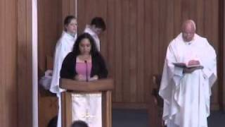
THE LITURGY OF THE WORD
Creed
Prayer of the Faithful

Slide 17
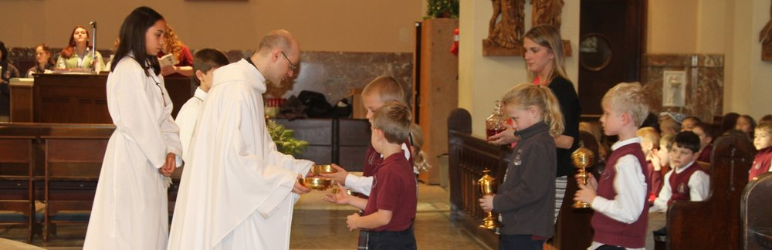
THE LITURGY OF THE EUCHARIST
Offertory
Prayer over the gifts

Slide 18
THE LITURGY OF THE EUCHARIST
Eucharistic prayer

Slide 19
THE LITURGY OF THE EUCHARIST
Communion Rite:
Lord’s Prayer
Sign of Peace

Slide 20
THE LITURGY OF THE EUCHARIST
Communion Rite:
Communion
Prayer after Communion

Slide 21
THE CONCLUDING RITE
Blessing
Dismissal

