Slide 1
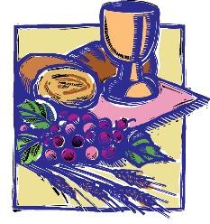
First Eucharist
Retreat

Slide 2
Prayer
Dear God, you know and love each one of us. Your Son, Jesus Christ, gave his Body and Blood in the Eucharist as a sign of your love for us.
Through it may we come to experience your love, and in turn love others. We ask this through Jesus your Son and with the Holy Spirit, one God for ever and ever.
Amen.

Slide 3
The Sacrament of the Eucharist
First Holy Communion is the name we give to the first time people receive Jesus in the sacrament of the Eucharist.
The celebration of First Eucharist is a sacred and important moment on a long journey of our faith.
With Baptism and Confirmation, it opens the door to full membership of the Christian community.

Slide 4
Sacraments of Initiation
Initiation into the Roman Catholic Church is through the sacraments of Baptism, Confirmation and Eucharist.
First Holy Communion, sharing in the body and blood of the Lord at Mass for the first time, is the high point of the initiation process.
Eating and drinking with the rest of the community at the Table of the Lord is a sign of belonging fully to that community.

Slide 5
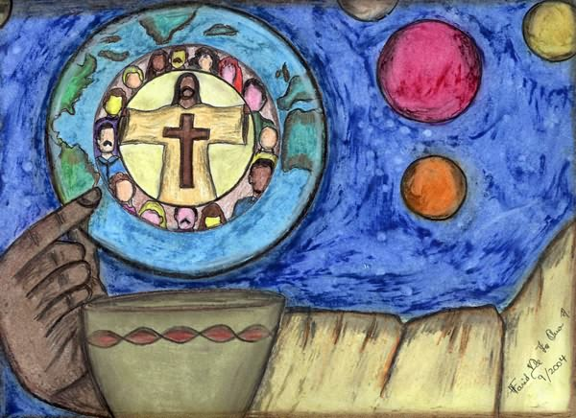
The word ‘communion’ means to be united with. Catholics believe that in holy communion they are united in a special way with Jesus Christ, that they are sharing in the body and blood of Christ the Saviour.

Slide 6
The Last Supper

Slide 7
Jesus
Jesus is truly present in the Eucharist
1) in the people that gather in the name of Jesus
2) in the priest
3) in the Word proclaimed to us from the bible
4) in the bread and wine.
Each of these presences is real but they are all different from each other, each of these presences is real, and each gives us a special way of recognising Jesus with us.

Slide 8
Jesus
It is only when people know Jesus and love him that they are drawn at each Eucharist to remember him. We can’t remember Jesus if we don’t know him. So the important question is: How do we come to know Jesus?
How can you get to know Jesus better?

Slide 9
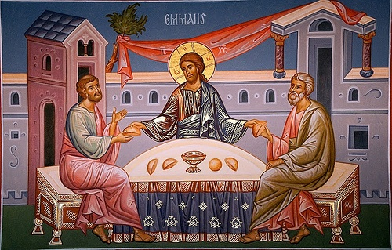
The Road to Emmaus

Slide 10
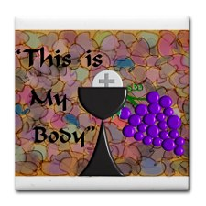
Placemat Activity Name: Date: Saturday 22nd September Sunday 23rd September
Diana Alteri
22.09.2012

Slide 11
Diana Alteri
22.09.2012
Cut out and name your pew card…

Slide 12
Why go to Mass?

Slide 13
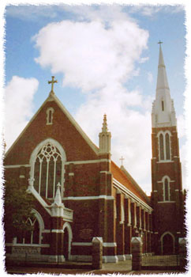
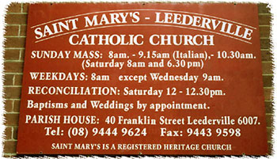
The parish community is very important in coming to know Jesus.
The parish will do all that it can to support you in your Journey of faith.
The parish is where you learn to live like Jesus and
receive the sacraments.

Slide 14
Letter to mum and dad
Dear mum and dad...
Thank you for:
caring about me
teaching me about Jesus
forgiving me
loving me always
I pray that....

