Slide 1
First Eucharist
Parent Meeting one

Slide 2
Prayer
Dear God, you know and love us personally. Your Son, our Lord Jesus Christ, gave us his Body and Blood in the Eucharist as a sign of your love for us.
Through it may we come to experience your love, and in turn love others. We ask this through Jesus your Son and in union with the Holy Spirit, one God for ever and ever.
Amen.

Slide 3
First Holy Communion
What do you remember of how you felt on your First Communion Day?
What do you remember of what you were taught for your First Communion?
Sharing and feedback

Slide 4
The Sacrament of the Eucharist
First Holy Communion is the colloquial name for a person's first celebration of the sacrament of the Eucharist. The celebration of First Eucharist is a sacred and important moment on a long journey of faith development. Together with Baptism and Confirmation, it opens the door to full membership of the Christian community.

Slide 5
Sacraments of Initiation
Initiation into the Roman Catholic Church is through the sacraments of Baptism, Confirmation and Eucharist.
First Holy Communion, sharing in the body and blood of the Lord at Mass for the first time, is the climax of the initiation process. Eating and drinking with the rest of the community at the Table of the Lord is a sign of belonging fully to that community.

Slide 6
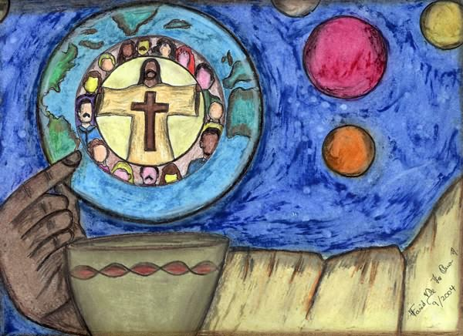
The word ‘communion’ means to be united with - Catholics believe that in Holy Communion they are united in a special way with Jesus Christ, that they are sharing in the body and blood of Christ the Saviour.

Slide 7
Jesus
Jesus is truly present in the Eucharist
1) in the assembly that gathers in Christ’s name
2) in the priest or bishop who presides
3) in the word proclaimed in our midst
4) in the eucharistic elements of bread and wine.
Though they differ from each other, each of these presences is real, and each offers us a unique opportunity to recognize Christ with us.

Slide 8
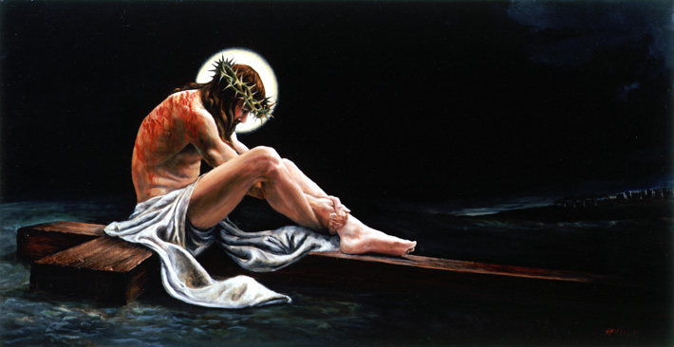
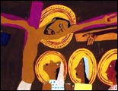
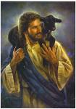
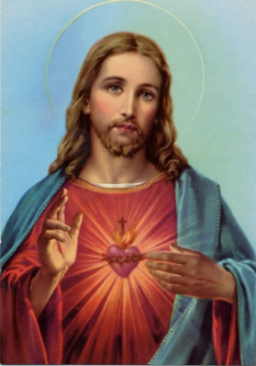
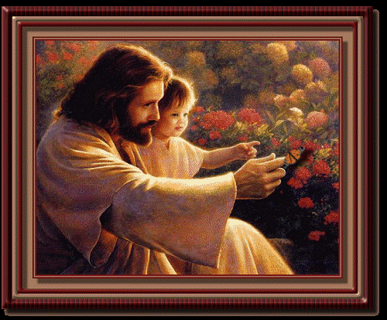
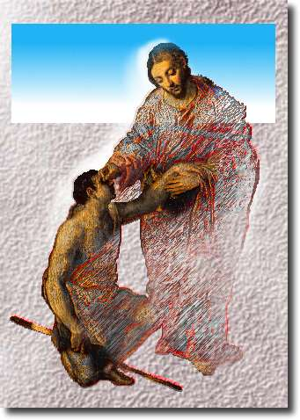
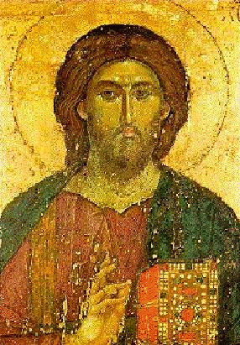
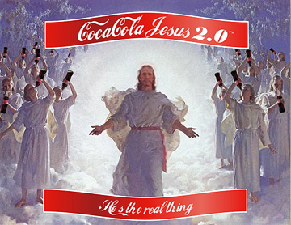
What images and memories shape your understanding of Jesus? How has your understanding of Jesus grown
and changed over time?

Slide 9
Jesus
It is only when people know Christ and love Christ that they are drawn at each Eucharist to remember him. We can’t remember Jesus if we don’t know him. So the important question is: How do we come to know Jesus?
How did you come to know Jesus? What people and experiences helped you learn about Jesus and develop a relationship with him?

Slide 11
The role of parents
Parents have the most essential role in the faith life of their children.
If the adults in a child’s life truly celebrate Eucharist, then that child’s First Eucharist is more likely to be just the first in a lifetime of meaningful encounters with the Body of Christ.

Slide 12
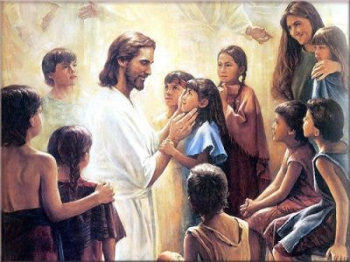
The role of parents
Ideally the best preparation for the Eucharist is taking your child to Mass regularly and helping your child understand what it is all about.

Slide 13
Why do I want my child to receive the Eucharist? Reflection

Slide 14
Important dates
Parent meeting 2: 22nd August
Retreat afternoon for children: 15th September 1.00pm-4.30pm
Reconciliation: TBA
First Communion: 22nd and 23rd September 6.30pm - 10.30am
Cost: Sacraments are a gift of Christ and our right as baptised Christians. However, to provide preparation programmes costs money and we would appreciate if you could cover this cost of your child's preparation by a donation to the church.

Slide 15
Important information
Appropriate clothing:
Seating: will be allocated

Slide 17
In your experience, what are the biggest tensions and arguments among people concerning the Mass and the Eucharist?

