Slide 1
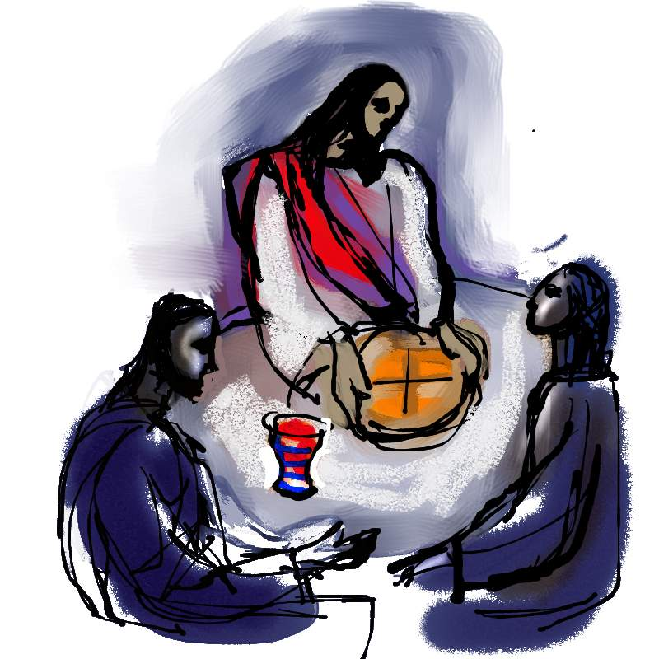
First Eucharist
Meeting Two

Slide 2
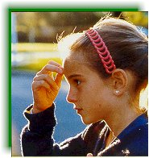
Sign of the Cross
The practice of making the Sign of the Cross goes back to the second century. It was used at many points during the celebration of the sacraments.

Slide 3

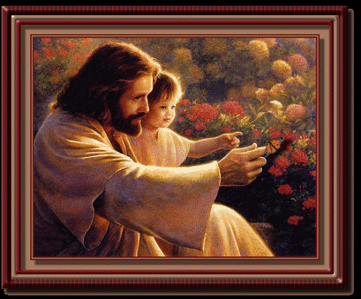
Dear God, you love each of us personally.
We ask your blessing on our children during their special preparation for first Holy Communion. We asked your blessing too on their families.
May they be nourished by the Body and Blood of Jesus so that they may live as your followers. We ask this through Christ our Lord.
All: Lord Jesus, you showed your love for children by saying ‘Let the children come to me’. Assist us as parents and teachers to prepare our children for this special meeting with you in the Sacrament of Eucharist. We ask your blessing of peace and love on us all. Amen.

Slide 4
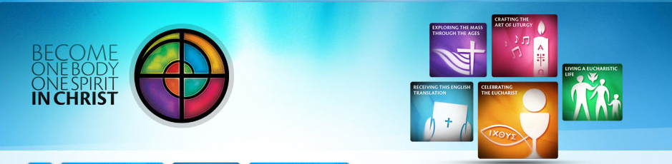
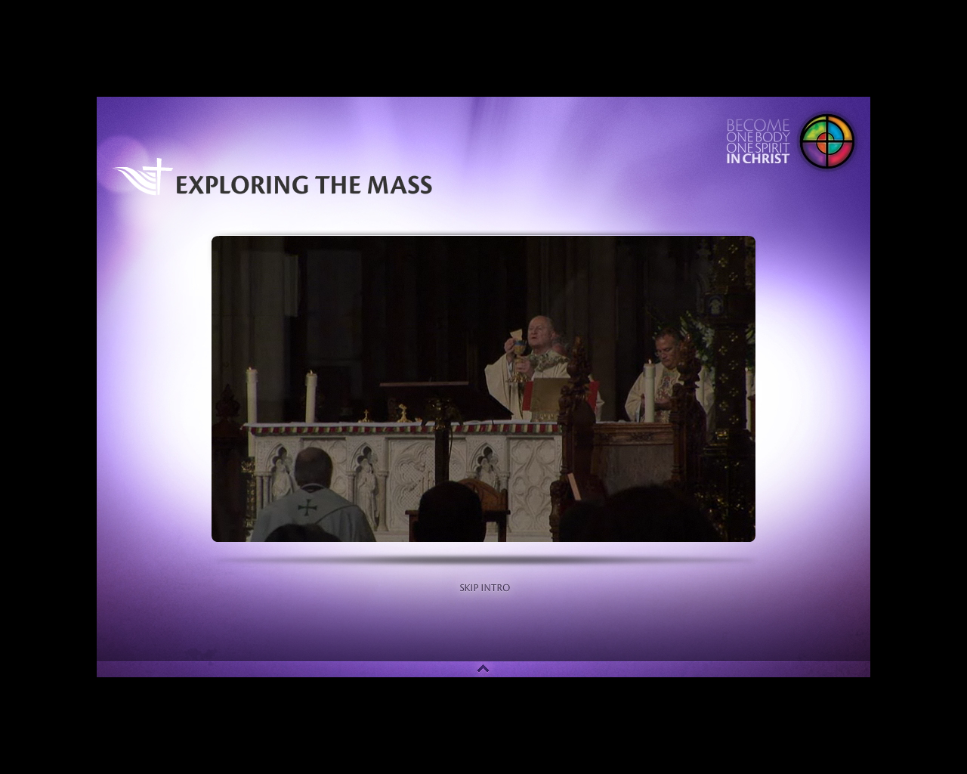

Slide 5
Discussion:
What did you hear from the DVD that is new to you or that you needed to be reminded about?
How can we remember and focus on what coming to Mass is about?
How can we encourage our children to appreciate the mystery and love of Jesus in the Eucharist?

Slide 6
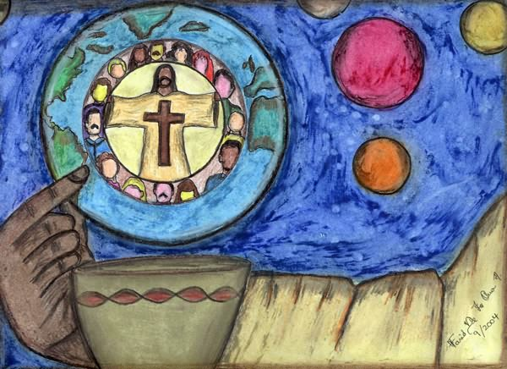
We pray in the Eucharistic Prayer that the Holy Spirit will change us just like the bread and wine have been changed. We are now to be Christ’s Body in the world. We have a mission (from the same word ‘to send’) to live what we proclaim and be what we receive.
So this word ‘Mass’ is meant to remind all of us who are baptised that what we celebrate on Sundays is to be lived out during the week until we gather again.

Slide 7
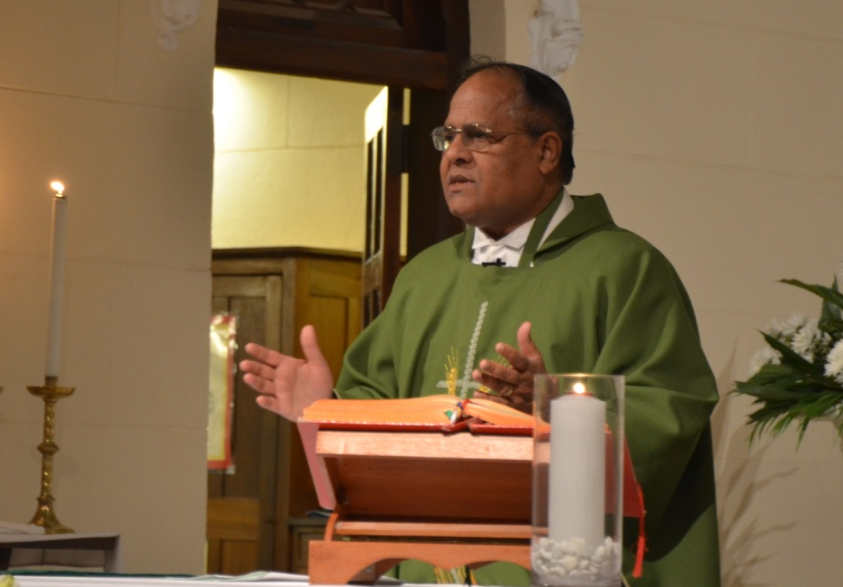
Our daily lives have their rituals. There are set ways of shaking hands, eating with a fork, responding to a letter. And when we are accustomed to a certain way of doing things we seldom ask why we do it that way. In the Eucharist there are many ritual actions which we perform without asking why.

Slide 8
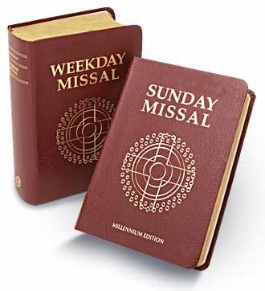
SHAPE OF THE MASS
There are four main segments in the Eucharist. In the Missal these are called:
Introductory Rites
Liturgy of the Word
Liturgy of the Eucharist
Concluding Rite

Slide 9
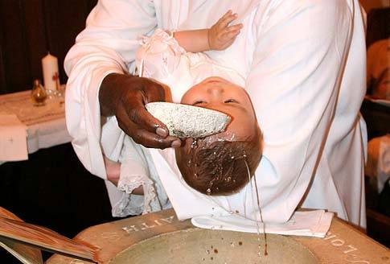
As a parent, you have a most important role in helping bring to fulfilment the potential for love and life in your children. Parents are the first teachers of their children by what they do and say. This is true about developing and growing in faith as much as everything else.

Slide 10
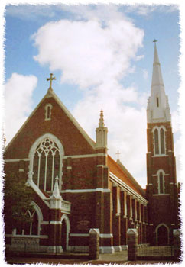
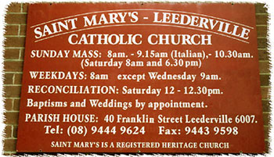
The parish community is delighted that you are choosing to bring your child up as a Christian, a member of the Roman Catholic church. The parish will do all that it can to support you in your role as parents and respect the role which is uniquely yours - that of being the first teachers of your children in the faith.
No-one and nothing can replace the role of a parent.

Slide 11

Through countless everyday caring actions in the lives of spouses, parents, children, extended family, neighbours and friends, the family is a source of hope in the world at large. From the life-giving presence of a newborn child to the wisdom of an elderly grandparent, ‘all members... have the grace and responsibility of building, day by day, the communion of persons, making the family “a school of deeper humanity”: this happens where there is care and love for the little ones, the sick, the aged; where there is mutual service every day; where there is a sharing of goods, of joys and of sorrows’ (Pope John Paul II, in a letter Familiaris Consortio (the letter’s
Latin title means ‘Community of the Family’), FC, 21).

Slide 12

“The task of the Christian family to educate its members is a true ministry through which the Gospel is spread” (Pope John Paul). Do not think of your family responsibilities as something from the mission of the Church. When you teach your children (and they teach you!) what it means to love, to pray, to celebrate the sacraments and to serve our neighbour, you are not just ‘helping’ the Church’s mission - you are living it!
So central is the family to the life and mission of the Church that it is often called the ‘domestic church’ or the ‘little church’. ‘The family called together by Word and Sacrament as the Church of the home, is both teacher and
mother; the same as the worldwide
Church’ (FC, 38).

Slide 13
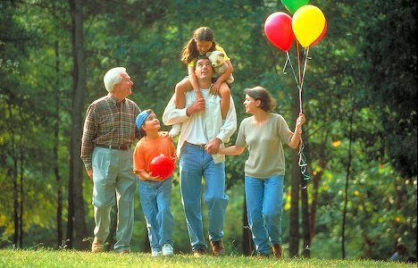
You carry out the mission of the church of the home in ordinary ways when:
You educate. As the primary teachers of your children, you impart knowledge of the faith and help them to acquire values necessary for Christian living."
Examine the priorities you have for your family. Compare them with how you actually spend your time…plan to take time to be together:
  Making shared meals a priority
  Praying and worshipping
  together, especially at the
  Sunday Eucharist
  Building family traditions
  and rituals,
  Taking part in retreats and family
  education programs-28th October Year of Grace retreat
  Teaching reverence

Slide 14
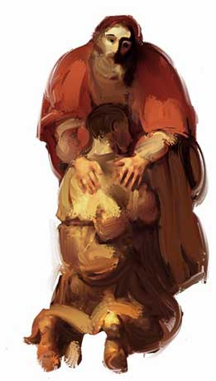
God never fails to love and the church celebrates this in the sacrament of reconciliation.
We call it a sacrament of “conversion”
because in celebrating it, we turn our hearts empowered by the Spirit of Love, back to Divine Love through Christ who reveals that Love.

Slide 15
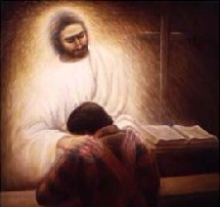
God forgives us endlessly and the church celebrates this reality through the Sacrament of Reconciliation.
Even though we are Baptised and Confirmed, and even though we are steeped in Eucharist, there remains that tendency within us to "miss the mark,“ to be selfish and to fail to love, a tendency to sin.

Slide 16
For Catholics, the Sacrament of Reconciliation (also known as the Sacrament of Penance, or Penance and Reconciliation) has three elements: conversion, confession and celebration. In it we find God's unconditional forgiveness, and as a result we are called to forgive others."

Slide 17
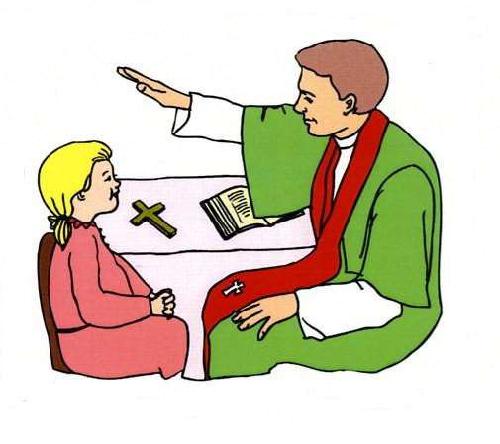
Celebrating Reconciliation
Importance of developing a healthy understanding
Parish celebrations Advent and Lent

Slide 18
Important dates
Retreat afternoon for children: 15th September
1.00pm- 4.30pm
Reconciliation: During retreat
First Communion: 22 & 23 September 6.30pm - 10.30am
Reconciliation in the Parish
Cost: Sacraments are free - a gift of Christ and our right as baptised Christians. However, to provide preparation programmes costs money and we would appreciate if you could cover this cost of your child's preparation by a donation to the church.

