Slide 1
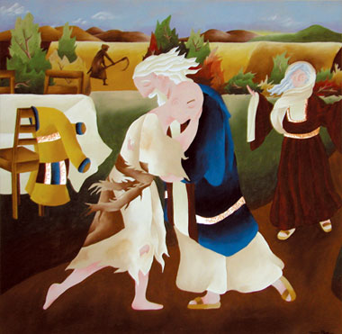
First Reconciliation
Parent Night
1 August 2012

Slide 2
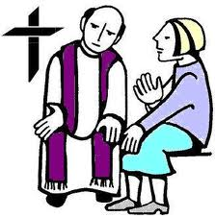
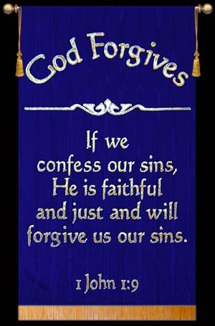
Prayer of Reconciliation
Forgiveness is a way of life for families. Every day family members are called to forgive one another for failings both great and small. As your child prepares for first reconciliation, let us pray together.
A Litany of Forgiveness
Leader: Blessed are you, Lord our God. We come before you to ask your forgiveness for all of our failings both great and small. Generous God, you give us so many gifts in life, yet sometimes we forget to share them.
And so we say...
All: We are sorry.
Leader: Faithful God, you are with us in one another, yet we sometimes refuse to recognise you. And so we say...
All: We are sorry.

Slide 3
Leader: God of gentleness, you ask us to bring peace to our family and to the world, yet sometimes we spread anger and trouble. And so we say...
All: We are sorry.
Leader: Gracious God, you give us a voice with which to sing, and words to speak, and yet sometimes our words are hurtful or untrue. And so we say...
All: We are sorry.
Leader: Loving God, you sent your only son to show us how to love and serve one another, and yet we sometimes are selfish and unloving. And so we say...
All: We are sorry.
Leader: Merciful God, as we prepare to celebrate our child’s first reconciliation, help us to ask forgiveness when we need to. Help us to forgive others who have wronged us. And let us be peacemakers in our school and in our family. We thank you for the gift of your forgiveness and love. All: Amen.

Slide 4
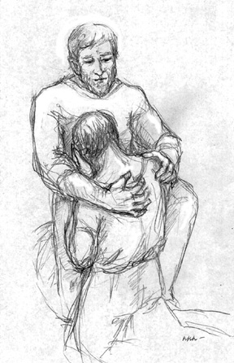
Children learn to celebrate the Sacrament of Penance as soon as they can benefit from the experience of acknowledging responsibility for their wrong– doing, and from knowing they are forgiven and accepted by God.
Children's First Communion is preceded by the Sacrament of Penance.

Slide 5
It is the responsibility of parents and those who take the place of parents as well as of the parish priest to see that children who have reached the use of reason are correctly prepared and are nourished by the divine food as early as possible, preceded by sacramental confession; it is also for the pastor to be vigilant lest any children come to the Holy Banquet who have not reached the use of reason or whom he judges are not sufficiently disposed. IV. Code of Canon Law Pope John Paul II (1983)

Slide 6
According to the Church's command, "after having attained the age of discretion, each of the faithful is bound by an obligation faithfully to confess serious sins at least once a year." Anyone who is aware of having committed a mortal sin must not receive Holy Communion, even if he experiences deep contrition, without having first received sacramental absolution, unless he has a grave reason for receiving Communion and there is no possibility of going to confession. Children must go to the sacrament of Penance before receiving Holy Communion for the first time. (1457 , Catechism of the Catholic Church)

Slide 7
SACRAMENT OF PENANCE
This Sacrament has undergone significant
changes over the centuries.
❖ These changes come about as the Church develops and grows in its understanding of the Sacraments.
❖ The theology is influenced by history and
cultural adaptations of various times.

Slide 8
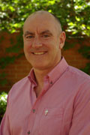
Rev Fr Vincent Glynn
Senior Lecturer – Sacramental Theology
Licentiate in Sacramental Theology from the Pontificio Anteneo San Anselmo Rome.

Slide 9


Slide 10
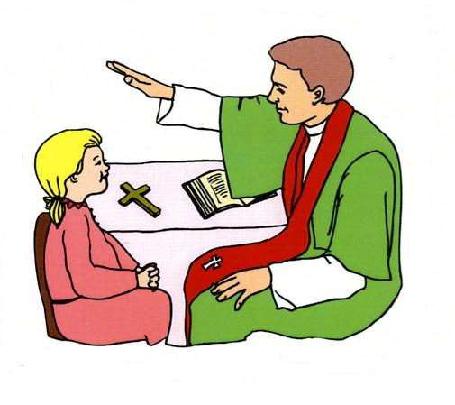
EFFECTS OF RECONCILIATION
(CCC 1496)
❖ Restoration of our relationship with God.
❖ Restoration of our relationship with each other.
❖ Strength and confidence to continue in faith.
❖ Ability to continually look at change in one’s
life (reflection and action).
❖ A sense of peacefulness and understanding
(acceptance).
❖ Freedom to begin again.

Slide 11

Celebrating Reconciliation
Welcome
1. The priest will welcome you to the celebration of the
sacrament. You will make the Sign of the Cross.
2. The Word of God
When we celebrate the sacrament of reconciliation it
is helpful to listen to the Scriptures and be reminded of the love
that God has for us.
3. Confession
The priest will invite you to tell him about the things
that you need Jesus to help you with - He will also
offer you an act of penance, a way of showing how
you wish to live a better life.

Slide 12
Celebrating Reconciliation
4. Prayer of Sorrow
O my God, I am very sorry that I have sinned against you, because you are so good, and with the help of your grace, I will not sin again.
5. Absolution
The priest will then extend his hands over your head
and say the words of Absolution. In this way you
receive God’s forgiveness of your sins. The priest
also prays for you that you will receive God’s gifts of
pardon and peace.

Slide 13
Absolution (RP #6d; Rec et Pen p.122-3)
God, the Father of mercies,
through the death and resurrection of his Son
has reconciled the world to himself
and sent the Holy Spirit among us
for the forgiveness of sins;
Through the ministry of the Church
may God give you pardon and peace,
and I absolve you from your sins
in the name of the Father, and of the Son,
and of the Holy Spirit.
Amen

Slide 14
EFFECTS OF RECONCILIATION
(CCC 1496)
❖ Restoration of our relationship with God.
❖ Restoration of our relationship with each other.
❖ Strength and confidence to continue in faith.
❖ Ability to continually look at change in one’s
life (reflection and action).
❖ A sense of peacefulness and understanding
(acceptance).
❖ Freedom to begin again.

Slide 15
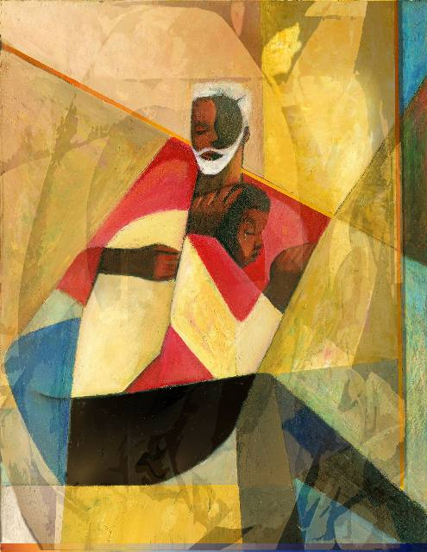
Information
Retreat afternoon:
1st September 1.00pm - 4.00pm
Celebration of the Sacrament:
5th of September

Slide 16
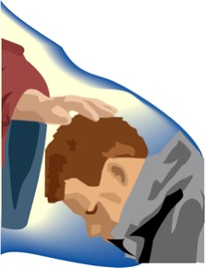
I forgive myself and others. I learn from my mistakes.
With God’s help I have the power to keep changing for the better.
Prayer of Sorrow
O my God, I am very sorry that I have sinned against you, because you are so good, and with the help of your grace, I will not sin again.

Slide 18
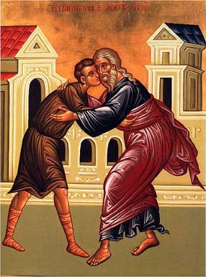
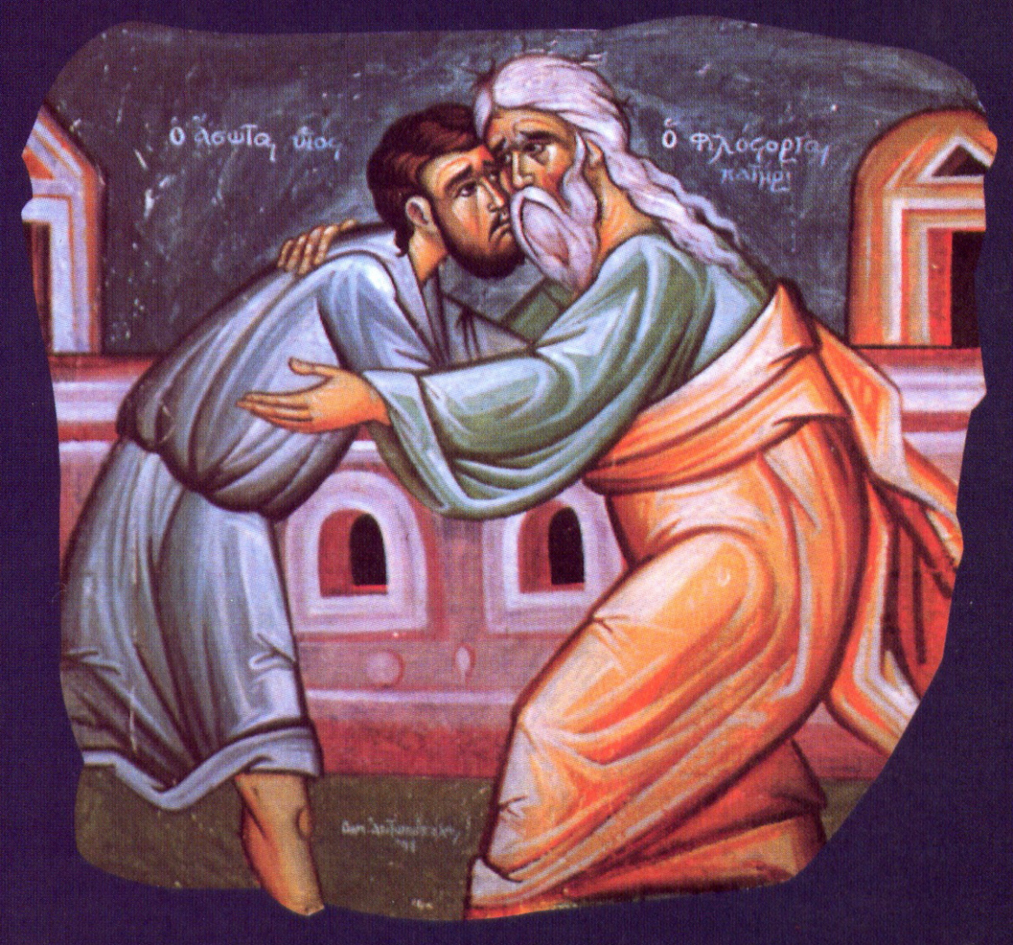

Slide 19

