Slide 1
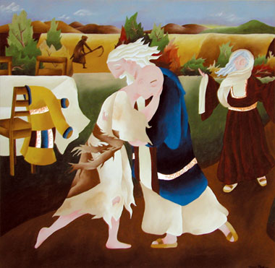
First Reconciliation
Retreat

Slide 2
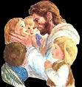
Prayer
Dear Lord we are so blessed to have our church, family, teachers, people who love and care for us, and lessons to help us know that we are always loved and forgiven. Thank you, Amen.

Slide 3
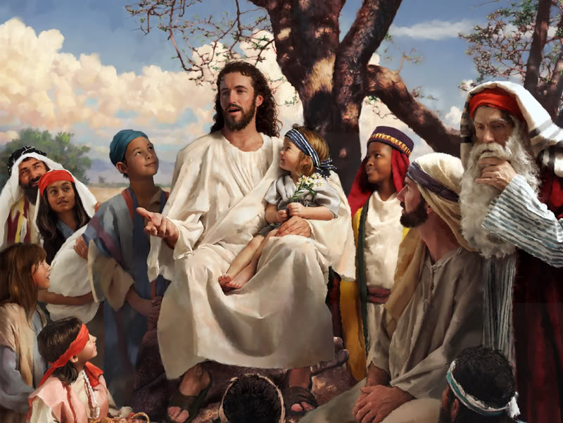
Parable
This is a story Jesus told:

Slide 4
Very soon the younger son got his money

Slide 5
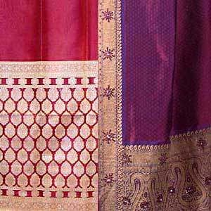
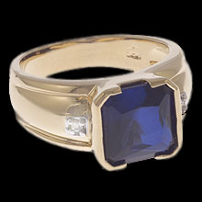
He ate out every day, bought fancy clothes, and jewellery

Slide 6
The only job he could find was feeding pigs

Slide 7
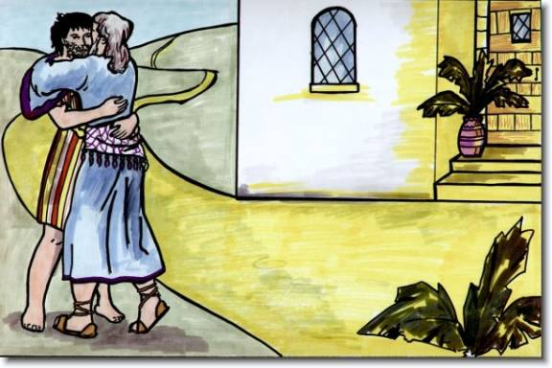
His father threw his arms around him and kissed him.

Slide 8
In this parable the father is just like God – he will always forgive us if we are truly sorry

Slide 9
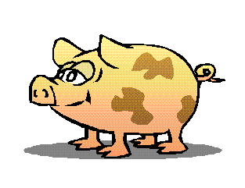
1. How does the father show his love to both his sons?
2. Did he forgive the younger son for wasting his money? How did he show his love?
3. Why was the older brother angry?
4. How do your parents show that they forgive you when you have made bad choices?
5. Do you think that all parents forgive their children as this father did?
6. What does this story teach us about God’s love?

Slide 10
Forgiveness Box
Write or draw one way you have grown more in the way Jesus taught.
Write or draw one thing you can do better to show your love for the people in your life and for Jesus – the thing you need to say sorry for…

Slide 11
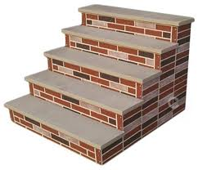
God’s forgiveness
Absolution
Penance
Confession
Contrition
Stairway to Heaven

Slide 12
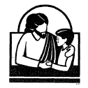
Celebrating Reconciliation
Welcome
The priest will welcome you to the celebration of the
sacrament. You will make the Sign of the Cross.
2. The Word of God
When we celebrate the sacrament of reconciliation it
is helpful to listen to the Scriptures, and be reminded of the love
that God has for us.
3. Confession
The priest will invite you to tell him about the things
that you need Jesus to help you with - He will also
offer you an act of penance, a way of showing how
you wish to live a better life.

Slide 13
Celebrating Reconciliation
4. Prayer of Sorrow
O my God, I am very sorry that I have sinned against you, because you are so good, and with the help of your grace, I will not sin again.
5. Absolution
The priest will then extend his hands over your head
and say the words of Absolution. In this way you
receive God’s forgiveness of your sins. The priest
also prays for you that you will receive God’s gifts of
pardon and peace.

Slide 14
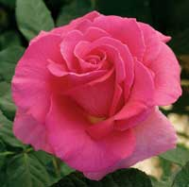
God Loves me - Activity
God Loves Me Always
Jane Brown
5-09-12

