Slide 1



Beginning of Year Staff Mass
Going Beyond
Year 12
St Mary’s College
Graduation Mass
2017

Slide 2
We warmly welcome you all here this evening to Nulungu Chapel. We gather together in thanksgiving for our many successes as Year 12 graduating students, and pray that as we continue our lives beyond St Mary’s College, we go forth with listening hearts. Our theme for the Mass is Going Beyond, the same theme as our retreat held at the beginning of the year. During this retreat, we explored how God’s Word compels us to move beyond our own immediate needs and reach out to others, to go beyond the limitations we and others put on us, and strive to excel in all we do.

Slide 3
Today is a day to acknowledge the times we have stretched ourselves and with faith, gone beyond what we thought was possible, to become the adults God intended us to be. We present our hopes, joys and plans for the future to the Lord. We thank God for all the blessings we have received during our time at St Mary’s College, and ask God to grant us the courage to continue building God’s Kingdom.

Slide 4
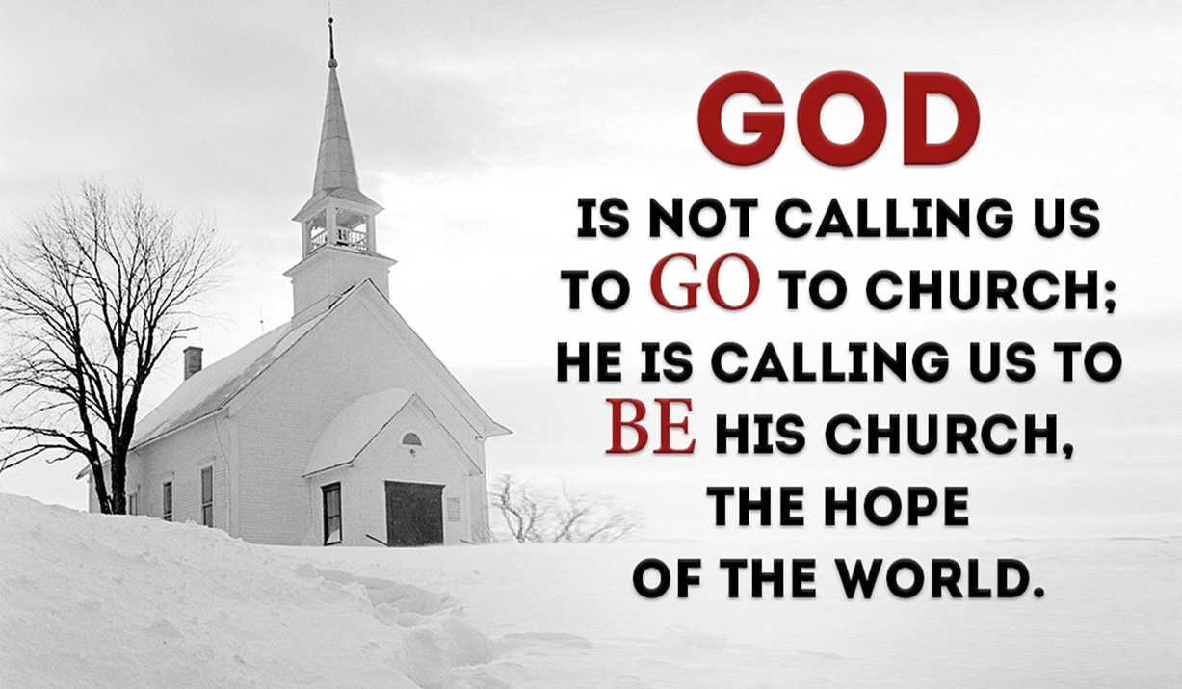
Our graduating students will process in with our Mass Bishop Christophers Bishop Christopher, Monsignor Paul and Father Marcello.
Please stand for the opening song, Here I Am to Worship.

Slide 5
Here I Am to Worship
Light of the world
You stepped down into darkness
Opened my eyes, let me see
Beauty that made this heart adore You
Hope of a life spent with You
Here I am to worship
Here I am to bow down
Here I am to say that You're my God
You're altogether lovely
Altogether worthy
Altogether wonderful to me

Slide 6
King of all days
Oh so highly exalted
Glorious in heaven above
Humbly You came to the earth You created
All for love's sake became poor
Here I am to worship
Here I am to bow down
Here I am to say that You're my God
You're altogether lovely
Altogether worthy
Altogether wonderful to me

Slide 7
Well, I'll never know how much it cost
To see my sin upon that cross
Well, I'll never know how much it cost
To see my sin upon that cross
So, here I am to worship
Here I am to bow down
Here I am to say that You're my God
You're altogether lovely
Altogether worthy
Altogether wonderful to me

Slide 8
Introductory Rite
Bishop Christopher: In the name of the Father, and of the Son and of the Holy Spirit
All: Amen.
Bishop Christopher: The Lord be with you
All: And with your spirit.

Slide 9

Welcome

Slide 10
Penitential Rite
Bishop Christopher: Jesus said, “You are the rock on which I build my Church.” As we prepare to go beyond the confines of St Mary’s College as Christ’s presence in the world, let us acknowledge the times when we have not been strong and faithful disciples.
Lord God, you invite us to grow close to you through prayer and sacrament. We ask forgiveness for the times we have broken or damaged our relationship with you.

Slide 11
Bishop Christopher: Lord have mercy
Response: Lord Have Mercy
Lord God, you showed us how to live a life of love. We ask forgiveness for the times we have been hard and lacking in generosity.
Bishop Christopher: Christ have mercy
Response: Christ have Mercy

Slide 12
Lord God, you gift us with the freedom to make wise choices. We ask forgiveness for the times we have chosen to do less than our best, and have not been strong in our service of your world.
Bishop Christopher: Lord have mercy
Response: Lord have mercy

Slide 13
Bishop Christopher: May almighty God have mercy on us, forgive us our sins, and bring us to everlasting life.
All: Amen

Slide 14
Opening Prayer:
Bishop Christopher: Let us pray, God our Father, you are the giver of life and love. You invite us to walk in your presence each day and see reflected in others, the face of Christ. As we come to the end of our time together, may all we have achieved through you, continue to flourish, and build your Kingdom. We ask this through Christ our Lord.
All: Amen.

Slide 15
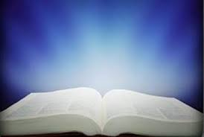
First Reading
A Reading from the prophet Jeremiah 29:11-15
The Lord God has this to say to you today: I have loved you with an everlasting love and I am constant in my affection for you. I will build you up and I will protect you in good times and in bad. So be happy and go forth in the dancing of the merrymakers. I have plans in my heart for you: plans for peace, not disaster, plans to give you a future and a reason to hope. And remember, when you call upon me and come and pray to me I will hear you. You will seek me and find me: when you seek me with all your heart, I will be found by you.
The Word of the Lord.
All: Thanks be to God.

Slide 16
Responsorial Psalm:
Psalm 39(40):7-10,17
Here am I, Lord; I come to do your will.
All: Here am I, Lord; I come to do your will.
You do not ask for sacrifice and offerings, but an open ear.
You do not ask for holocaust and victim.
Instead, here am I.
All: Here am I, Lord; I come to do your will.

Slide 17
In the scroll of the book it stands written
that I should do your will.
My God, I delight in your law
in the depth of my heart.
All: Here am I, Lord; I come to do your will.
Your justice I have proclaimed
in the great assembly.
My lips I have not sealed;
you know it, O Lord.
All: Here am I, Lord; I come to do your will.

Slide 18
O let there be rejoicing and gladness for all who seek you.
Let them ever say: ‘The Lord is great’, who love your saving help.
All: Here am I, Lord; I come to do your will.

Slide 19
Second Reading: A reading from Colossians 3:12-15
You are God’s chosen race, his saints; he loves you, and you should be clothed in sincere compassion, in kindness and humility, gentleness and patience. Bear with one another; forgive each other as soon as a quarrel begins. The Lord has forgiven you; now you must do the same. Over all these clothes, to keep them together and complete them, put on love. And may the peace of Christ reign in your hearts, because it is for this that you were called together as parts of one body. Always be thankful.
The Word of the Lord
All: Thanks be to God

Slide 20
Gospel Acclamation:
Please stand to welcome the Gospel
All: Alleluia, Alleluia!
Come and listen, and I will tell what great things God has done for me.
Alleluia!

Slide 21
Priest: The Lord be with you
All: And with your spirit.
Priest: A reading from the Holy Gospel according to Matthew.
All: Glory to you, O Lord
Gospel Reading:

Slide 22
Gospel:Matthew 28:16-20
Priest:
The eleven disciples went to the hill in Galilee where Jesus had told them to go. When they saw him, they worshipped him, even though some of them doubted. Jesus drew near and said to them, “I have been given all authority in heaven and on earth. Go, then, to all peoples everywhere and make them my disciples: baptise them in the name of the Father, the Son and the Holy Spirit, and teach them to obey everything I have commanded you. And I will be with you always, to the end of the age.

Slide 23
This is the Gospel of the Lord
All: Praise to you Lord, Jesus Christ
Please be seated

Slide 24
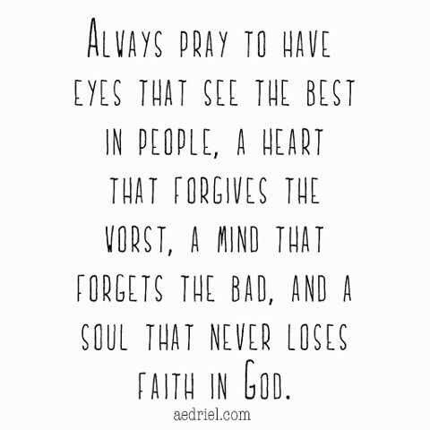
Homily

Slide 25
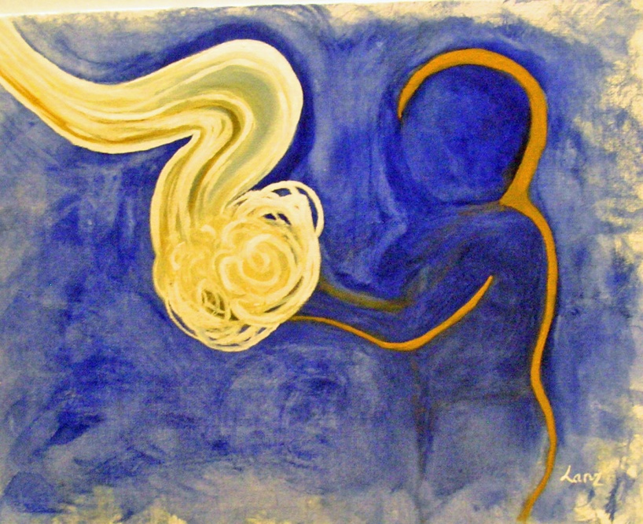
Prayer of the Faithful
Bishop Christopher:
We are claimed as God's own people, chosen from the beginning. Nourished by God's Word, we turn now to our God in prayer.

Slide 26
For the Holy Catholic Church, for Francis our pope, Christopher our bishop, and all priests, that through word and action they bring forth the Kingdom of God.
Lord hear Us
All: Lord Hear Our Prayer.
For the leaders of the world, that they are moved by the Spirit to work together to promote the good of all, and enact policies that give us a future filled with hope.
Lord hear us
All: Lord Hear Our Prayer.

Slide 27
For the St Mary’s College community, that your Spirit which dwells in Yawaru Country, continues to open the eyes and ears of all to your grace at work in the world, and nurture listening hearts.
Lord hear us
All: Lord Hear Our Prayer
For all graduating students, that as we go beyond, we will continue to respect and support others, strive for excellence, and carry the love of Christ with us always. Lord hear us
All: Lord Hear Our Prayer

Slide 28
For all those who have died, especially our loved ones and classmates who have departed from our school community, may they rest in peace.
Lord hear us
All: Lord hear our prayer
Like Mary, we ponder in our hearts our own needs and intentions.
Lord hear us
All: Lord hear our prayer

Slide 29
Bishop Christopher:
Lord our God, we offer you these prayers, asking your guidance and strength for this graduating class and all your church.
We ask this through Christ our Lord.
All: Amen
Please be seated

Slide 30
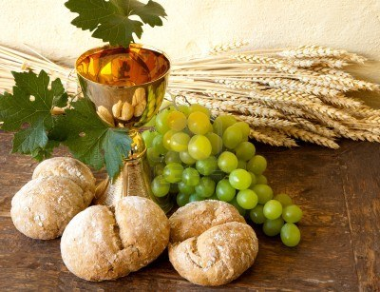
Procession of Gifts

Slide 31
Preparation of the Gifts
Blessed are you, Lord God of all creation,
for through your goodness we have received the bread we offer you:
fruit of the earth and work of human hands, it will become for us the bread of life.
All: Blessed be God for ever.

Slide 32
Blessed are you, Lord God of all creation, for through your goodness we have received the wine we offer you: fruit of the vine and work of human hands, it will become our spiritual drink.
All: Blessed be God for ever.

Slide 33
Please Stand

Slide 34
Liturgy of the Eucharist
Bishop Christopher: Pray brothers and sisters, that my sacrifice and yours may be acceptable to God the almighty Father.
All: May the Lord accept the sacrifice at your hands for the praise and glory of his name, for our good and the good of all his holy Church.

Slide 35
Prayer over the Gifts:
Bishop Christopher: Grant us Lord, we pray, a sincere respect for your gifts, that through the purifying action of your grace, we may be cleansed by the very mysteries we serve. Through Christ our Lord
All: Amen

Slide 36
Bishop Christopher : The Lord be with you.
All: And with your spirit.
Bishop Christopher : Lift up your hearts.
All: We lift them up to the Lord.
Bishop Christopher : Let us give thanks to the Lord our God.
All: It is right and just.

Slide 37
Eucharistic Prayer 2
Bishop Christopher: It is truly right and just, our duty and our salvation, always and everywhere to give you thanks, Lord, holy Father, almighty and eternal God, through Christ our Lord. For through his Paschal Mystery, he accomplished the marvellous deed, by which he has freed us from the yoke of sin and death, summoning us to the glory of being now called a chosen race, a royal priesthood, a holy nation, a people for your own possession, to proclaim everywhere your mighty works, for you have called us out of darkness into your own wonderful light.

Slide 38
And so, with Angels and Archangels, with Thrones and Dominions, and with all the hosts and Powers of heaven, we sing the hymn of your glory, as without end we acclaim:

Slide 39
All: Holy, holy, holy Lord, God of hosts,
Heaven and earth are full of your glory.
Hosanna in the highest.
Blessed is he who comes in the name of the Lord.
Hosanna in the highest.
Please kneel or sit

Slide 40
You are indeed Holy, O Lord, the fount of all holiness. Make holy, therefore, these gifts, we pray, by sending down your Spirit upon them like the dewfall, so that they may become for us the Body and Blood of our Lord Jesus Christ. At the time he was betrayed and entered willingly into his Passion, he took bread and, giving thanks, broke it, and gave it to his disciples, saying: take this, all of you, and eat of it, for this is my body, which will be given up for you.

Slide 41


Slide 42
In a similar way, when supper was ended, he took the chalice and, once more giving thanks, he gave it to his disciples, saying: take this, all of you, and drink from it, for this is the chalice of my blood, the Blood of the new and eternal covenant, which will be poured out for you and for many for the forgiveness of sins. Do this in memory of me.

Slide 44
Profession of Faith:
Bishop Christopher: The mystery of faith
All: When we eat this Bread and drink this Cup, we proclaim your Death, O Lord, until you come again.

Slide 45
Therefore, as we celebrate the memorial of his Death and Resurrection, we offer you, Lord, the Bread of life and the Chalice of salvation, giving thanks that you have held us worthy to be in your presence and minister to you.
Humbly we pray that, partaking of the Body and Blood of Christ, we may be gathered into one by the Holy Spirit. Remember, Lord, your Church, spread throughout the world, and bring her to the fullness of charity, together with Francis our Pope, Christopher our Bishop, and all the clergy.

Slide 46
Remember also our brothers and sisters who have fallen asleep in the hope of the resurrection, and all who have died in your mercy: welcome them into the light of your face. Have mercy on us all, we pray, that with the Blessed Virgin Mary, Joseph her spouse with the blessed Apostles, and all the Saints who have pleased you throughout the ages, we may merit to be coheirs to eternal life, and may praise and glorify you through your Son, Jesus Christ.

Slide 47
Doxology
Bishop Christopher: Through him, and with him, and in him, O God, almighty Father, in the unity of the Holy Spirit, all glory and honour is yours, for ever and ever.
All: Amen
Please stand

Slide 48
Bishop Christopher : At the Saviour’s command and formed by divine teaching, we dare to sing…

Slide 49
Our Father: ‘Aboriginal Our Father’
You are our Father, you live in Heaven. We talk to you, Father, you are good. (Repeat)
We believe your word Father. We are your children, give us this bread today. (Repeat)
We have done wrong, we are sorry. Teach us Father, all about your word. (Repeat)

Slide 50
Others have done wrong to us, and we are sorry for them, Father today. (Repeat)
Stop us from doing wrong, Father. Save us all from the evil one. (Repeat)
(Clap)
You are our Father, you live in Heaven. We talk to you, Father, you are good. (Repeat)

Slide 51
Bishop Christopher : Deliver us, Lord, we pray, from every evil, graciously grant peace in our days, that, by the help of your mercy, we may be always free from sin and safe from all distress, as we await the blessed hope and the coming of our Saviour, Jesus Christ.
All: For the kingdom, the power and the glory are yours, now and for ever.

Slide 52
Bishop Christopher : Lord Jesus Christ, who said to your Apostles: Peace I leave you, my peace I give you; look not on our sins, but on the faith of your Church, and graciously grant her peace and unity in accordance with your will. Who live and reign for ever and ever.
All: Amen.

Slide 53
Bishop Christopher : The peace of the Lord be with you always.
All: And with your spirit.
Bishop Christopher : Let us offer each other the sign of peace.

Slide 54
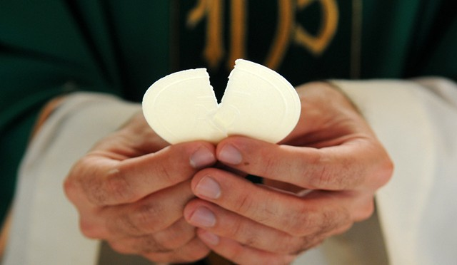
Breaking of the Bread

Slide 55
ALL: Lamb of God, you take away the sins of the world, have mercy on us.
Lamb of God, you take away the sins of the world, have mercy on us.
Lamb of God, you take away the sins of the world, grant us peace.
Please kneel or sit

Slide 56
Bishop Christopher : Behold the Lamb of God, behold him who takes away the sins of the world. Blessed are those called to the supper of the Lamb.
All: Lord I am not worthy that you should enter under my roof, but only say the word and my soul shall be healed.

Slide 57
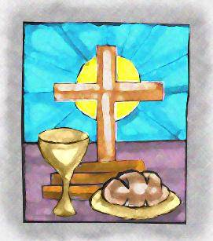
Everyone is invited forward to either
receive Communion or a blessing

Slide 58
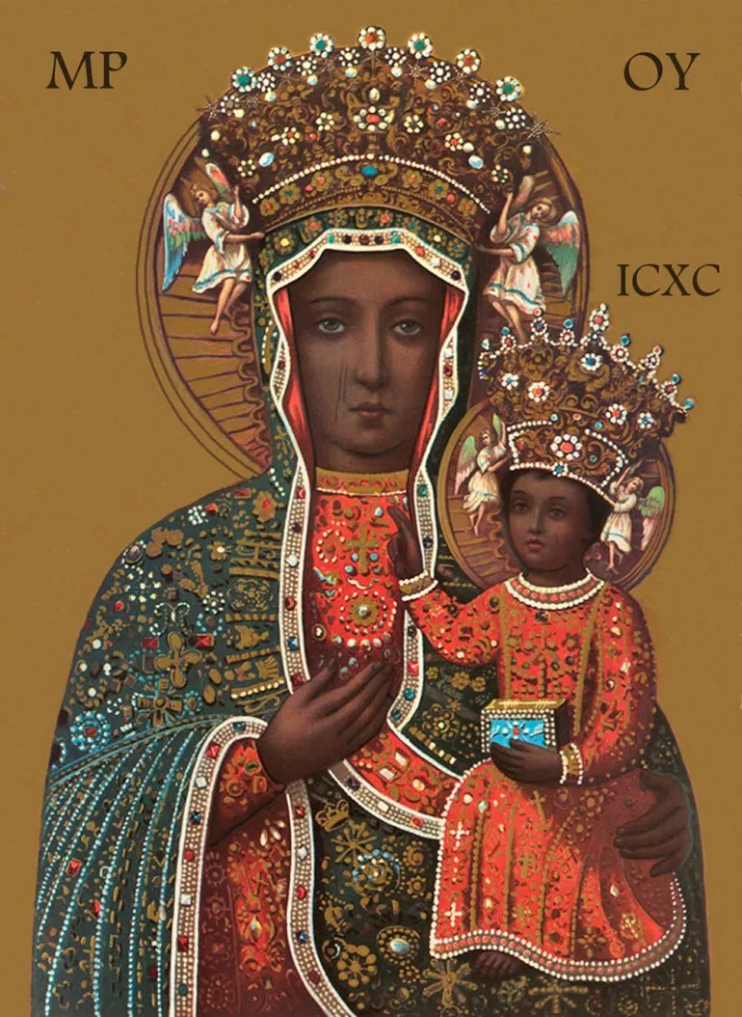
Hail Mary, Gentle Woman
Hail Mary, full of grace, the Lord is with you
Blessed are you among women
And blessed is the fruit of your womb, Jesus
Holy Mary, mother of God, pray for us sinners
Now, and at the hour of death, Amen

Slide 59
Gentle Woman, quiet light
Morning Star, so strong and bright
Gentle mother, peaceful dove
Teach us wisdom, teach us love
You were chosen by the Father
You were chosen for the Son
You were chosen from all women
And for woman, shining one

Slide 60
Gentle Woman, quiet light
Morning Star, so strong and bright
Gentle mother, peaceful dove
Teach us wisdom, teach us love
Blessed are you among women
Blessed in turn all women too
Blessed they with peaceful spirits
Blessed they with gentle hearts

Slide 61
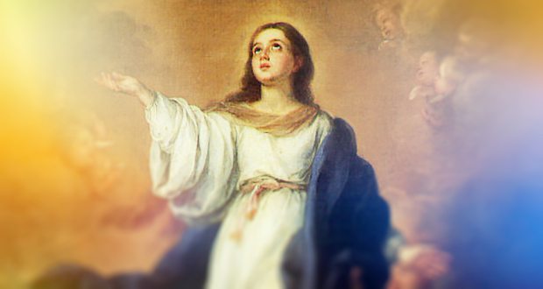
Gentle Woman, quiet light
Morning Star, so strong and bright
Gentle mother, peaceful dove
Teach us wisdom, teach us love

Slide 62
This World is Yours – J. Dresden

Slide 63
Prayer After Communion
Bishop Christopher :Grant O Lord, we pray, that, benefiting from participating in heavenly things, we may be helped by what you give in this present age and prepared for the gifts that are eternal.
Through Christ our Lord
All: Amen

Slide 64
Communion Reflection: This evening marks for us an ending, but also a new beginning. We tell that story of ending and beginning now using the Easter light, the symbol of Christ, the Alpha and the Omega, the beginning and the end.

Slide 65
On behalf of the staff of the school, I offer you the light of Wisdom. As you go beyond, carry this light from this place to a world that stands in need of wisdom; a world that faces decisions and choices never dreamed of in times past. Remember that everything you learned in school was learnt in the company of others. Be open to the learning that is ahead of you. May you be a light of wisdom for others. May you grow in a wisdom that will inspire you to find the good and the true, as you travel the road ahead.

Slide 66
On behalf of all families gathered here this evening I offer you the light of love. This is a light we lit for you a long time ago. It is the light you depended on in those early days, the light you ran to when things went wrong. The light that was left on for you because you were afraid of the dark. This is the light that waited up for you if you were late home…and the light that was always there even though sometimes, just sometimes, you wish it wasn’t! As you go beyond, carry this light of love into a world where real love is rare and precious. Use it to light the path of your own search to love and be loved. And when you find that the light is flickering, blown about by the troubles of life, remember that there will always be a light burning for you in that place called home.

Slide 67
On behalf of the School Board of St Mary’s College I offer you the light of faith. When you were a baby someone held this light for you and named you as a child of God. Over the years this flame has been fuelled by the example of those around you. Now you must carry that light for yourself. You will not find it an easy task; there may be a price to pay. The flame will flicker, it may even be extinguished for a time. But the most important thing about the flame of faith, is that it is not yours alone. A lone flame cannot pierce the darkness, but many flames together can cast a great light. As you go beyond, we urge you to be part of the Christian community wherever you find it. Be as God called you to be. As the stars in the night, as the sun in the sky. A source of light for all you will meet on the way. Be a light for the world.

Slide 68
On behalf of all remaining St Mary’s College students, I offer you the light of memory. When you are in Year 7 as I am, you Year 12 students seem very old and very big. Five or six years ago seems a very long time. I will leave school in the year 2022. Where will you be then? Days pass by, and for you now, school days are over. Carry the light of those days with you. When you meet, tell again the stories of those years in the classroom and on the playing field. Remember the victories and the disappointments, the lost locker key, the exam success and perhaps the cooling off time outside the Principal’s office. We ask you to remember us who will continue the story of the school to the end of the year 2022 and beyond. Remember us, we will remember you!

Slide 69
I now invite all remaining Year 12 students to join with your fellow graduates at the front of the altar.
It is a tradition at St Mary’s for those who are leaving to be given a special blessing by the College community.
I invite Bishop Christopher to lead the congregation in the blessing. Please stand and raise your hands over the St Mary’s College Graduation Class of 2017.

Slide 70
Blessing Song
May the blessing of God be upon you, the blessing of the Father and the Son,
And may the Spirit of God, the Spirit of love, be with you all your days.

Slide 71
May God the Father,
From whom every family takes its name,
Give you the power through His Spirit
For your hidden self to grow strong.
And may Jesus, the Son, live in your heart
Through faith and then, planted in love
And built on love,
May you be filled with the fullness of God.

Slide 72
May the blessing of God be upon you, the blessing of the Father and the Son,
And may the Spirit of God, the Spirit of love, be with you all your days.

Slide 73
Concluding Rite
Bishop Christopher : The Lord be with you.
All: And with your Spirit.
Bishop Christopher : May almighty God bless you, the Father, and the Son, and the Holy Spirit.
All: Amen.
Bishop Christopher : Go in peace glorifying the Lord by your life.
All: Thanks be to God.

Slide 74
Recessional Hymn
Hearts on Fire
We come from Ancient Dreamtime,
From the bush or by the sea,
We come from a thousand city streets.
We are the rich & lowly,
We are the poor and strong
We come to share this moment,
Gathering here, singing one song.

Slide 75
With our hearts on fire with the love of Jesus,
Hearts on fire, let’s spread the Word.
Hearts on fire, feel the Spirit blazing.
Hearts on fire,
Called to live the Good News in this land,
Setting hearts on fire, with our hearts on fire,
Setting hearts on fire.

Slide 76
We long to live in freedom, we yearn for unity.
We dream of justice, joy and peace
Spirit, fill us with your power.
Jesus, help us live your call.
O Creator, give us wisdom,
So we will be Good News for all.

Slide 77
With our hearts on fire with the love of Jesus,
Hearts on fire, let’s spread the Word.
Hearts on fire, feel the Spirit blazing.
Hearts on fire,
Called to live the Good News in this land,
Setting hearts on fire, with our hearts on fire,
Setting hearts on fire.

Slide 78
We are the voice of Jesus,
We are his heart & hands,
We are his body in our land.
Stand up, live the story,
To all the world proclaim,
Go out to all creation,
Lighting the fire, fanning the flames.

Slide 79
With our hearts on fire with the love of Jesus,
Hearts on fire, let’s spread the Word.
Hearts on fire, feel the Spirit blazing.
Hearts on fire,
Called to live the Good News in this land,
Setting hearts on fire, with our hearts on fire,
Setting hearts on fire.

Slide 80
