Slide 1
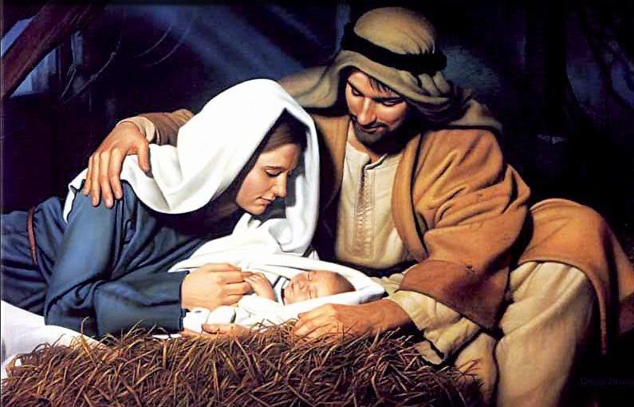
The Birth of Jesus
Comparing the Stories

Slide 2
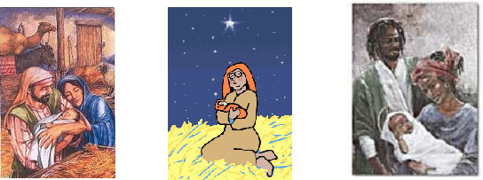
Images found in the Christmas Story
Use Google Image Search to locate online Christmas cards and images.
Use a T Chart to record people and things found on the Christmas cards.

Slide 3
Luke’s Christmas Story Luke 2:1-20
Matthew’s Christmas Story Matthew 1:18-2:12
Locate and read the two different accounts of the Christmas Story in Matthew’s and Luke’s Gospels.
Use a 5Ws + H Chart to record your information. Complete one chart for each of the Gospel Accounts.
http://www.biblegateway.com/
Record here what you found in Luke’s Gospel.
Record here what you found in Matthew’s Gospel.

Slide 4
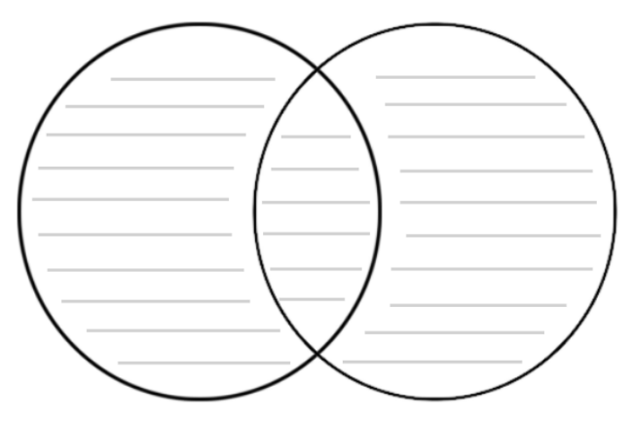
Comparing the Christmas Stories
Use a Venn Diagram to record the similarities and differences between the two accounts of the Christmas Stories

Slide 5
Design your own Christmas Card
Choose either Matthew or Luke and re-read the Christmas Story using a Bible or BibleGateway.com
Use Microsoft Word to create a Christmas eCard which accurately reflects the Gospel story you chose.
Email the card to someone you know. Explain in the body of the email why you chose the particular Gospel author.
Save your email and Christmas eCard in your folder.

Slide 6
More Christmas Stories…
Locate and read the book Wombat Divine written by Mem Fox
View this video clip which retells the Christmas Story
Choose either the picture book or the film and complete a Compare and Contrast Chart. Identify the similarities and differences between the book/film and one of the Bible accounts of Jesus’ birth.

