Slide 1
Religious Education
Units of Work
2019

Slide 2
Religious Education Policy - Link

Slide 3
Teacher Background Material

Slide 4
Teacher Background Material
Name of unit.

Slide 5
Teacher Background Material
Units numbered 1-8.
Year level.

Slide 6
Teacher Background Material
Mandated curriculum.
Order for teaching.

Slide 7
Teacher Background Material
To assist teacher understanding.
Links to Church documents.

Slide 8
Teacher Background Material
Explains the content descriptor.

Slide 9
Teacher Background Material
The New Jerusalem Bible (NJB) translation of Scripture is used in Western Australian Religious Education Units of Work and supporting resources.

Slide 10
Teacher Background Material
To assist understanding of the context and message.

Slide 11
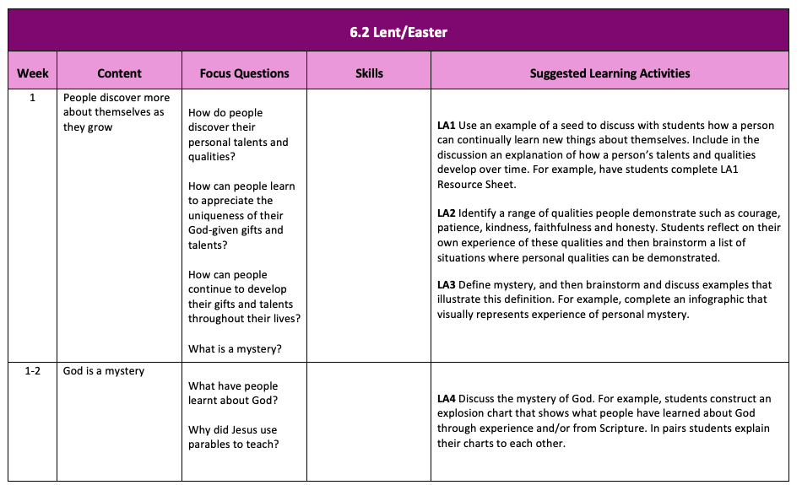
Suggested Teaching and Learning Outline
Aligns with SCSA sample Teaching and Learning Outlines.

Slide 12
Suggested Teaching and Learning Outline
Content descriptor.

Slide 13
Suggested Teaching and Learning Outline
To interrogate and sequence learning.

Slide 14
Suggested Teaching and Learning Outline
Suggested learning activities.
Suggested resources.

Slide 15
Suggested Resources
Unit number.
Learning activity identification.

Slide 16
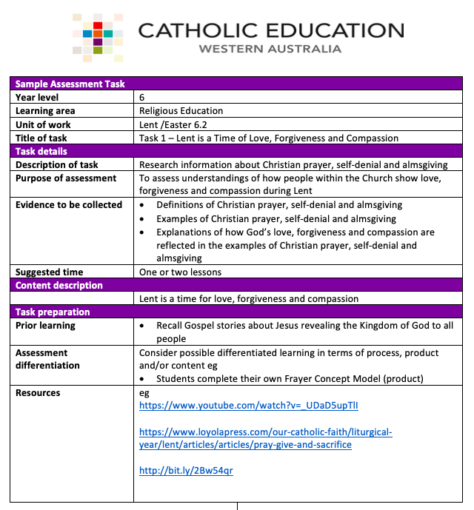
Sample Assessment Task
Unit number
Assessment task number

Slide 17
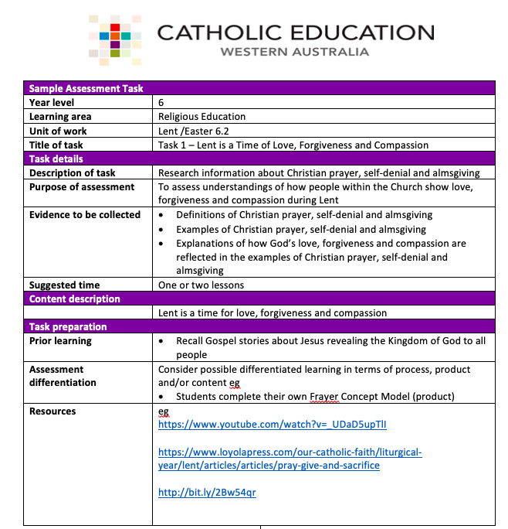
Sample Assessment Task
Aligns with SCSA Sample Assessment Task.

Slide 18
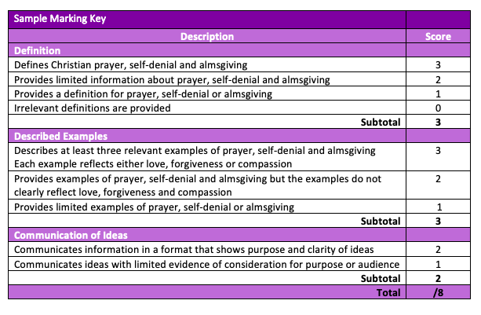
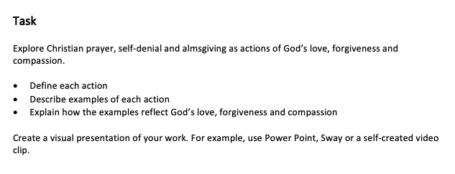
Sample Assessment Task
Clear description of assessment expectations.

Slide 19
Sample Parent Letter
Religious Education learning area.
Explains the focus of the unit.

Slide 20
Religious Education Website - Landing Page

Slide 21
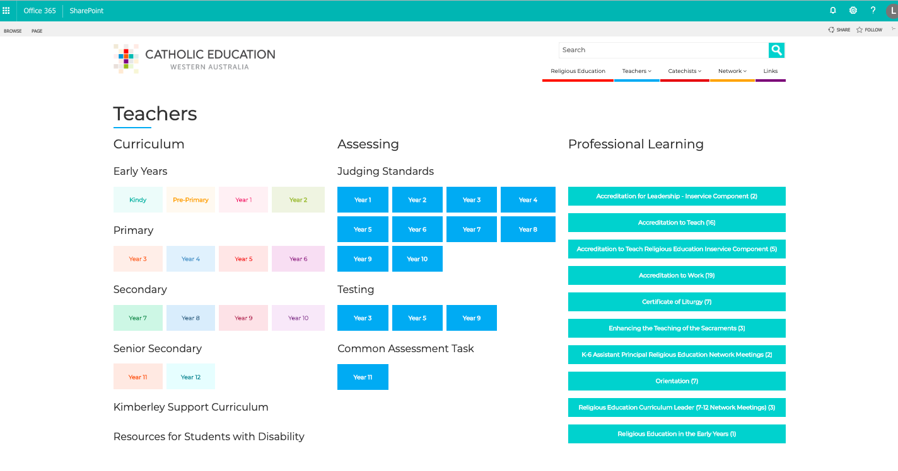
Religious Education Website - Teachers

Slide 22
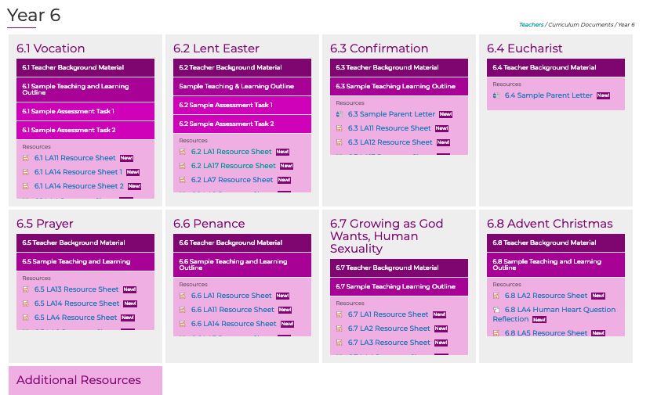
Year Level Curriculum

Slide 23
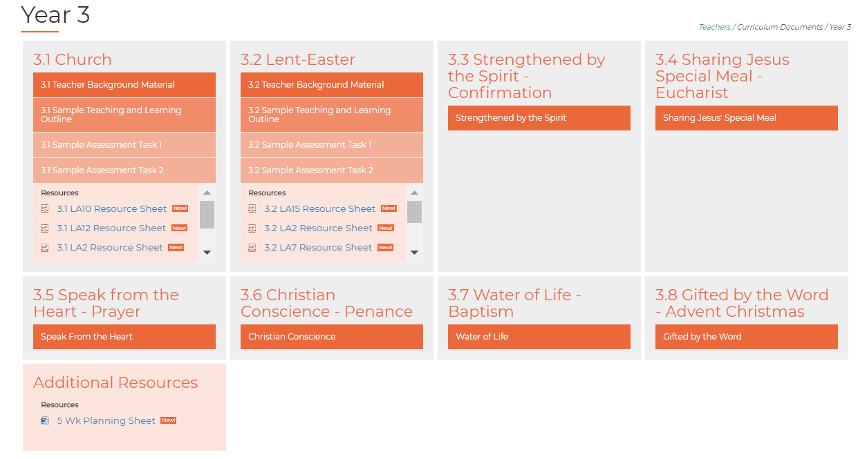
Year Level Curriculum

Slide 24
Let the Little Children Come to Me

Slide 25
Suggested Bibles
Years 4-6
The Breakthrough Bible
link
Years K-3
The Catholic Children’s Bible
link

Slide 26
Alignment of Documents
5.1 Church
Content descriptor : Members of God’s family are called to love in communities (page 14-16)
Suggested Teaching and Learning Outline Week 5 LA12, LA13, LA14 and LA15
Assessment Task 2
Parent Letter- assist with report comments (achievements)

Slide 27
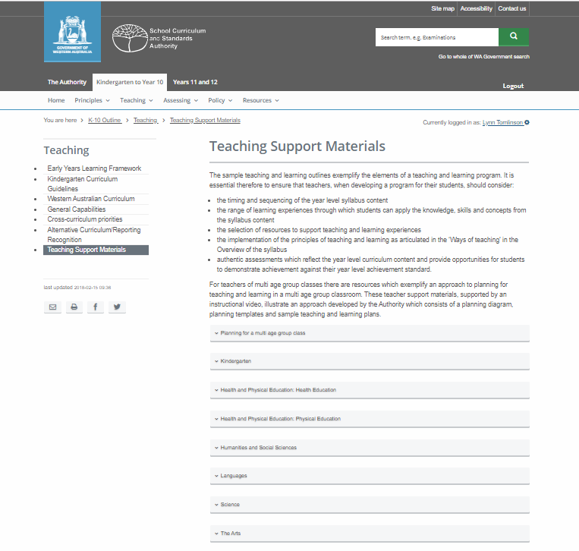
SCSA Resources- Link

