Slide 1
What’s so special about the month of October?
Notes:
The month of October is known for many things!
What can you think of that is special about the month of October?

Slide 2
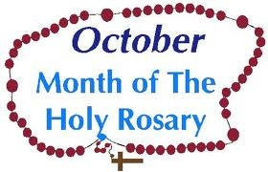
What’s so special about the month of October?
Notes:
Lots of fun things are happening in the month of October!
The seasons change to the start of the wet season when we see leaves grow on some of the trees that have had no leaves on for a while and we get clouds in the sky and some rain.
But there’s something else that makes the month of October a special month: it is the month of the Holy Rosary and, in fact, October 7 is the Feast of the Holy Rosary. Throughout the entire month, Catholics are encouraged to pray the Rosary to grow closer to Jesus through his Mother, Mary.

Slide 3
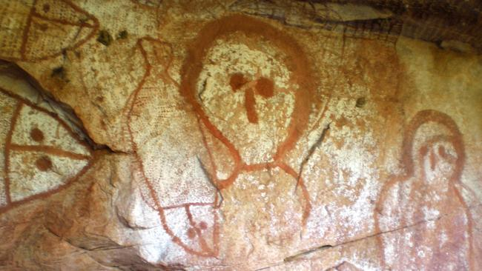
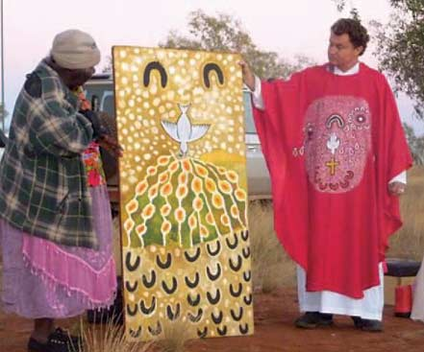
What is the Rosary?
Think of what you do when you see artwork: you GAZE at the images.
Notes:
Let’s talk about what the Rosary is and how we pray it.
For starters, think of what you do when you go to an art gallery or look at a painting. When you look at a painting, you pause and gaze at the image, taking in all of the colors, the texture, the pattern, and the shapes.

Slide 4
The Rosary helps us to “gaze” upon Jesus and upon moments in his life and in the life of his Mother, Mary.
We call that “gazing” meditation.
Notes:
In many ways, praying the Rosary is like gazing on different images that show us events in the lives of Jesus and his Mother, Mary. When we pray by “mentally gazing” at these moments in the lives of Jesus and Mary, we call that meditation. Praying in this manner helps us to be more contemplative (reflective, thoughtful).

Slide 5
But sometimes it’s not easy to focus or concentrate…too many worries, concerns, and distractions get in the way!
Notes:
Praying in this way can be a challenge for us, especially since we live in a world with so many distractions. It’s hard to stay focused. That’s where the Rosary beads come in!

Slide 6
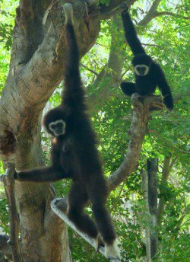
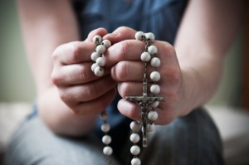
We call that lack of focus, “monkey brain” because our brains have a habit of jumping from thought to thought the way monkeys swing from branch to branch. The Rosary helps us to “tame” the “monkey brain!”
Notes:
Our brains are often jumping around from thought to thought, from idea to idea, and from worry to worry, in much the same way that monkeys jump from tree to tree, branch to branch. The Buddhists refer to this as “monkey brain” – the tendency of our minds to skip around. Praying the Rosary and fingering the beads is a way that we “tame” the ‘monkey brain!” The beads help us to keep our focus and to prevent the mind from skipping away during prayer.

Slide 7
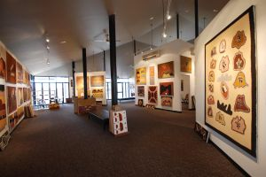
Just as an art centre has different “galleries” to visit, the Rosary invites us to “visit” four such “galleries” where we gaze upon certain scenes from the life of Jesus and Mary.
Notes:
So what do we reflect on when we are praying the Rosary? What are these “images” of moments in the lives of Jesus and Mary? We call these moments the “Mysteries” of the Rosary and they are divided into 4 different sets, much the way an art centre is divided into different galleries, each with a different theme. Let’s take a look at the 4 themes of the Mysteries of the Rosary.

Slide 8
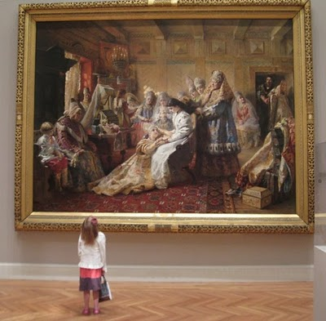
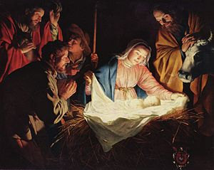
The Joyful Mysteries (Mondays and Saturdays)
The Annunciation Mary learns that she has been chosen to be the mother of Jesus.
The Visitation Mary visits Elizabeth, who tells her that she will always be remembered.
The Nativity Jesus is born in a stable in Bethlehem.
The Presentation Mary and Joseph take the infant Jesus to the Temple to present him to God.
The Finding of Jesus in the Temple Jesus is found in the Temple discussing his faith with the teachers.
Notes:
The first set of Mysteries are referred to as the Joyful Mysteries because they focus on the wonderful events leading up to and following Jesus’ birth. The Joyful mysteries are:
The Annunciation Mary learns that she has been chosen to be the mother of Jesus.
The Visitation Mary visits Elizabeth, who tells her that she will always be remembered.
The Nativity Jesus is born in a stable in Bethlehem.
The Presentation Mary and Joseph take the infant Jesus to the Temple to present him to God.
The Finding of Jesus in the Temple Jesus is found in the Temple discussing his faith with the teachers.
The Joyful Mysteries are traditionally prayed on Mondays and Saturdays.

Slide 9
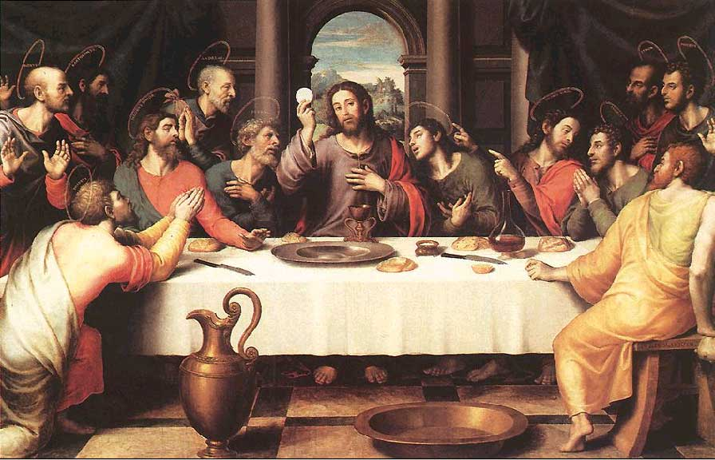
The Luminous Mysteries
(Mysteries of Light)
(Thursdays)
The Baptism of Jesus in the River Jordan God proclaims that Jesus is his beloved Son.
The Wedding Feast at Cana At Mary’s request, Jesus performs his first miracle.
The Proclamation of the Kingdom of God Jesus calls all to conversion and service to the Kingdom.
The Transfiguration of Jesus Jesus is revealed in glory to Peter, James, and John.
The Institution of the Eucharist Jesus offers his Body and Blood at the Last Supper.
Notes:
The Luminous Mysteries (also called the Mysteries of Light) were added to the Rosary by Pope John Paul II in 2002, the first change to the Rosary in over 400 years! The Luminous Mysteries focus on the public ministry of Jesus when he shared the light of truth through his words and deeds. The Luminous Mysteries are:
The Baptism of Jesus in the River Jordan God proclaims that Jesus is his beloved Son.
The Wedding Feast at Cana At Mary’s request, Jesus performs his first miracle.
The Proclamation of the Kingdom of God Jesus calls all to conversion and service to the Kingdom.
The Transfiguration of Jesus Jesus is revealed in glory to Peter, James, and John.
The Institution of the Eucharist Jesus offers his Body and Blood at the Last Supper.
It is suggested that the Luminous Mysteries be prayed on Thursdays.

Slide 10
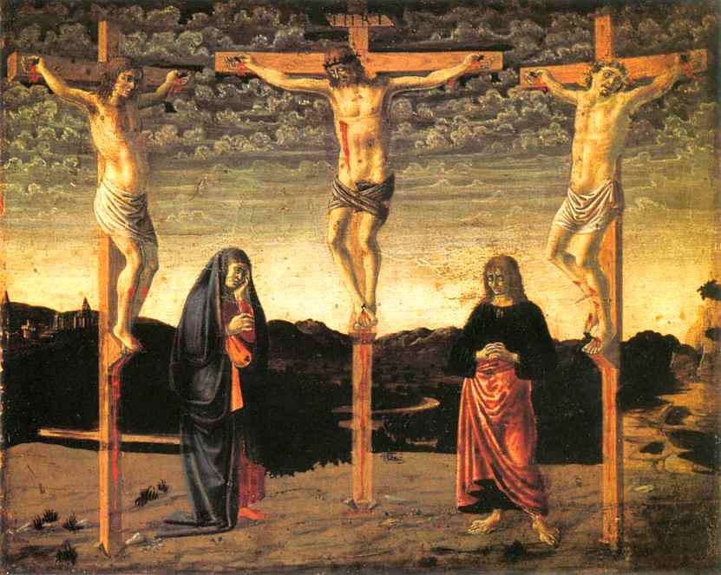
The Sorrowful Mysteries (Tuesdays and Fridays)
The Agony in the Garden Jesus prays in the Garden of Gethsemane on the night before he dies.
The Scourging at the Pillar Jesus is lashed with whips.
The Crowning With Thorns Jesus is mocked and crowned with thorns.
The Carrying of the Cross Jesus carries the cross that will be used to crucify him.
The Crucifixion Jesus is nailed to the cross and dies.
Notes:
The Sorrowful Mysteries focus on the Passion, suffering, and death of Jesus, when he laid down his life out of love for us. The Sorrowful Mysteries include:
The Agony in the Garden Jesus prays in the Garden of Gethsemane on the night before he dies.
The Scourging at the Pillar Jesus is lashed with whips.
The Crowning With Thorns Jesus is mocked and crowned with thorns.
The Carrying of the Cross Jesus carries the cross that will be used to crucify him.
The Crucifixion Jesus is nailed to the cross and dies.
The Sorrowful Mysteries are traditionally prayed on Tuesdays and Fridays.

Slide 11
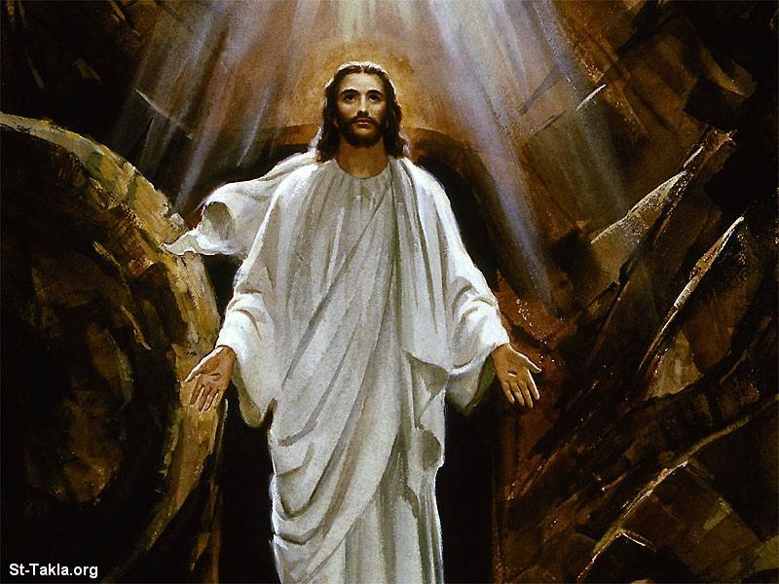
The Glorious Mysteries (Wednesdays and Sundays)
The Resurrection God the Father raises Jesus from the dead.
The Ascension Jesus returns to his Father in heaven.
The Coming of the Holy Spirit The Holy Spirit comes to bring new life to the disciples.
The Assumption of Mary At the end of her life on earth, Mary is taken body and soul into heaven.
The Coronation of Mary Mary is crowned as Queen of Heaven and Earth.
Notes:
The Glorious Mysteries bring us face to face with the wonderful events surrounding Jesus’ Resurrection and Ascension into heaven. The Glorious Mysteries are:
The Resurrection God the Father raises Jesus from the dead.
The Ascension Jesus returns to his Father in heaven.
The Coming of the Holy Spirit The Holy Spirit comes to bring new life to the disciples.
The Assumption of Mary At the end of her life on earth, Mary is taken body and soul into heaven.
The Coronation of Mary Mary is crowned as Queen of Heaven and Earth.
The Glorious Mysteries of the Rosary are to be prayed on Wednesdays and Sundays.

Slide 12
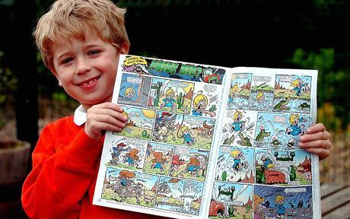
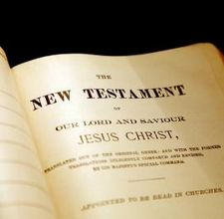
Like reading the “thumbnails” in a comic book, the Mysteries of the Rosary give us “thumbnails” of the entire life of Jesus Christ.
Notes:
When you think about it, these 20 images provide us with a “thumbnail” sketch of the Gospels. By praying the Rosary, we are focusing on the most important events in the life of Jesus Christ so that we can come to know him better.

Slide 13
Let’s take a closer look at how to pray the Rosary.
Notes:
Now, let’s take a closer look at how we actually pray the Rosary.
[at this point, it would be helpful for students to have a Rosary in their hands to follow along with you.]

Slide 14
When we prepare to exercise, we “warm up.” In a similar way, we begin the Rosary with a “warm up.”
Notes:
Just as we stretch and “warm up” before beginning a strenuous exercise, the Rosary also invites us to “warm up” before we pray the 5 decades of beads.

Slide 15
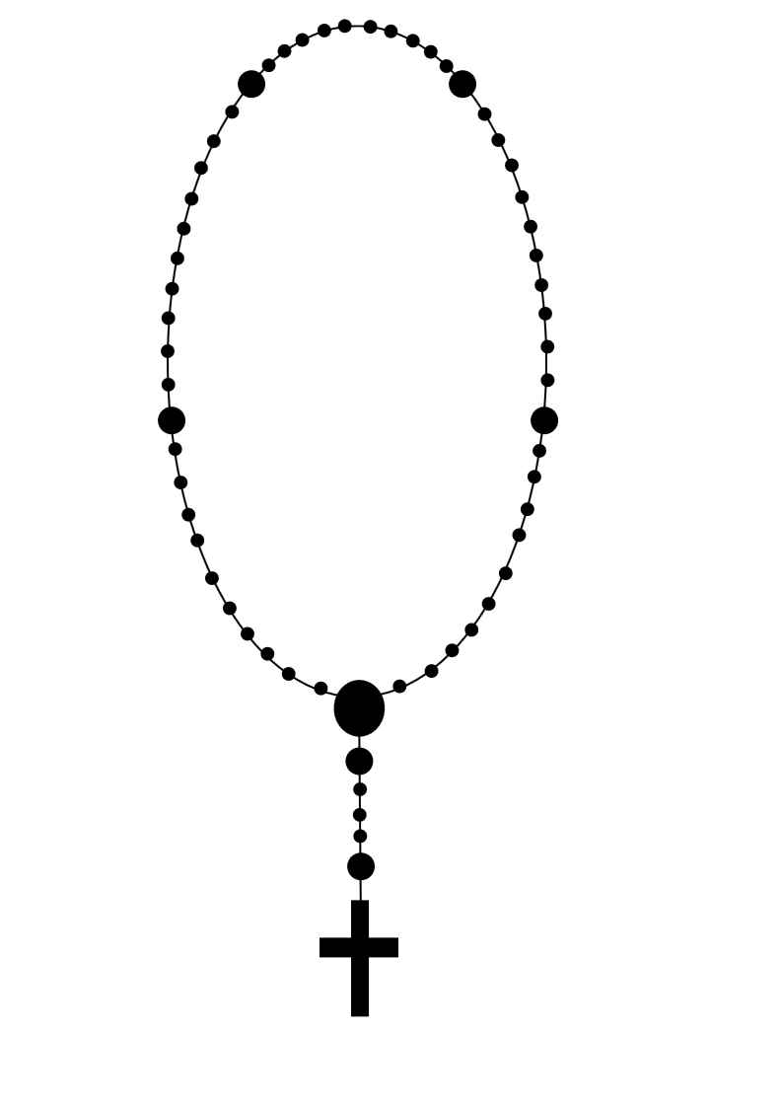
3. Pray Three Hail Marys (for an increase in faith, hope, and charity) and one Glory Be.
2. Pray the Lord’s Prayer.
1. Pray the Sign of the Cross and the Apostles’ Creed.
Notes:
The Rosary is made up of a string of beads and a crucifix.
We hold the crucifix in our hands as we pray the Sign of the Cross.
Then we pray the Apostles’ Creed.
Between the crucifix and the medal of Mary, there is a single bead, followed by a set of three beads and another single bead. We pray the Lord's Prayer as we hold the first single bead and a Hail Mary at each bead in the set of three that follows (as we pray for an increase in each of the three theological virtues: faith, hope, and love). Then we pray the Glory Be to the Father.

Slide 16
5. Pray ten Hail Marys (a decade) and one Glory Be.
4. Think about/announce the first Mystery. Pray the Lord’s Prayer.
Notes:
On the next single bead we think about (or announce, if praying with others) the first mystery and pray the Lord's Prayer. There are five sets of ten beads; each set is called a decade. We pray a Hail Mary on each bead of a decade as we reflect on a particular mystery in the lives of Jesus and Mary.
The Glory Be to the Father is prayed at the end of each set. Between sets is a single bead on which we think about one of the mysteries and pray the Lord's Prayer.

Slide 17
7. Pray ten Hail Marys (a decade) and one Glory Be.
6. Think about/announce the second Mystery. Pray the Lord’s Prayer.
Notes:
On the next single bead we think about (or announce, if praying with others) the second mystery and pray the Lord's Prayer. We pray a Hail Mary on each bead of this decade as we reflect on the announced mystery.
The Glory Be to the Father is prayed at the end of the decade.

Slide 18
9. Pray ten Hail Marys (a decade) and one Glory Be.
8. Think about/announce the third Mystery. Pray the Lord’s Prayer.
Notes:
On the next single bead we think about (or announce, if praying with others) the third mystery and pray the Lord's Prayer. We pray a Hail Mary on each bead of this decade as we reflect on the announced mystery.
The Glory Be to the Father is prayed at the end of the decade.

Slide 19
10. Think about/announce the fourth Mystery. Pray the Lord’s Prayer.
11. Pray ten Hail Marys (a decade) and one Glory Be.
Notes:
On the next single bead we think about (or announce, if praying with others) the fourth mystery and pray the Lord's Prayer. We pray a Hail Mary on each bead of this decade as we reflect on the announced mystery.
The Glory Be to the Father is prayed at the end of the decade.

Slide 20
12. Think about/announce the fifth Mystery. Pray the Lord’s Prayer.
13. Pray ten Hail Marys (a decade) and one Glory Be.
Notes:
On the next single bead we think about (or announce, if praying with others) the fifth mystery and pray the Lord's Prayer. We pray a Hail Mary on each bead of this decade as we reflect on the announced mystery.
The Glory Be to the Father is prayed at the end of the decade.

Slide 21
14. Pray the Hail, Holy Queen (Rosaries often have a medal here).
15. Pray the Sign of the Cross
Notes:
For many, it is customary to pray the prayer, Hail, Holy Queen, while holding the medal.
We end by holding the crucifix in our hands as we pray the Sign of the Cross.

Slide 22
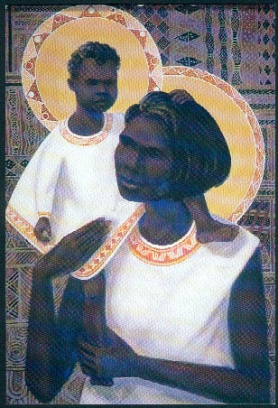
Images of Mary often show her holding up her Son, Jesus, for us to see. In the Rosary, Mary “holds up” Jesus for us to see and to believe in.
Notes:
You may have noticed that many pictures and statues of Mary depict her as showing us her Son, Jesus, as if offering him to us so that we can grow closer to him. In the same way, through the Rosary, Mary is “holding up” her Son Jesus so that we can see him and believe in him.

Slide 23
Just as we can listen to our favorite songs over and over again, we can reflect on the Mysteries of the Rosary, over and over again, throughout our lives!
Notes:
While praying the Rosary involves a lot of repetition, this is something that you are used to. Many of the songs you listen to repeat words and phrases over and over again for emphasis or just as way of inviting us to “lose ourselves” in the music. In the same way, the Rosary invites us to “lose ourselves” in the rhythm of the Hail, Marys being prayed in repetition.
Likewise, when you find a song you like, you don’t listen to it only once: you find yourself playing it over and over again over time. In the same way, we don’t “visit” the amazing story of Jesus only once! We return to it over and over again throughout our lives, allowing the story of Jesus to speak to our hearts at different moments in our lives.

