Slide 1
12.00pm Monday, Tuesday, Thursday (SP 12.25pm Thursday)
11.50am Wednesday
11.15am Friday
Instructions:
Open Slide Show
Advance to Slide 2
Click or Down Arrow to begin bells.
Down Arrow to advance to Slide 3.

Slide 2
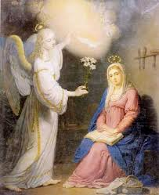
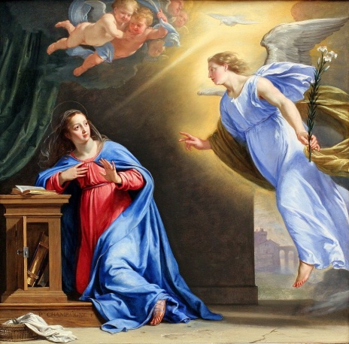
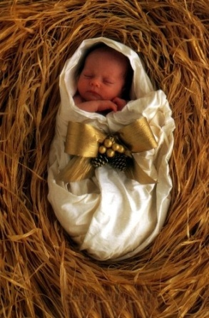
Sign of the Cross:
V. The angel of the Lord declared unto Mary. R. And she conceived by the power of the
Holy Spirit.
Hail Mary, full of grace, the Lord is with thee. Blessed art thou amongst women, and blessed
is the fruit of thy womb, Jesus. Holy Mary, Mother of God,
pray for us sinners,
now and at the hour of our death. Amen.
V. Behold the handmaid of the Lord. R. Be it done unto me according to your Word.
Hail Mary, full of grace, ...
V. And the Word was made flesh. R. And dwelt among us.
Hail Mary, full of grace, ...

Slide 3
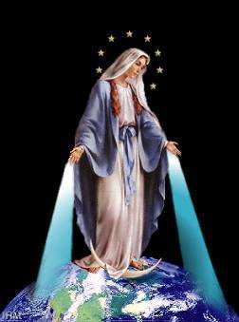
V. Pray for us, O Holy Mother of God. R. That we may be made worthy of the promises of Christ.
Let us pray:
Pour forth, we beseech thee, O Lord, Thy grace into our hearts,
that we to whom the incarnation of Christ Thy Son was made known by the message of an angel, may by His Passion and Cross be brought to the glory of His resurrection; through the same Christ our Lord.
Amen.
Glory be to the Father, and to the Son, and to the Holy Spirit.
As it was in the beginning, is now, and forever shall be, world without end.
Amen.
Sign of the Cross:

