Slide 1
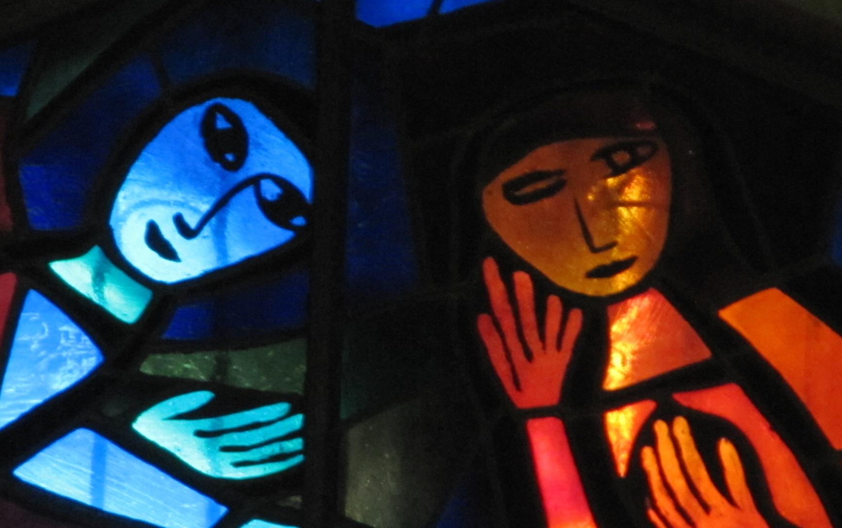
The Annunciation
Lk: 1:26-38
Stain glassed window in the Church of the Annunciation, Nazareth

Slide 2
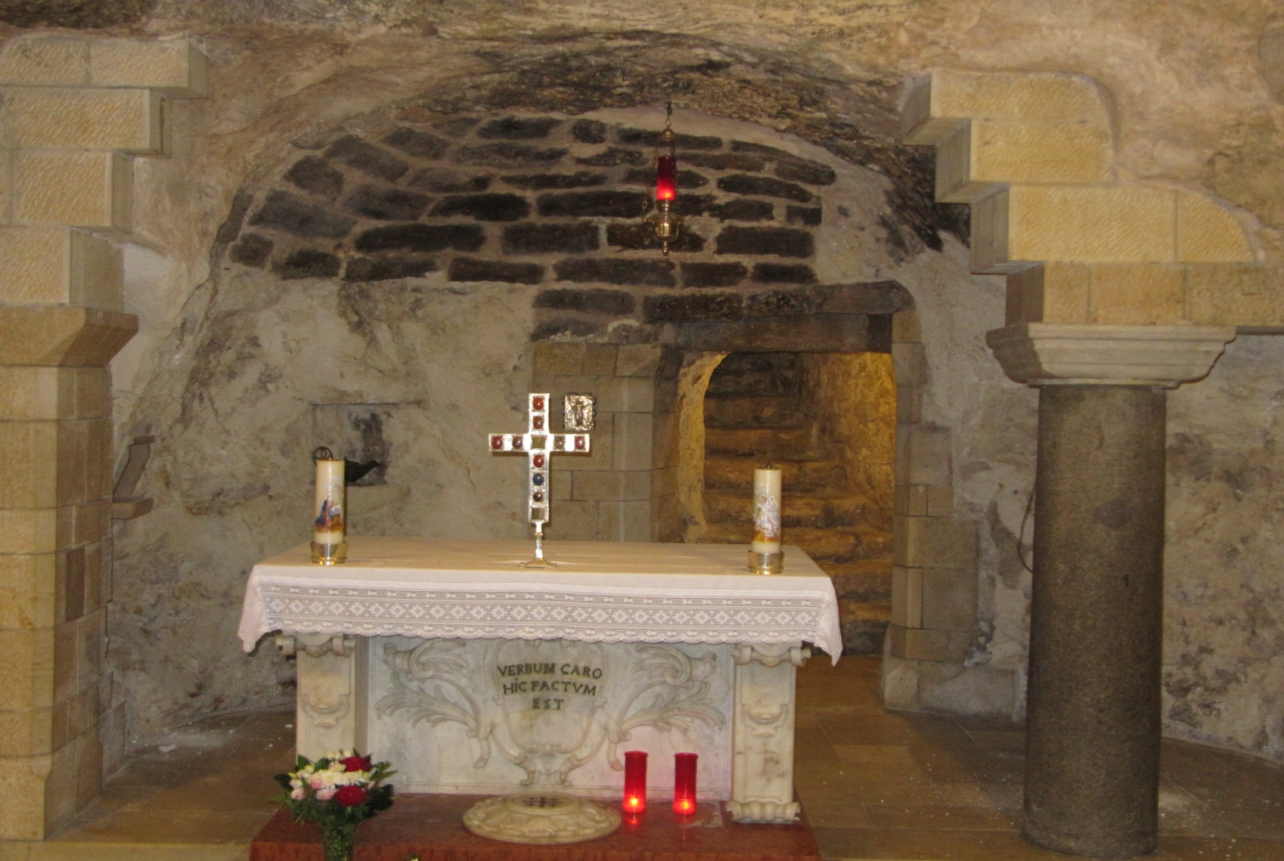
In the sixth month, God sent the angel Gabriel to Nazareth, a town in Galilee, to a young woman pledged to be married to a man named Joseph, a descendant of David. Her name was Mary.
Church of the Annunciation (sacred site of Mary’s house), Nazareth

Slide 3
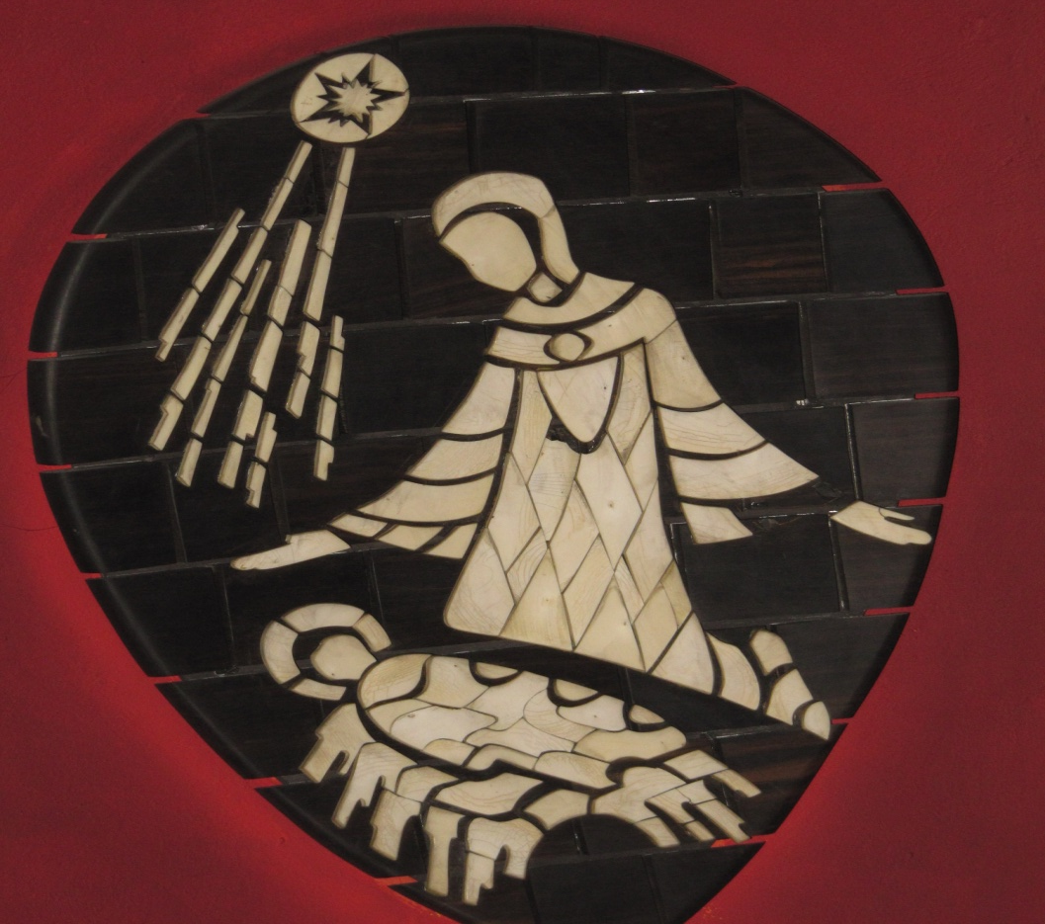
The angel went to her and said, “Greetings, you who are highly favoured! The Lord is with you.” Mary was greatly troubled at his words and wondered what kind of greeting this might be. But the angel said to her, “Do not be afraid, Mary, you have found favour with God. You will be with child and give birth to a son, and you are to give him the name Jesus.
Mother of pearl mosaic in Church of the Dormition, Jerusalem.

Slide 4
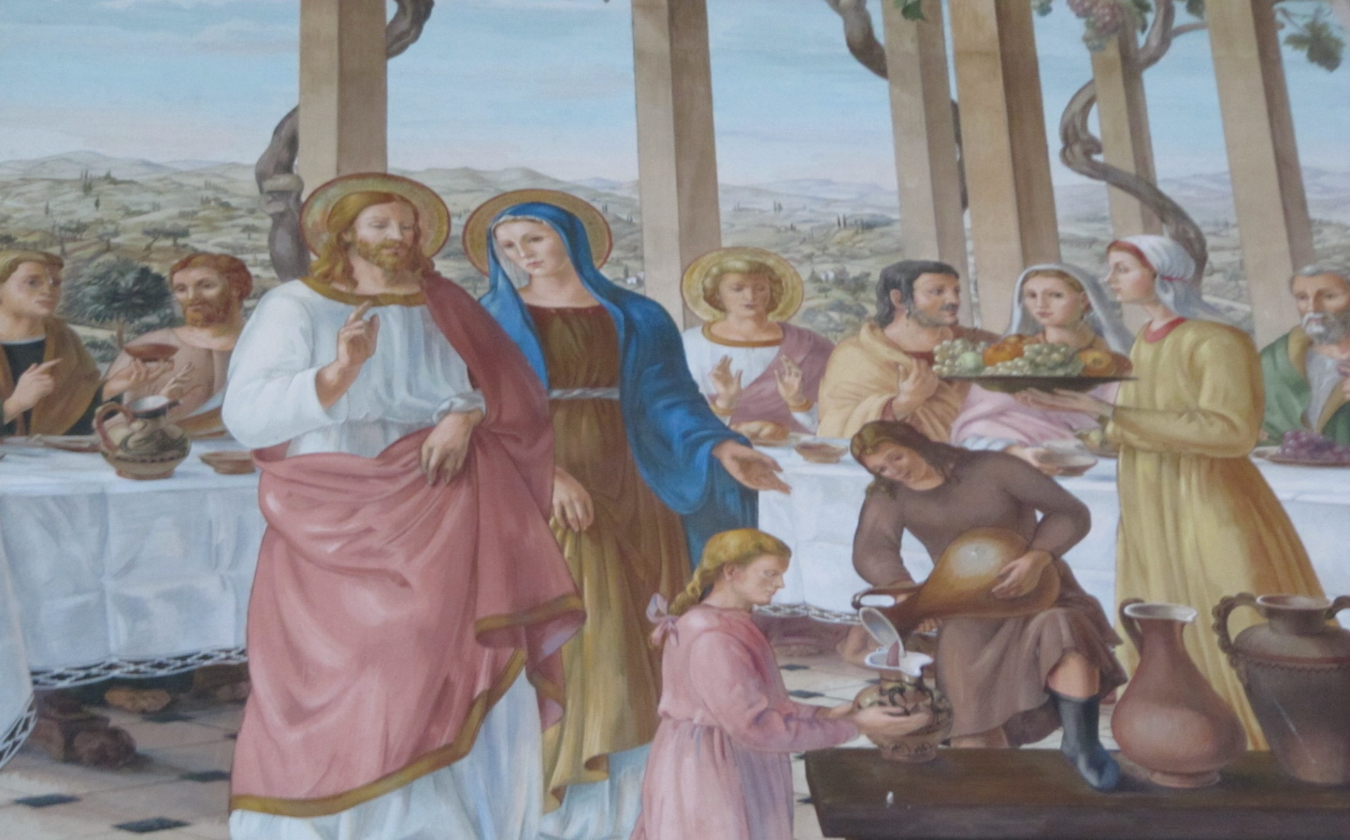
He will be great and will be called the Son of the Most High.
Image in Church of the Visitation, Judea

Slide 5
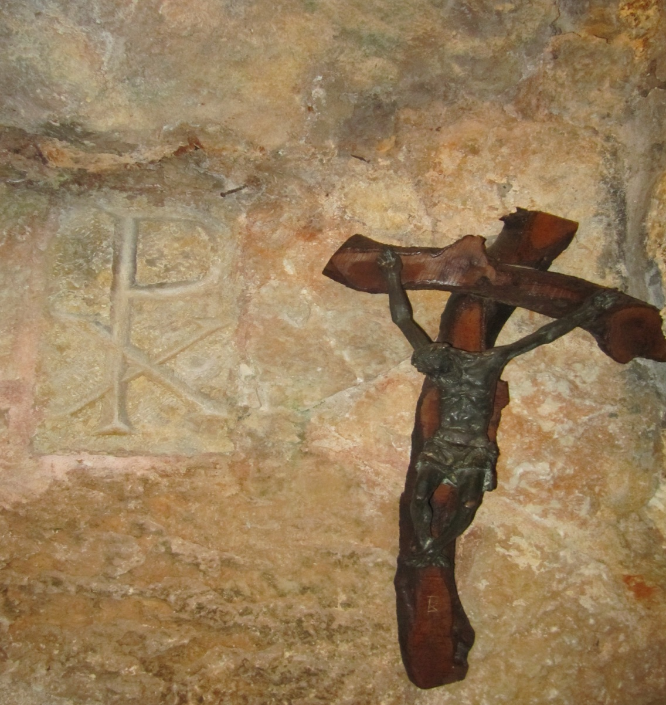
The Lord God will give him the throne of his father David, and he will reign over the house of Jacob forever; his kingdom will never end.
Crucifix in cave under Church of the Nativity with symbol of early Christians.

Slide 6
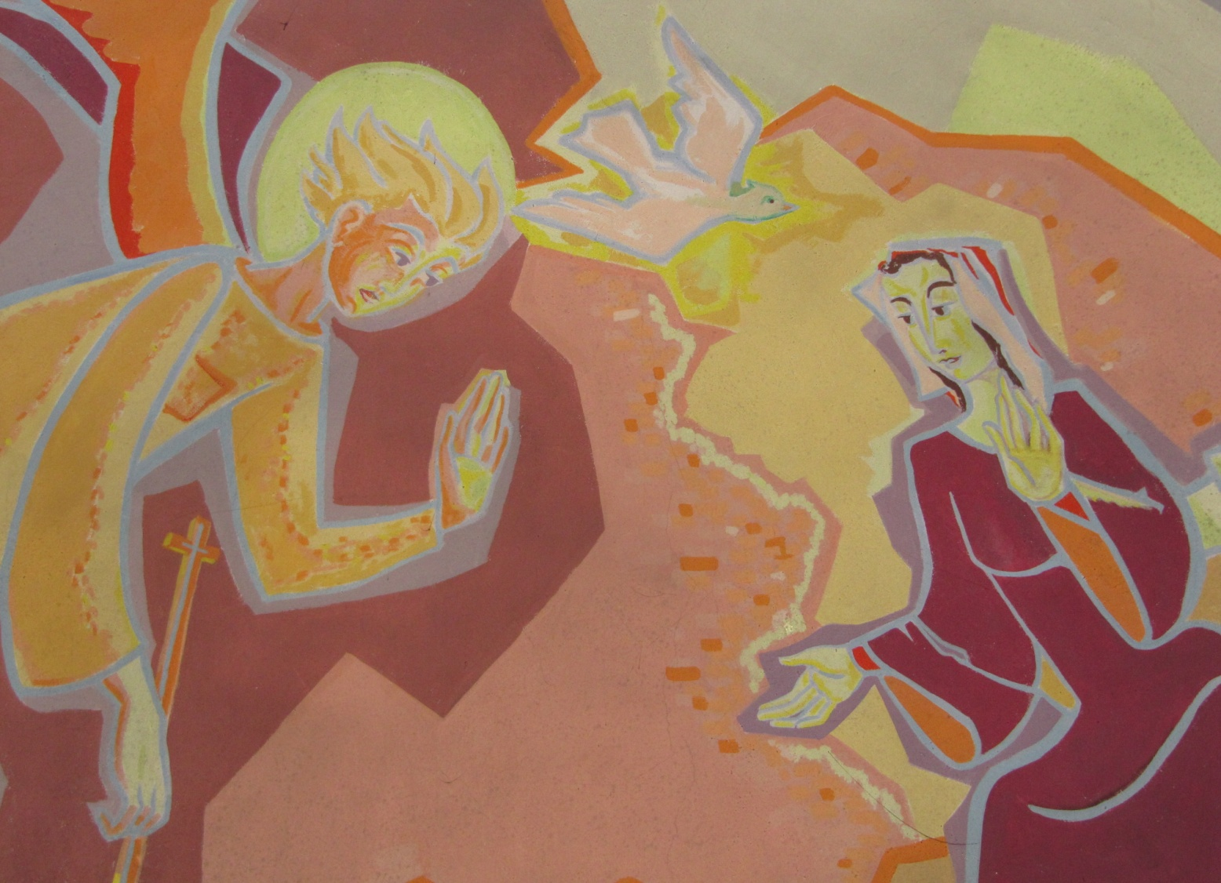
“How will this be” Mary asked the angel, “since I am not married?” The angel answered, “The Holy Spirit will come upon you, and the power of the Most High will overshadow you. So the holy one to be born will be called the Son of God.
Painting of the Annunciation in the Church of the Dormition (Mary’s resting place), Jerusalem.

Slide 7
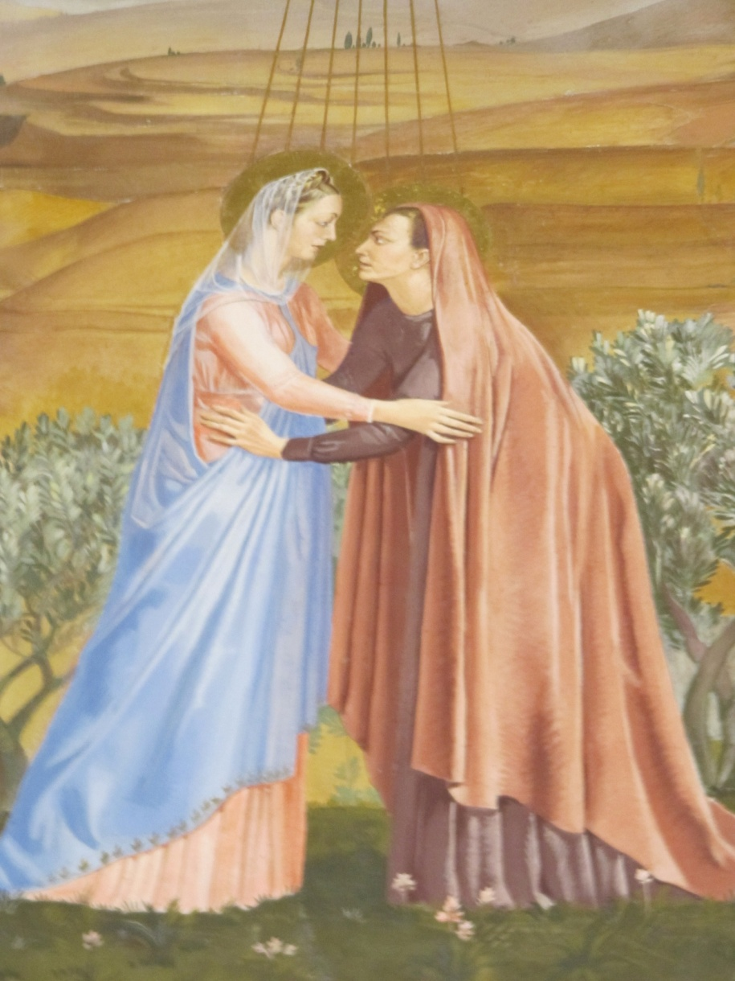
Even Elizabeth your relative is going to have a child in her old age, and she who was said to be barren is in her sixth month. For nothing is impossible with God.”
Painting on ceiling of the Chapel of Mary’s Well, Judea.

Slide 8
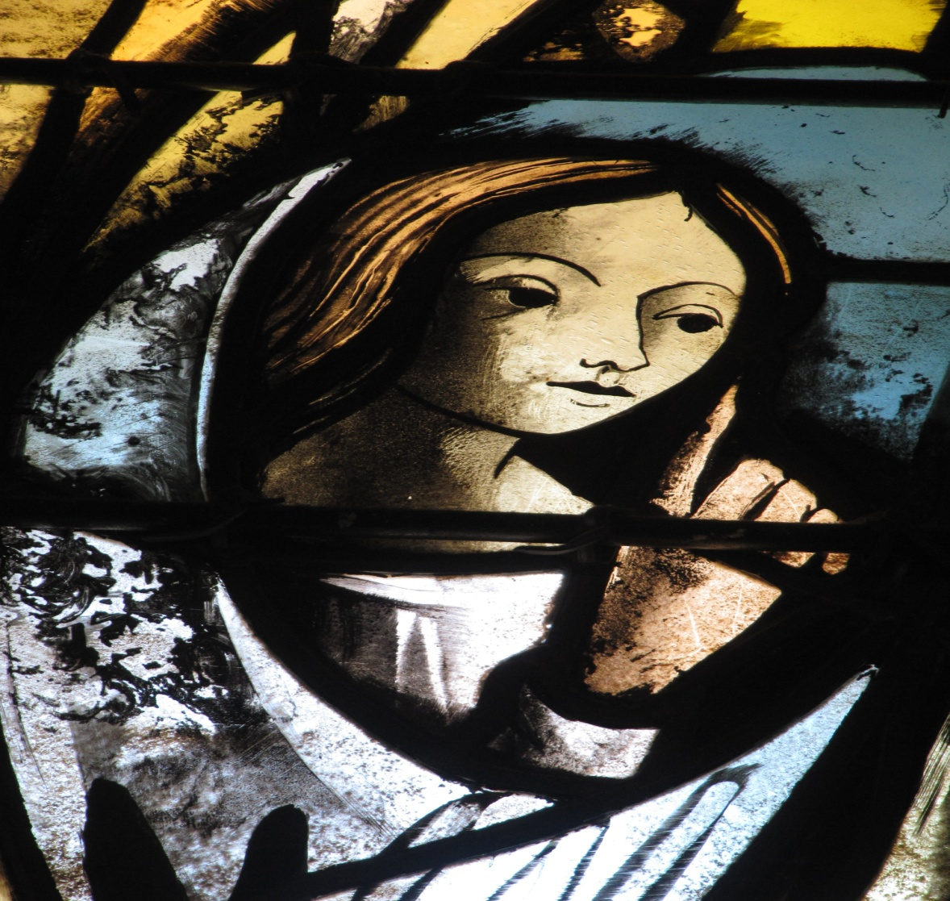
“I am the Lord’s servant,” Mary answered. “May it be to me as you have said”.
Stain glassed window in Church of the Annunciation, Nazareth

