Slide 1
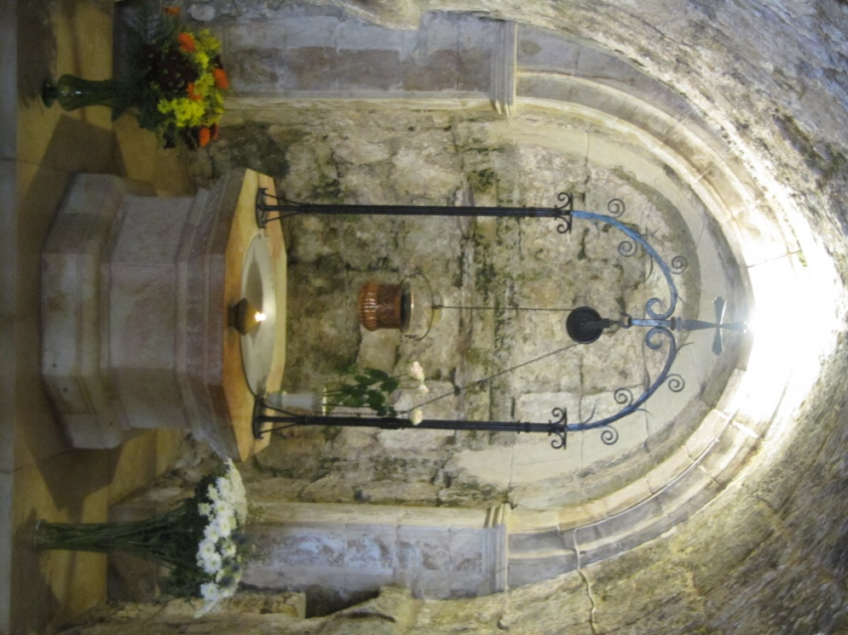
The Visitation
Gospel: Luke 1: 39- 56
Images from Church of Visitation – Ein Karen, Israel
Mary’s Well - Judea

Slide 2
At that time Mary got ready and hurried to a town in the hill country of Judea, where she entered Zechariah’s home and greeted Elizabeth.

Slide 3
When Elizabeth heard Mary’s greeting, the baby leaped in her womb, and Elizabeth was filled with the Holy Spirit. In a loud voice she exclaimed: “Blessed are you among women, and blessed is the child you will bear!

Slide 4
But why am I so favoured, that the mother of my Lord should come to me? As soon as the sound of your greeting reached my ears, the baby in my womb leaped for joy. Blessed is she who has believed that the Lord would fulfil his promises to her!”

Slide 5
And Mary said: “My soul glorifies the Lord and my spirit rejoices in God my Saviour, for he has been mindful of the humble state of his servant. From now on all generations will call me blessed, for the Mighty One has done great things for me— holy is his name.
The Magnificat (Mary’s Song) is written in several languages on mosaics around the walls of The Church of the Visitation, Judea.

Slide 6
His mercy extends to those who fear him, from generation to generation. He has performed mighty deeds with his arm; he has scattered those who are proud in their inmost thoughts. He has brought down rulers from their thrones but has lifted up the humble.
Painting on wall of the Church of the Visitation, Judea.

Slide 7
He has filled the hungry with good things but has sent the rich away empty. He has helped his servant Israel, remembering to be merciful to Abraham and his descendants forever just as he promised our ancestors.”
Altar of the Church of the Visitation, Judea

Slide 8
Mary stayed with Elizabeth for about three months and then returned home.
Image of the Visitation at Church of the Dormition, Jerusalem

